Slide 1
Sexual Integrity of Expat Christian Men Mark Ainsworth, Glenn Miles PhD, Kenneth Taylor, LCSW

Slide 2
Why did we do the Survey?
Mark Ainsworth (Christian Vision for Men) – recognizing the need for the church (in this case the international church) to be good role models
Kenneth Taylor (Psychotherapist, ICA) - recognizing the need for member care in this area
Glenn Miles PhD (Director of Prevention, Love146) - recognizing the need to address demand of sexual exploitation by starting with ourselves.

Slide 3
Methodology
Set up the survey on Survey Monkey
Confidential, secure, easy to access and share.
Asked some general demographics
Asked some direct questions
Have you done…? Do you do…?
Also indirect questions
The effects of sexual behaviours on them & others
PATHOS

Slide 4
Results
We had 99 responses.
The results of those who were atheist, agnostic or other religions (7 men) were left out the main results
82 valid responses

Slide 5
What is your view on Porn?
Overwhelmingly negative

Slide 6
How often do you view porn?
Over half indulge to some extent
20% indulge regularly

Slide 7
What is your view on prostitution?
Overwhelmingly negative

Slide 8
Why do you think men use prostitutes?

Slide 9
Have you had a ‘traditional’ massage where masseur touched you sexually?
One-third reported “Yes”

Slide 10
How did you respond when you were touched?
Only one-third took action against

Slide 11
Traditional to Erotic Massage
 | Married | Single | All
Total No. of Men | 17 | 9 | 26
Ignored It | 52.9% | 33.3% | 46.2%
Told her/him to stop | 23.5% | 44.4% | 30.8%
Encouraged them to continue | 23.5% | 22.2% | 23.1%
No Response | 0% | 0% | 0
More singles than marrieds took action against

Slide 12
Do you feel that erotic massage is the same as prostitution?

Slide 13
Have you ever had sexual intercourse with a prostitute?

Slide 14
Pornography vs. Erotic Massage
vs. Sex with a Prostitute
29% of men have one of these 3
 | Porn ≥ Monthly | Sex with Prostitute | Intentional Erotic Massage
Porn ≥ Monthly | 20% | 5% | 5%
Sex with Prostitute | 5% | 11% | 7%
Intentional Erotic Massage | 5% | 7% | 11%
Crossover of all is 2.4% - 2 (Christian) men.
Men have one of these three is 29% - 24 (Christian) men.

Slide 15
Are you fearful that if honest about any aspect of your sexual behavior that you may face discipline?

Slide 16
How likely would you go to church/mission/NGO leader to discuss sexual issues?
Less than one-third reported “Yes”

Slide 17
Would you like to receive/be part of any counseling/therapy/support group for your sexual behavior?
Only 16% interested in help

Slide 18
Help?
 | Single | Married | 5+ Yrs in Kh | 2 - 5 Yrs in Kh | 1 - 2 Yrs in Kh | < 1 Yr in Kh | All
Sought help? | 25.0% | 17.7% | 18.8% | 17.4% | 17.6% | 30.0% | 19.5%
Be part of group? | 35.0% | 9.7% | 15.6% | 8.7% | 11.8% | 40.0% | 15.9%
Total | 20 | 62 | 32 | 23 | 17 | 10 | 82

Slide 19
What Next?
Specialist SA groups
Hope Campaign
One to One counselling
Orientations involving sexual integrity
More frank sermons/teaching
Accountability on personal level – twos, threes or more
Member care – application process, reviews
Marriage enrichment and counselling
Challenge: Pride and losing face issues – those who have said they need help are not necessarily those who have followed through…

Slide 20
Lessons from the Prodigal Son
For those of us who are still struggling with sexual sin we need to get to the point where we are kneeling before the father and seeking genuine healing.
For those of us who are not struggling with sexual sin we need to be careful not to be the resentful older son who is indignant of the Father’s lavish graciousness.

Slide 21
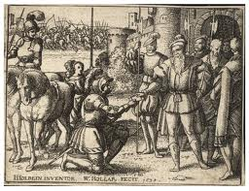
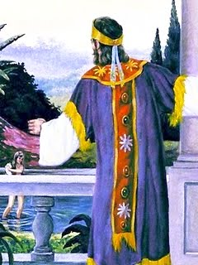
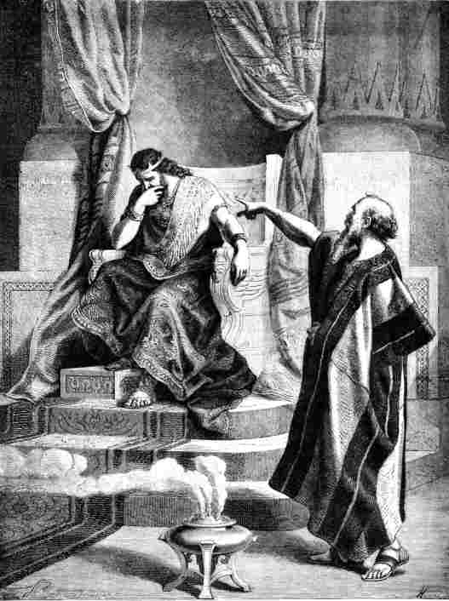
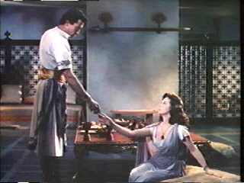
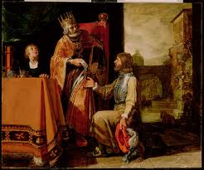
Lessons
from the Fall of King David

Slide 22
II Samuel 11
1 In the spring of the year, the time when kings go out to battle, David sent Joab, and his servants with him, and all Israel. And they ravaged the Ammonites and besieged Rabbah. But David remained at Jerusalem.
2 It happened, late one afternoon, when David arose from his couch and was walking on the roof of the king's house, that he saw from the roof a woman bathing; and the woman was very beautiful.
Notes:
My text this morning is found in 2 Samuel 11. It's a story familiar to all of you; the tragic tale of David's moral failure and it's consequences. Let me read this slightly abridged account.

Slide 23
II Samuel 11
3 And David sent and inquired about the woman. And one said, "Is not this Bathsheba, the daughter of Eliam, the wife of Uriah the Hittite?"
4 So David sent messengers and took her, and she came to him, and he lay with her...Then she returned to her house.
5 And the woman conceived, and she sent and told David, "I am pregnant."
Notes:
My text this morning is found in 2 Samuel 11. It's a story familiar to all of you; the tragic tale of David's moral failure and it's consequences. Let me read this slightly abridged account.

Slide 24
6 So David sent word to Joab, "Send me Uriah the Hittite.”
7 When Uriah came to him, David asked how Joab was doing and how the people were doing and how the war was going.
8 Then David said to Uriah, "Go down to your house and wash your feet." And Uriah went out of the king's house, and there followed him a present from the king.

Slide 25
9 But Uriah slept at the door of the king's house with all the servants of his lord, and did not go down to his house.
10 When they told David, "Uriah did not go down to his house," David said to Uriah, "Have you not come from a journey? Why did you not go down to your house?“
11 Uriah said to David, "The ark and Israel and Judah dwell in booths, and my lord Joab and the servants of my lord are camping in

Slide 26
the open field. Shall I then go to my house, to eat and to drink and to lie with my wife? As you live, and as your soul lives, I will not do this thing.“
12 Then David said to Uriah, "Remain here today also, and tomorrow I will send you back." So Uriah remained in Jerusalem that day and the next.
13 And David invited him, and he ate in his presence and drank, so that he made him drunk. And in the evening he went out to lie

Slide 27
on his couch with the servants of his lord, but he did not go down to his house.
14 In the morning David wrote a letter to Joab and sent it by the hand of Uriah.
15 In the letter he wrote, "Set Uriah in the forefront of the hardest fighting, and then draw back from him, that he may be struck down, and die.”
16 And as Joab was besieging the city, he assigned Uriah to the place where he knew there were valiant men.

Slide 28
17 And the men of the city came out and fought with Joab, and some of the servants of David among the people fell. Uriah the Hittite also died.
18 Then Joab sent and told David all the news about the fighting.
19 And he instructed the messenger, "When you have finished telling all the news about the fighting to the king,

Slide 29
20 then, if the king's anger rises, and if he says to you, 'Why did you go so near the city to fight? Did you not know that they would shoot from the wall?...
21...Why did you go so near the wall?' then you shall say, 'Your servant Uriah the Hittite is dead also.'"
22 So the messenger went and came and told David all that Joab had sent him to tell...

Slide 30
25 …David said to the messenger, "Thus shall you say to Joab, 'Do not let this matter displease you, for the sword devours now one and now another. Strengthen your attack against the city and overthrow it.' And encourage him.“
26 When the wife of Uriah heard that Uriah her husband was dead, she lamented over her husband.
27 And when the mourning was over,

Slide 31
David sent and brought her to his house, and she became his wife and bore him a son. But the thing that David had done displeased the LORD.
Notes:
I want to make two brief points about this passage before I get to the main point of my message.
1. I would like to summarize the consequences of David's actions--I want to break down the consequences according to two distinct phases of this story. (1) The first phase is described in verses 1-14: David's lust, leading to seduction and adultery, and (2) the second phase described in verses 15-27: David's cover-up. Two separate sins, but sins that almost always go together. One never commits sexual sin without following that with the sin of deceit, motivated by seeking to avoid responsibility. So let's look at the lists of consequences.

Slide 32
Consequences of David's Lust
Seduced Bathsheba
Got her pregnant
Violated God's command to be the moral leader
Violated personal conscience
Betrayed some of closest comrades: Uriah, her father Eliam, and grandfather Ahitophel, one of David's closest confidants.
Notes:
[Read 1st 3 points without comment]
This is a very difficult passageDo you know the significance of David's learning of who Bathsheba was? It is extremely eye-opening. She was not only the wife of Uriah, who was a member of David's Mighty Men--30 of his most elite fighting men! (He had to have personally known all 30.) She was also the daughter of Eliam, who was also one of the 30 most loyal and trusted protectors of Israel and of David himself. Moreover, she was the grand-daughter of Ahitophel, who was one of David's most trusted advisors. One would like to think that he would have paused and asked himself, do I really want to betray 3 of the most valued people in my life? But he did not, he blew right past that boundary.

Slide 33
Consequences of David's Cover-up
Abused his authority by ordering General Joab to alter battle plans in order to insure Uriah's death
Many other soldiers lost lives due to intentional bad battle plan
Multiple family grief due to many deaths
Notes:
We all think of this whole sorry affair as David’s sexual sin. But I must point out, that there was much more involved than just sexual sin. There was a 2nd sin that may be worse than the sex—that is the sin of covering up. Had he faced his responsibility and repented right away, the consequences to himself and, especially to others would have been much less. Almost all sin is followed up with an attempt to minimize, obfuscate, and avoid taking responsibility, but I believe sexual sin is particularly Verse 14 takes us straight into that; no evidence of forethought, just mindless reaction. With one terse note to his general, it has escalated to murder and more.
[Read each point with only brief comment]
[Last point] This was the worst. He is now recognizing that the consequences have extended to the loss of many lives (we don't know how many). What does he say? He blames God; He says that it's in the mystery of the providence of God that these soldiers had the misfortune of being in the wrong place at the wrong time. Despicable!

Slide 34
Consequences of David's Cover-up
Morale of army damaged
Everybody confused by Joab's seeming stupidity
No investigation for the loss (compare to situation with Achan)
Continued cover-up by shifting responsibility for the deaths on God.
Notes:
All of the above was bad enough, but now let's look at the consequences of his 2nd sin, the cover-up. Verse 14 takes us straight into that; no evidence of forethought, just mindless reaction. With one terse note to his general, it has escalated to murder and more.
[Read each point with only brief comment]
[Last point] This was the worst. He is now recognizing that the consequences have extended to the loss of many lives (we don't know how many). What does he say? He blames God; He says that it's in the mystery of the providence of God that these soldiers had the misfortune of being in the wrong place at the wrong time. Despicable!

Slide 35
Could this have been prevented?
By better self-awareness?
By better accountability?
Could something like this be prevented in your life?
How?
Notes:
Now I come to the main point of my use of this story. As some of you know, I am a psychotherapist, who specializes in the treatment of sexual addiction, sexual sin--it doesn't matter what one calls it. Most of the time, I am contacted because someone has been caught in sexual sin and is in trouble. He is in a state described in the 1st Step of AA, being totally powerless over the behavior and whose life has become totally unmanageable. I find this work to be challenging, to say the least, but rewarding, because real solutions are possible. What I really would like, however, would be to help folks avoid the problem before they become a train wreck. So, my question regarding the David/Bathsheba story is this: Could it have been prevented? [click to slide 13]

Slide 36
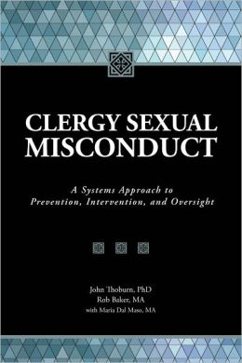
John Thoburn, PhD.
And
Rob Baker, M.A.
Notes:
Jesus said in Matthew 13 that every trained scribe brings out of his treasure things old and new. What I want to mix in with the ancient divinely-inspired word, are some scientific data that was attained in order to learn everything they could to try to understand what the authors call Clergy Sexual Misconduct. I found this book extremely interesting and enlightening . I hope I don’t bore you with too many statistics, but here goes:

Slide 37
Clergy Sexual Misconduct
First survey was in 1991. Since then, over 25 research articles have been published in journals.
Taken together, it is estimated that:
10-14% of pastors have inappropriate sexual contact with someone.

Slide 38
Clergy Sexual Misconduct (cont’)
30% engage in sexual behavior they themselves consider inappropriate.
15% meet the criteria as addicted to internet pornography
Notes:
Now I come to the main point of my use of this story. As some of you know, I am a psychotherapist, who specializes in the treatment of sexual addiction, sexual sin--it doesn't matter what one calls it. Most of the time, I am contacted because someone has been caught in sexual sin and is in trouble. He is in a state described in the 1st Step of AA, being totally powerless over the behavior and whose life has become totally unmanageable. I find this work to be challenging, to say the least, but rewarding, because real solutions are possible. What I really would like, however, would be to help folks avoid the problem before they become a train wreck. So, my question regarding the David/Bathsheba story is this: Could it have been prevented? [click to slide 13]

Slide 39
Systems View of Vulner-ability
Work/Church Environment
Host Environment
Interpersonal
Intrapersonal

Slide 40
Why are missionaries in the “At Risk” group ?
1. Intrapersonal factors
87% of sex addicts come from disengaged families; 77% from rigid families
70% indicated no current close friends
Notes:
Now I come to the main point of my use of this story. As some of you know, I am a psychotherapist, who specializes in the treatment of sexual addiction, sexual sin--it doesn't matter what one calls it. Most of the time, I am contacted because someone has been caught in sexual sin and is in trouble. He is in a state described in the 1st Step of AA, being totally powerless over the behavior and whose life has become totally unmanageable. I find this work to be challenging, to say the least, but rewarding, because real solutions are possible. What I really would like, however, would be to help folks avoid the problem before they become a train wreck. So, my question regarding the David/Bathsheba story is this: Could it have been prevented? [click to slide 13]

Slide 41
Why are missionaries in the “At Risk” group ?
1. Intrapersonal factors
Narcissistic, dependent, or anxiety personality traits
The phenomenon of “burn-out” is associated with a background of loneliness, shame, and poor attachments
Notes:
Now I come to the main point of my use of this story. As some of you know, I am a psychotherapist, who specializes in the treatment of sexual addiction, sexual sin--it doesn't matter what one calls it. Most of the time, I am contacted because someone has been caught in sexual sin and is in trouble. He is in a state described in the 1st Step of AA, being totally powerless over the behavior and whose life has become totally unmanageable. I find this work to be challenging, to say the least, but rewarding, because real solutions are possible. What I really would like, however, would be to help folks avoid the problem before they become a train wreck. So, my question regarding the David/Bathsheba story is this: Could it have been prevented? [click to slide 13]

Slide 42
Average age a pastor/missionary experiences burnout: 40-45
Average age a pastor/missionary has an affair: 40-45
Notes:
Now I come to the main point of my use of this story. As some of you know, I am a psychotherapist, who specializes in the treatment of sexual addiction, sexual sin--it doesn't matter what one calls it. Most of the time, I am contacted because someone has been caught in sexual sin and is in trouble. He is in a state described in the 1st Step of AA, being totally powerless over the behavior and whose life has become totally unmanageable. I find this work to be challenging, to say the least, but rewarding, because real solutions are possible. What I really would like, however, would be to help folks avoid the problem before they become a train wreck. So, my question regarding the David/Bathsheba story is this: Could it have been prevented? [click to slide 13]

Slide 43
Clergy Burnout
Burn-out is most likely to occur when:
The person has a fear of intimacy
The person overworks out of a fear of failure or rejection
The person puts their emotional and physical energy into their careers because things are not going well at home.

Slide 44
Burnout
Relationship with God declines as a consequence of burnout
David's personal relationship with God was not enough to get through to him the true nature and scope of his sinfulness. It took the inter-vention of Nathan.
“When burn-out occurs, a pastor may feel anger and fatigue, and have little motivation for spiritual disciplines or accountability” (Wilson & Hoffman)
Relationship with others declines as a consequence of burnout.

Slide 45
Burnout
The combination of loneliness, unbalance, narcissism, lack of accountability to God or man, and burnout creates the perfect storm for lust and sexual misconduct to occur." - Thoburn & Baker

Slide 46
Why are missionaries in the “At Risk” group ?
2. Interpersonal factors
Marital conflict or estrangement
41% of clergy who acted out sexually acknowledged marital dissatisfaction
75% of those with long-standing (5-20 years) marital dissatisfaction were at risk for sexual misconduct
Notes:
Now I come to the main point of my use of this story. As some of you know, I am a psychotherapist, who specializes in the treatment of sexual addiction, sexual sin--it doesn't matter what one calls it. Most of the time, I am contacted because someone has been caught in sexual sin and is in trouble. He is in a state described in the 1st Step of AA, being totally powerless over the behavior and whose life has become totally unmanageable. I find this work to be challenging, to say the least, but rewarding, because real solutions are possible. What I really would like, however, would be to help folks avoid the problem before they become a train wreck. So, my question regarding the David/Bathsheba story is this: Could it have been prevented? [click to slide 13]

Slide 47
Why are missionaries in the “At Risk” group ?
3. Host Environmental factors
Cambodian culture leans much more toward normalization of prostitution as compared to most missionary sending countries.
Massage businesses are ubiquitous.
No clear boundaries between “legitimate” massage and erotic massage
Notes:
Now I come to the main point of my use of this story. As some of you know, I am a psychotherapist, who specializes in the treatment of sexual addiction, sexual sin--it doesn't matter what one calls it. Most of the time, I am contacted because someone has been caught in sexual sin and is in trouble. He is in a state described in the 1st Step of AA, being totally powerless over the behavior and whose life has become totally unmanageable. I find this work to be challenging, to say the least, but rewarding, because real solutions are possible. What I really would like, however, would be to help folks avoid the problem before they become a train wreck. So, my question regarding the David/Bathsheba story is this: Could it have been prevented? [click to slide 13]

Slide 48
Why are missionaries in the “At Risk” group ?
4. Work/Church Environmental factors
The culture of the church demands super-human characteristics of the pastor/missionary
eg. It is considered unthinkable that someone in the ministry be capable of sexual sin
Notes:
Now I come to the main point of my use of this story. As some of you know, I am a psychotherapist, who specializes in the treatment of sexual addiction, sexual sin--it doesn't matter what one calls it. Most of the time, I am contacted because someone has been caught in sexual sin and is in trouble. He is in a state described in the 1st Step of AA, being totally powerless over the behavior and whose life has become totally unmanageable. I find this work to be challenging, to say the least, but rewarding, because real solutions are possible. What I really would like, however, would be to help folks avoid the problem before they become a train wreck. So, my question regarding the David/Bathsheba story is this: Could it have been prevented? [click to slide 13]

Slide 49
Why are missionaries in the “At Risk” group ?
4. Work/Church Environmental factors
Pastor is expected to have all the attributes of leadership + humility and servant heart
90% of pastors feel inadequate for the task
25% have experienced a firing in the past due to not having met the expectations of the congregation
Notes:
Now I come to the main point of my use of this story. As some of you know, I am a psychotherapist, who specializes in the treatment of sexual addiction, sexual sin--it doesn't matter what one calls it. Most of the time, I am contacted because someone has been caught in sexual sin and is in trouble. He is in a state described in the 1st Step of AA, being totally powerless over the behavior and whose life has become totally unmanageable. I find this work to be challenging, to say the least, but rewarding, because real solutions are possible. What I really would like, however, would be to help folks avoid the problem before they become a train wreck. So, my question regarding the David/Bathsheba story is this: Could it have been prevented? [click to slide 13]

Slide 50
Personal Questions to Ponder
Are there intrapersonal factors in your life that make you at-risk for sexual misconduct?
Narcissistic, dependent, or anxious traits?
Family background of abuse, rigidity, or emotional neglect?
Have you experienced burnout? Where are you with that now?

Slide 51
Personal Questions to Ponder
Are there interpersonal factors in your life that make you vulnerable?
Marital discord or lack of intimacy?
No close friendships?
Lack of accountability?
Have you seriously given support and accountability a real “shot” in dealing with stubborn habits/sins?

Slide 52
Personal Questions to Ponder
Are there host environmental factors in your life that make you vulnerable?
Are you triggered by the ever-present availability of prostitutes/bar girls?
Do you utilize massage for relaxation? If so, do you have clear boundaries that you do not violate?

Slide 53
Church/Mission Leader Questions to Ponder
Regarding environmental factors:
Do you have policies that encourage/discourage open communication about sexuality and the reality of sexual temptation by both men & women in your organization? Do you have meaningful (not legalistic) accountability with your team?

Slide 54
Church/Misssion Leader Questions to Ponder
Do you place excessively high expectations of your staff, thus contributing to drivenness and burnout?
Do you have clear protocol in event that inappropriate sexual conduct occurs in your organization? i.e. support for victims, family, and perpetrator?

