Slide 1
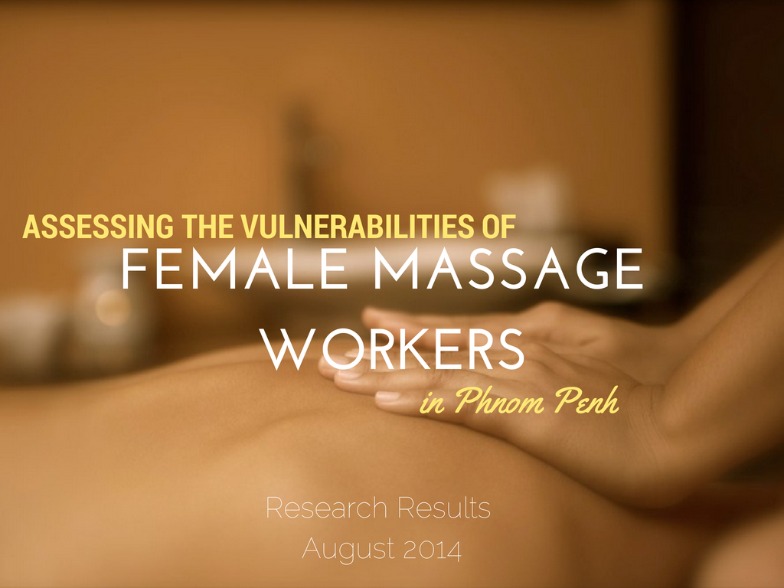




Slide 2

Introduction & Purpose
Methods
Sample
Entry Factors
Income & Financial Obligations
Relationships
Vulnerabilities
Work Satisfaction
Existential Wellbeing
Discussion

Slide 3

Research about the vulnerability of female massage parlor workers in Phnom Penh
Team of 9: Love146, Destiny Rescue, Precious Women, XP Missions
  4 Khmer researchers
  5 researchers from the UK, USA, Germany and
  Canada

Slide 4


Structured interviews:
  data gathering: 3 weeks
  10,000R massage parlors
Location: Phnom Penh
Notes:
http://www.tourismcambodia.org/images/multimedia/phnom_penh_map.jpg
- Hilite the roads we went on...

Slide 5

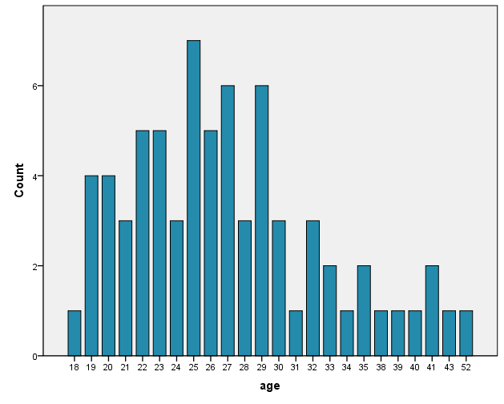
Age Distribution
71 respondents
Age range:
18-52 years old

Slide 6

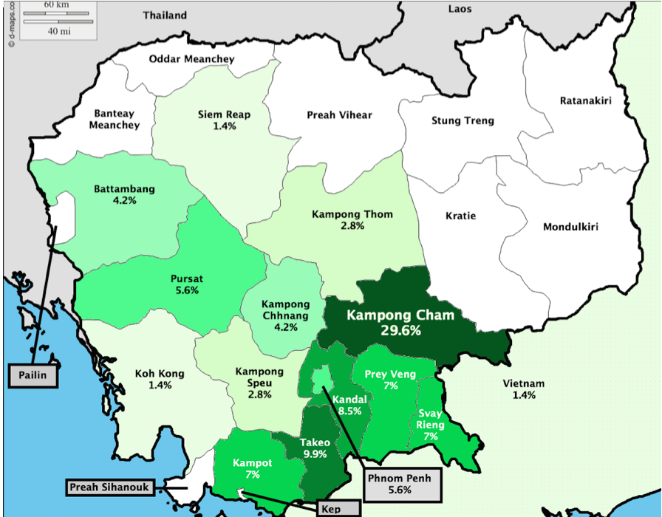
Notes:
Note: 1 Vietnamese migrant worker
The 1 Vietnamese presents a bias in our sample because of greater language barrier, greater reluctance to participate in interviews, etc.)
Combined place of birth and why move to PP to clarify the strong rural-urban migration that is still valid today (is it increasing?)
Talk about why they moved to the city

Slide 7

20% good money
17% no choice
16% easy work
OTHER INTERESTING REASONS:
3% job pays for accommodations/food
6% physical limitations
Notes:
17% No choice does this include lack of education? – link to next slide

Slide 8

24% had no schooling at all
Only 3% achieved past 9th Grade
“I do not like my job because I have no education.”
“I have to study more.”
“Girls should try to study hard to have a nice job. I do not want them to have a job like mine.”

Slide 9

24% never worked before
51% worked in a garment factory at some point
39% worked in garment factory immediately prior to entering the massage industry
Why they left the garment industry:
13% needed greater income
11% got sick, became unfit to work in garment industry

Slide 10

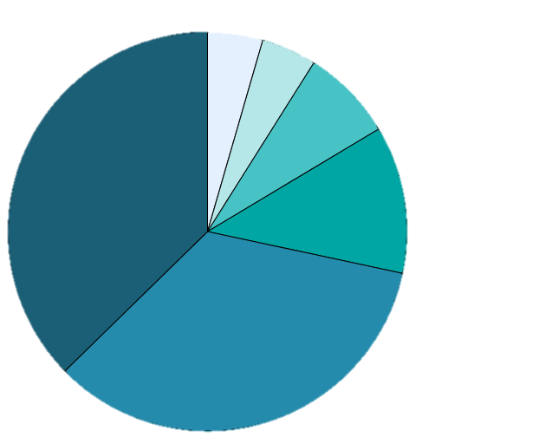
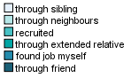
Notes:
Less clear-cut trafficking, as lots of people came here through a friend, or found job by themselves

Slide 11

82% do not receive all the money they earn
Receiving 30% of money earned appeared as the standard wage for the majority
Notes:
3000 riel

Slide 12

Note: 89 % live inside vs. 11% outside the massage parlor
Types of Expense
1 “Go for a Walk”/Leisure
2 Pay Back Debt
3 *Food
4 *Clothes
5 Toiletries/Makeup/Perfume
6 Transportation
7 Sibling/Child’s Tuition
8 Medical Expenses
9 Personal Items
10 *Send Money to Family
11 Rent
12 Utilities/Bills
13 Supporting Children
14 Jewelry
15 Drinks
16 Pay Police
Notes:
*GRAPH DOES NOT APPEAR ON ZOE’S MAC

Slide 13
80% send money to their family (i.e. support children and/or parents)
Roughly 50% of their families owe some kind of debt
Family Debt
Amount of Debt ($)

Slide 14

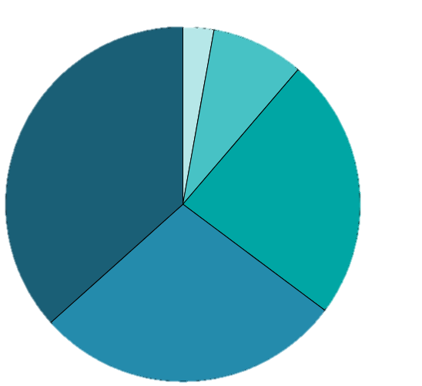
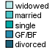
Are you currently in a committed relationship?
  37% divorced
  28% boyfriend
  24% single
  8% married
  3% widowed

Slide 15
58% of their families were NOT aware of them working in a massage parlor
48% did not tell the people in their hometown about their work

Slide 16
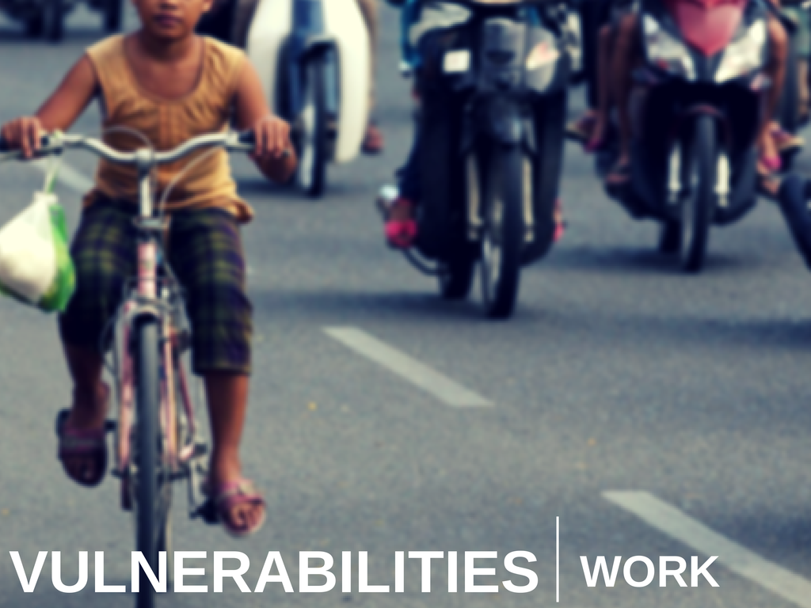
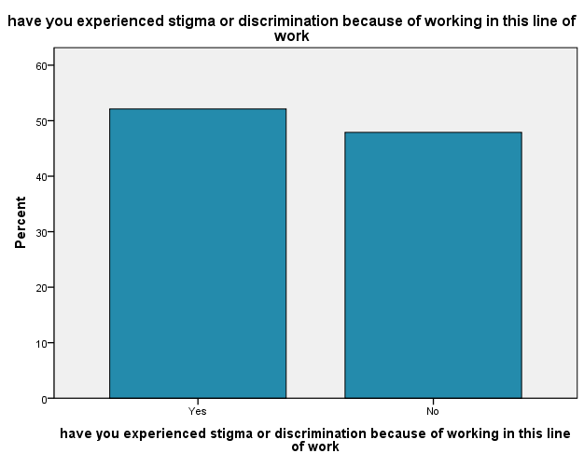
Notes:
Add %s

Slide 17
“From whom do you experience stigma/discrimination?”
Clients
Friends
Neighbors

Slide 18
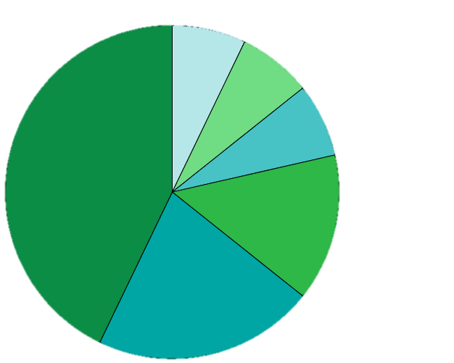
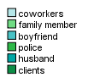
20%
had experienced physical violence as result of work
Who was violent
towards you?
“The clients who come here to do massage, some of them are soldiers or policemen with guns, they talk rudely to me and threaten me and they don’t want to pay me.”

Slide 19
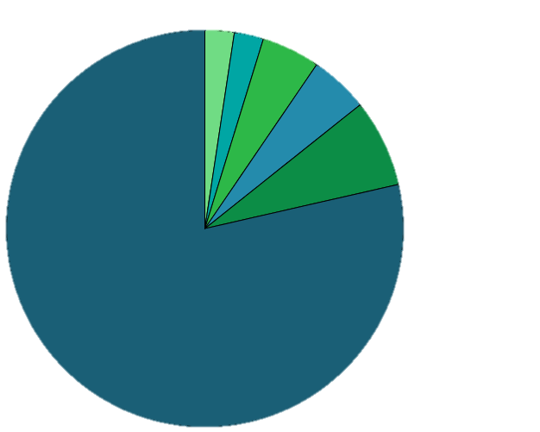
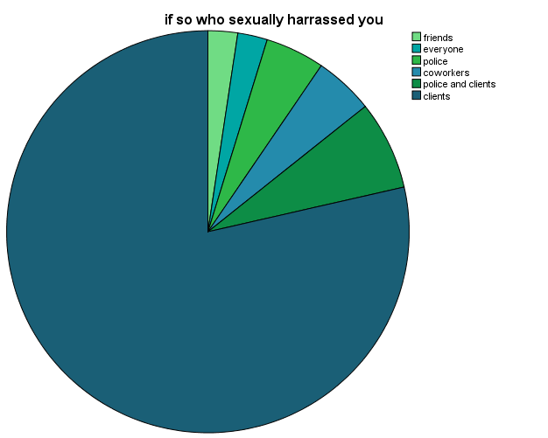
From whom did you experience sexual violence/abuse
Unwanted sexual touching: 24%
Harassment: 52%
Attempted rape: 23%
Rape: 6%

Slide 20

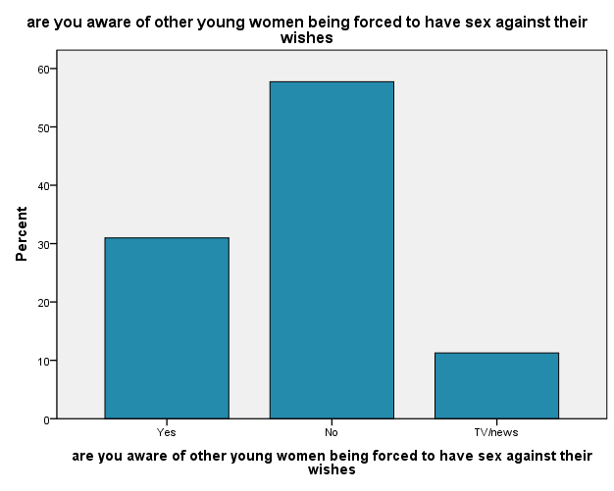

Slide 21
How many require Sexual Intercourse?
Percent of clients who require sexual intercourse

Slide 22
Location of sexual encounters
Guesthouse: 30
Massage parlor: 3
Both: 2
Age range: 16-87
30% of respondents who have sex with clients have foreign clients
Majority of foreign clients are Chinese and “Barang”
Notes:
Add in about not knowing about sex work when entering job (14 respondents)
0-49 Clients: 24
50-99 clients: 12
100-149: 16
150-199: 4
200 and above: 6

Slide 23
Awareness of sex work prior to entry
“People brought me here, just told me I work only to do massage. But it was not what they said, it is massage with sex in the working place. I normally have sex with clients at the guest house, not at my working place, but I do not like it.”
“Before I came to work here, I did not know that I would be required to do sexual services;
now I know.”
(14/98 respondents had similar quotes)

Slide 24

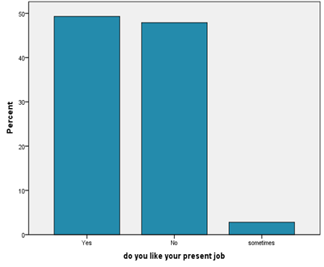
Do you like your present job?
Those who DO NOT:
“I don’t have a choice” (20%)
“People think we are not good girls” (20%)
Those who DO:
“It is easy and relatively more money”, “It isn’t tiring” (28%)
Notes:
When asked about their satisfaction with their work, there was a relatively even spread between those who liked their job as a massage worker and those who did not.
1 in 5 girls would say they didn’t like their job because they had to settle for this job, stating that they didn’t have a choice to be there.
1 in 5 girls also disliked their job primarily due to the discrimination they faced. They said things like “People think we are not good girls.”
For those who DO like their job, they reasoned that it was because of how easy it is, the better pay and that it wasn’t tiring
In the end, more people actually claimed to like their job more than not like it. However, those who did like their job still made comments about their job that exposed contradictory feelings toward their line of work.. E.g. 15% (6/40) said they like it because they have no choice

Slide 25

Would you recommend this job to a sister or friend?
89% of respondents answered that they would not recommend massage work for these (top 3) reasons:
    Not a good job
    Not wanting others to have the same experiences as they have
    Not wanting others to know that they work there
“I only want to be wrong
alone.”
“I chose the wrong job
already…I do not want
anyone to imitate me.”
“No one gives us value.”
39% of respondents had been referred to the job by a
friend (35%) or sibling (4%)
Notes:
Now looking at whether they would recommend this job to a sister or friend, there’s a stark difference in these responses compared to whether they liked their job or not.
Almost 90% of them would not recommend this job, and the top three reasons were: this is not a good job, they didn’t want others to undergo the same experiences as them, and simply not wanting people to know that they even work there.
Here are some of the things the girls said to us in our interviews.
Now while most of them would not recommend this job, about 40% of them were themselves referred to the job by a friend or sibling.

Slide 26
Would you recommend this job to a sister or friend?
10% would recommend because:
  lack of choice and/or poverty (6 women)
  It is “easy/good” (2 women)
    One respondent was involved in sex work and experiences sexual/physical violence
Notes:
Moreover, the 10% who said they would recommend this job to a sister or friend gave reasons that did not portray their job in a necessarily positive light.
For example, 60% would recommend the job if their friend ‘had no choice’ or was ‘very poor’
2 respondents said they would recommend the job because it was ‘easy/good’ – interesting side note: one of these respondents said this even despite admitting to sex work and experiencing sexual/physical violence

Slide 27
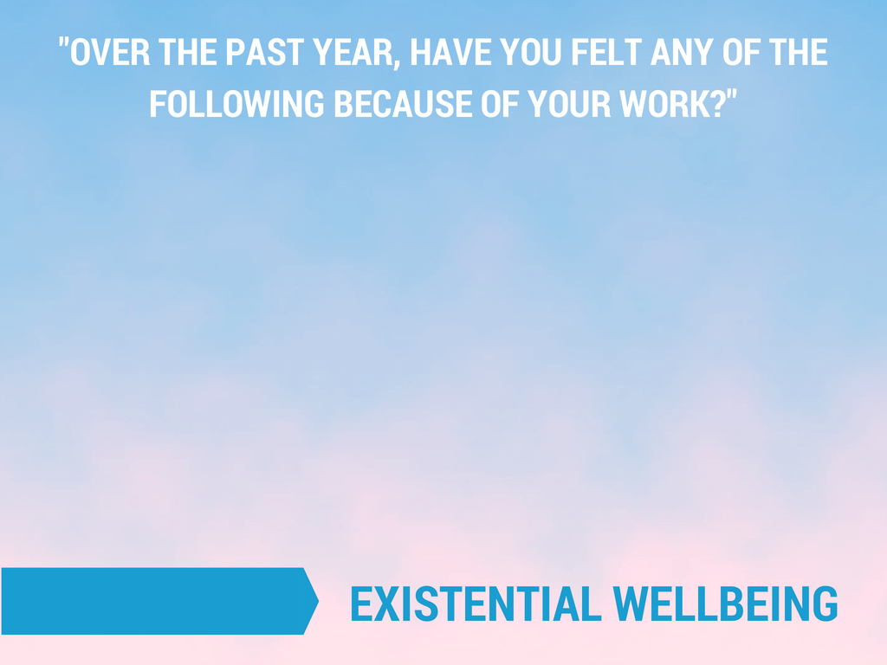
Notes:
We probed for these feelings
The first two are coloured differently because they are positive feeilngs
Blaming others was not a significant part of their attitude in life…vs. blaming self
Ashamed most experienced feeling
But also felt respected/valued – would be interesting to see where these feelings originated from/what triggered them
“Working here, no value. I do not know why I chase it, but I need money to support my children.”

Slide 28

82% do not see themselves working in massage
35% have a vision for their future, with a specific job industry in mind.
Examples:
Beauty salon, Restaurant industry, Tailoring
1 planned to still be working in massage
2 want to run their own massage parlors
“Since working here, I feel like I don’t have a future.”
Notes:
Although most of them don’t want to be in this job, only 35% have an actual plan or idea of what they would replace this job with
- Most of them don’t won’t be working here even though many said they liked their job
Many of these women have been in massage for only a short amount of time (it would be good to actually have the data from the quantitative side of the range of time respondents had been in the industry)
Overall, this data suggests that working in a massage parlour is a step along the way in many women’s lives, not a permanent job, at least in terms of what women want. Whether or not theses plans are realised would require further research in the form of a longitudinal study.
“Since working here, I feel like I don’t have a future.”

Slide 29
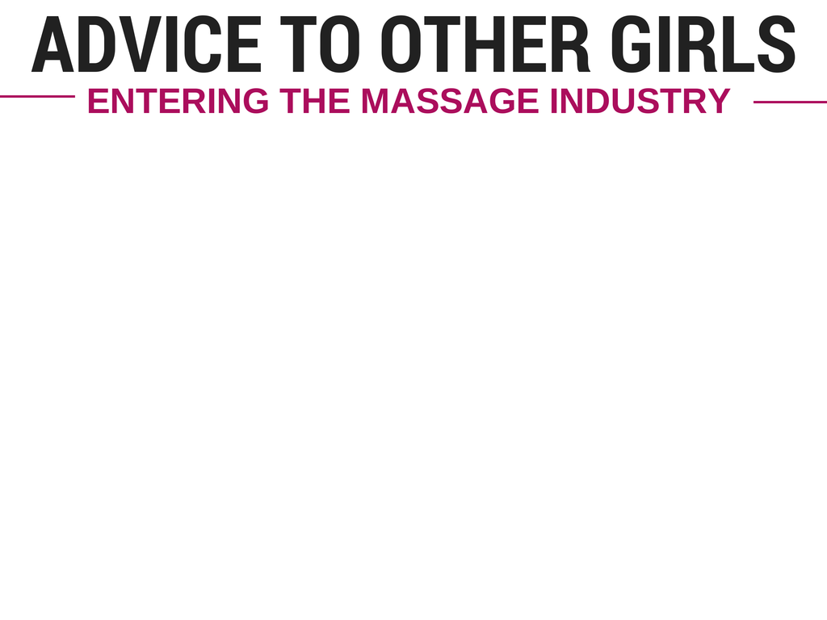
DON’T!
“Do not come to work here, people around us do not value us. Please find another job instead.” (21)
WITHIN THE INDUSTRY
“I want them to know how to protect themselves from HIV when they have sex with clients.”
“Girls should not drink alcohol and know how to protect themselves if they go with out customers.” (12)
GENERAL LIFE ADVICE
“Every work is valuable, it depends on us. So we are the ones who make ourselves valuable, we help ourselves” (15)
“I want to share my idea to every girl and boy, go away from drugs.” (10)
“I have to endure no matter what. Get up and stop trusting men from now on. Although men hurt you, you have to get up.” (8)
“If I would give advice, I would advise that they should learn specific skills. As long as we have our own skill no one can look down on us.” (6)
“I don’t want to give them advice. I’d rather they decide by themselves.”

Slide 30
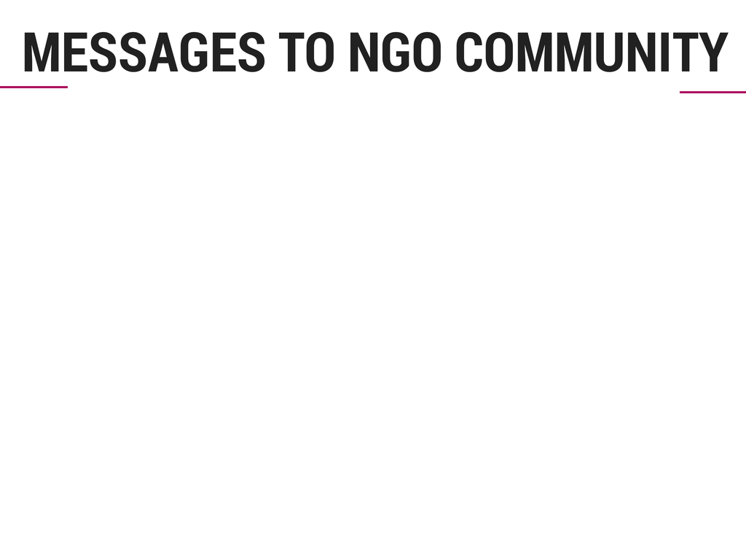
Help!
“Can an NGO help me to find another job?”
“Please educate all the girls who work in the massage places about healthy and safe sex.”
“Please help the women who suffer.”
Thank you! (25%)
“I want to say thank you very much for asking and knowing about my
situation. It makes me happy that
someone cares about me.”
No more discrimination
“No girl wants this job. Don’t look down on us.”
“I want Cambodian men to value and respect massage girls.”
“Please do not discriminate against massage girls because we are not all bad.”
Notes:
health problems
skills training (tailoring, hairdressing, language)
alternative employment (8 women asked for)
family situation (child education, poverty, sickness, etc)

Slide 31

Thank You!

