Slide 1
The Butterfly Longitudinal Reintegration Research 2010-2020
Chab Dai Coalition

Slide 2

What is Human Trafficking?

Slide 3
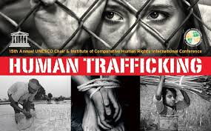

Slide 4
Human Trafficking –Background-1
Since the 1990’s increasing global attention
End of Cold war
Increased Migration across Europe and rest of of world,
First world concerned about border control/security

Slide 5
Trafficking –How developed -2
Influencers and players
Radical Feminist (Abolitionist Feminists) in USA
  White slave trade
  Against Male patriarchy-violence
(Neo-) Abolitionists (Faith based)- Slavery
  Kevin Bales,
USA-1990’s -Clinton, 2000 Bush
  Definition of Human Trafficking (Palermo)
  TIP Report
Notes:
Abolition was/is a movement to end slavery- Historical movement to end the African and Indian slave trade and set slaves free.

Slide 6
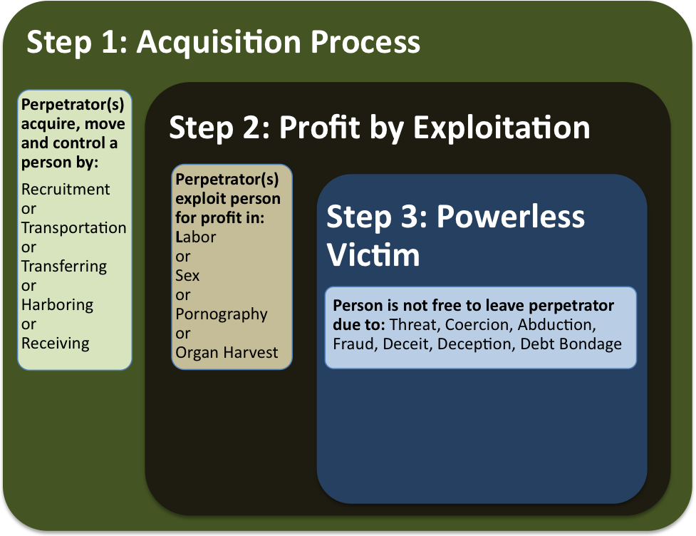

Modern Day Human Trafficking

Slide 7
Protocol to Prevent, Suppress and Punish Trafficking in Persons Especially Women and Children, supplementing the
United Nations Convention against Transnational Organized Crime
Palermo Protocol-
2000
(a) "Trafficking in persons" shall mean the recruitment, transportation, transfer, harbouring or receipt of persons, by means of the threat or use of force or other forms of coercion, of abduction, of fraud, of deception, of the abuse of power or of a position of vulnerability or of the giving or receiving of payments or benefits to achieve the consent of a person having control over another person, for the purpose of exploitation. Exploitation shall include, at a minimum, the exploitation of the prostitution of others or other forms of sexual exploitation, forced labour or services, slavery or practices similar to slavery, servitude or the removal of organs;
(b) The consent of a victim of trafficking in persons to the intended exploitation set forth in subparagraph (a) of this article shall be irrelevant where any of the means set forth in subparagraph (a) have been used;
(c) The recruitment, transportation, transfer, harbouring or receipt of a child for the purpose of exploitation shall be considered "trafficking in persons" even if this does not involve any of the means set forth in subparagraph (a) of this article;
(d) "Child" shall mean any person under eighteen years of age.
Means- threat, force, coercion, abduction, fraud, deception, abuse of power
Exploitation-prostitution, sexual exploitation, forced labour, removal of organs
Consent irrelevant if above means
Or a Child <18

Slide 8
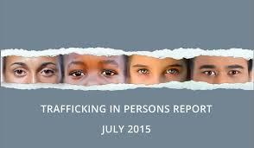
Trafficking in Persons Report
(TIP)
Tier 1-
Fully comply with TVPA’s minimum standards
USA, UK, S. Korea
Tier 2-
Don’t fully comply but are making significant efforts
Indonesia, Vietnam, Singapore
Tier 2-Watch list
Cambodia, China, Laos, Malaysia , Miramar
Tier 3-
Don’t comply and are not making significant efforts
Thailand
Notes:
USA finally joined

Slide 9
Palermo Protocol and TIP ratings
As of 2010 there were 117 state signatories to the Protocol and 141 parties.
The number of countries having anti-trafficking legislation more than doubled between 2003 and 2008; more than half of the responding States have established an anti-human trafficking police unit; and many have launched a national action plan.
Cambodia: Law on the Suppression of Human Trafficking 2008

Slide 10
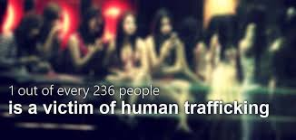
Human Trafficking Estimates Vary widely-
2.4 million to 27 million
The clandestine nature of human trafficking makes it difficult to arrive at authentic numbers
In some countries there is either no specific anti-trafficking legislation or the definition of human trafficking does not comply with the Trafficking Protocol.
Victims of human trafficking are also very often not identified as victims of a crime, but rather considered as persons who have violated migration, labour and/or prostitution laws.

Slide 11
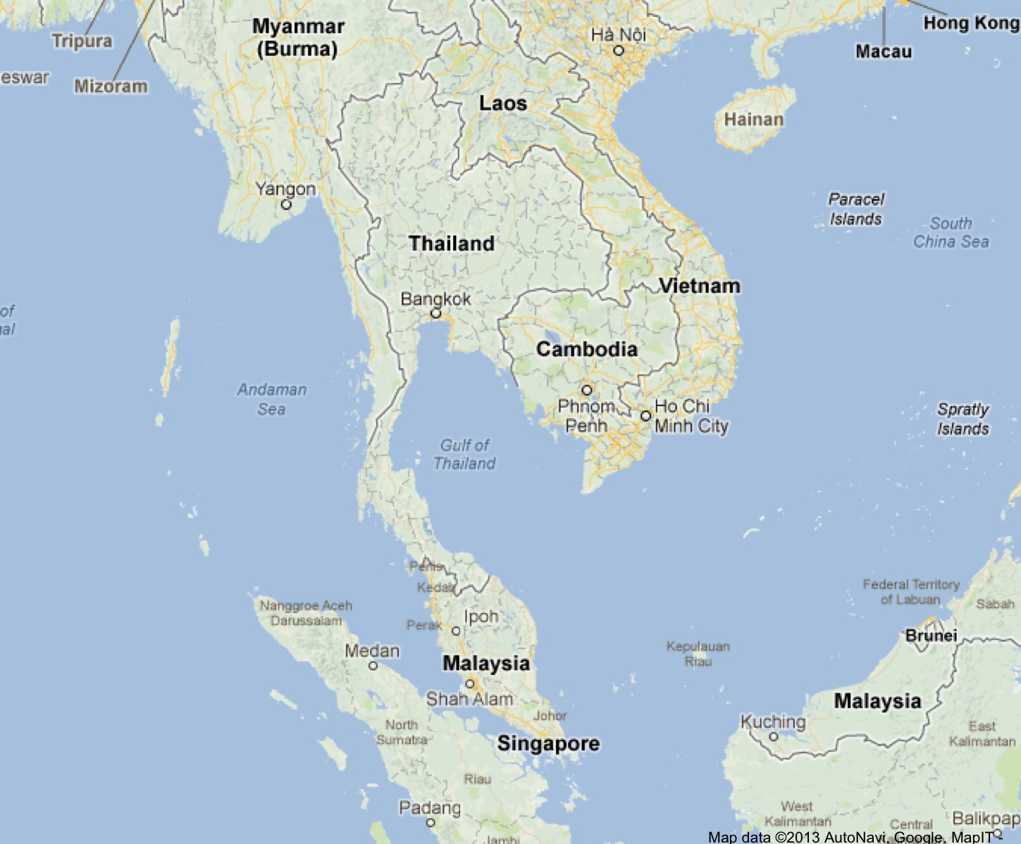
Cambodia
1975-1979- Khmer Rouge auto-genocide
1980-1989- Vietnamese liberation/occupation/ Displaced camps/ cold war era
1991- Paris Peace Accord
1993- UNTAC and Elections and increase prostitution/ trafficking

Slide 12
Cambodian Context since 2000’s
“The traffickers: organized crime syndicates, parents, relatives, friends, intimate partners, and neighbours.” UNAIP
“Trafficking victims are predominantly women and girls- sexual exploitation (and Virgin sales)
Sexual Exploitation occurs in brothels, massage parlours, salons, beer gardens and karaoke bars” (UN-ACT)
Epicenter- source, transit and destitation
Some context this:- moral panic? Numbers? Crime rings”
Notes:
UNAIP
UN_ACT

Slide 13
Chab Dai (Hands Together)
Coalition
Founded 2005
50 plus agencies working in counter human trafficking
Rescues, Shelters, Training programs, Work programs, community programs, Legal support
Does any of this work do any good to people who move on from their programs? No long term f/u
Commissioned Butterfly Longitudinal research

Slide 14
The Butterfly Longitudinal Research Project
First Longitudinal project – prospectively following a cohort of survivors of trafficking for sexual exploitation
Cross sectional data can be tricky and the quality of data will depend greatly on the trust and truthfulness of participants
Exploratory
Team –One expatriate and 3 Nationals

Slide 15
Definitions
Reintegration: is the process of recovery, and economic and social inclusion following a trafficking experience. A central aspect of successful (re)integration is the empowerment of trafficking victims
“Assistance” refers to formal anti-trafficking assistance, provided by national and international NGOs, IOs and state bodies as well as more generalized assistance (i.e. non-trafficking specific assistance), provided by state agencies (e.g. social services, child protection agencies, health departments), NGOs or IOs. For the purpose of the Butterfly research, means Chab Dai NGOs partnering with the Butterfly research.

Slide 16
The Asia Foundation study (2005) on reintegration assistance in Cambodia identified seven major components that nearly all reintegration efforts (globally) include.
1. Preventing stigmatization (awareness and sensitization campaigns).
2. Education (formal education, literacy, life-skills).
3. Job / skills training / (could include assistance with job placement – but not many programmes pay attention to this).
4. Legal support and assistance.
5. Health / medical care.
6. Social services (including material and economic assistance, follow-up by NGO, advocacy to link the child to whatever support networks already exist in the community, i.e. educational scholarships through another NGO).
7. Psychological services (counseling for the child; theoretically may include family/ community reconciliation efforts but this is seldom practiced).
Notes:
16
16

Slide 17
Butterfly Overarching Purposes
Provide a safe opportunity for survivors of sexual exploitation/trafficking to express their perspectives about their reintegration experiences….
Inform Policy and Practice of Cambodian government, and anti-trafficking stakeholders based on survivor voices
Contribute to wider anti-trafficking movement/efforts
Notes:
Provide an opportunity for survivors of sexual exploitation/trafficking to express their perspectives about their reintegration experiences through participating in a longitudinal study in order to give dignity and voice to this often marginalized group.
To present the perspectives and experiences of a cohort of sexually exploited/trafficked individuals to Butterfly NGO partners and other relevant stakeholders in Cambodia in order to expose them to this cohorts’ views and experiences.
To disseminate the research findings and lessons learned amongst mixed audiences of practitioners, policy makers and academics within the wider region and global community who are concerned and/or addressing the issues of people who experience reintegration following sexual exploitation and trafficking.

Slide 18
Challenges with NGO partners (Access)
Challenges to initiate amongst NGO who commissioned research - 2009-
Distrust of researchers and each other (AFESIP)
  Inclusion criteria- in their own programs
  Informed Consent/Assent
  MOUs (Changing personnel)

Slide 19
Methodology and Cohort
Cohort of 128 participants (2010)
80% female
20% male
Age range:
<12->35
Prospective Panel Longitudinal design
Initially mixed methods, 2010-2014
  Broad End of year Reports
To Qualitative, since end 2014
  Thematic Papers

Slide 20
Ethics
  Annual Ethics approval/ International Advisory Panel
Children Assent and recheck every year
Adults-Consent and recheck every year
Confidentiality- critical
Child protection/ Human protection
Surprises- some NGOS wanted names and our data!

Slide 21
Methodology and Limitations/Lessons Learned
Inherent attrition (potential)
Inconsistent Participant Responses due to:
  Varying emotional states on different interview days
  Sexual trauma and its negative affect on memory
  Second guessing ‘answers’
  Evolving trust, increasing ‘truth’, contradicting earlier answers
  Increasing ‘truth’, contradicting earlier answers
Inter-year ‘missing’ numbered data means numbers cannot be merged, thereby lowering already low numbers.
2014-2015 shift to primarily qualitative –thematic papers
Notes:
Inter-year ‘missing’ numbered data means numbers cannot be merged, thereby lowering already low numbers.
Disconnect between numbered data and qualitative findings.
Inconsistent Participant Responses due to:
Varying emotional states on different interview days
Sexual trauma and its negative affect on memory
Second guessing ‘answers’
Evolving trust, increasing ‘truth’, contradicting earlier answers
The broad end of year report format hinders more in-depth communication of participants’ perspectives and experiences, because it is too wide-ranging and general. In addition, the end of year report format does not communicate the Butterfly’s interactions with NGO partners, their feedback and ways that findings are informing their programs.

Slide 22
Methodology and Limitations/Lessons Learned/Vulnerable group
Trust earned- keeping secrets
Patron Client
Listening/Respect/ Empathy
“I do not trust anyone because I am afraid they cannot keep my secrets.” – 2013
“I think people are good in front of us but behind our backs they same something bad about us.” - 2013

Slide 23
Surprises- Workshops
Child Protection issues
  Reintegration Social worker follow up- missing abuse 2013
  Peer-on Peer Sexual abuse in Shelters- lack trust in staff and shame- taboo subject 2012
Sexual harassment on Work placements- shamed and thought staff would not believe their accounts- 2013

Slide 24
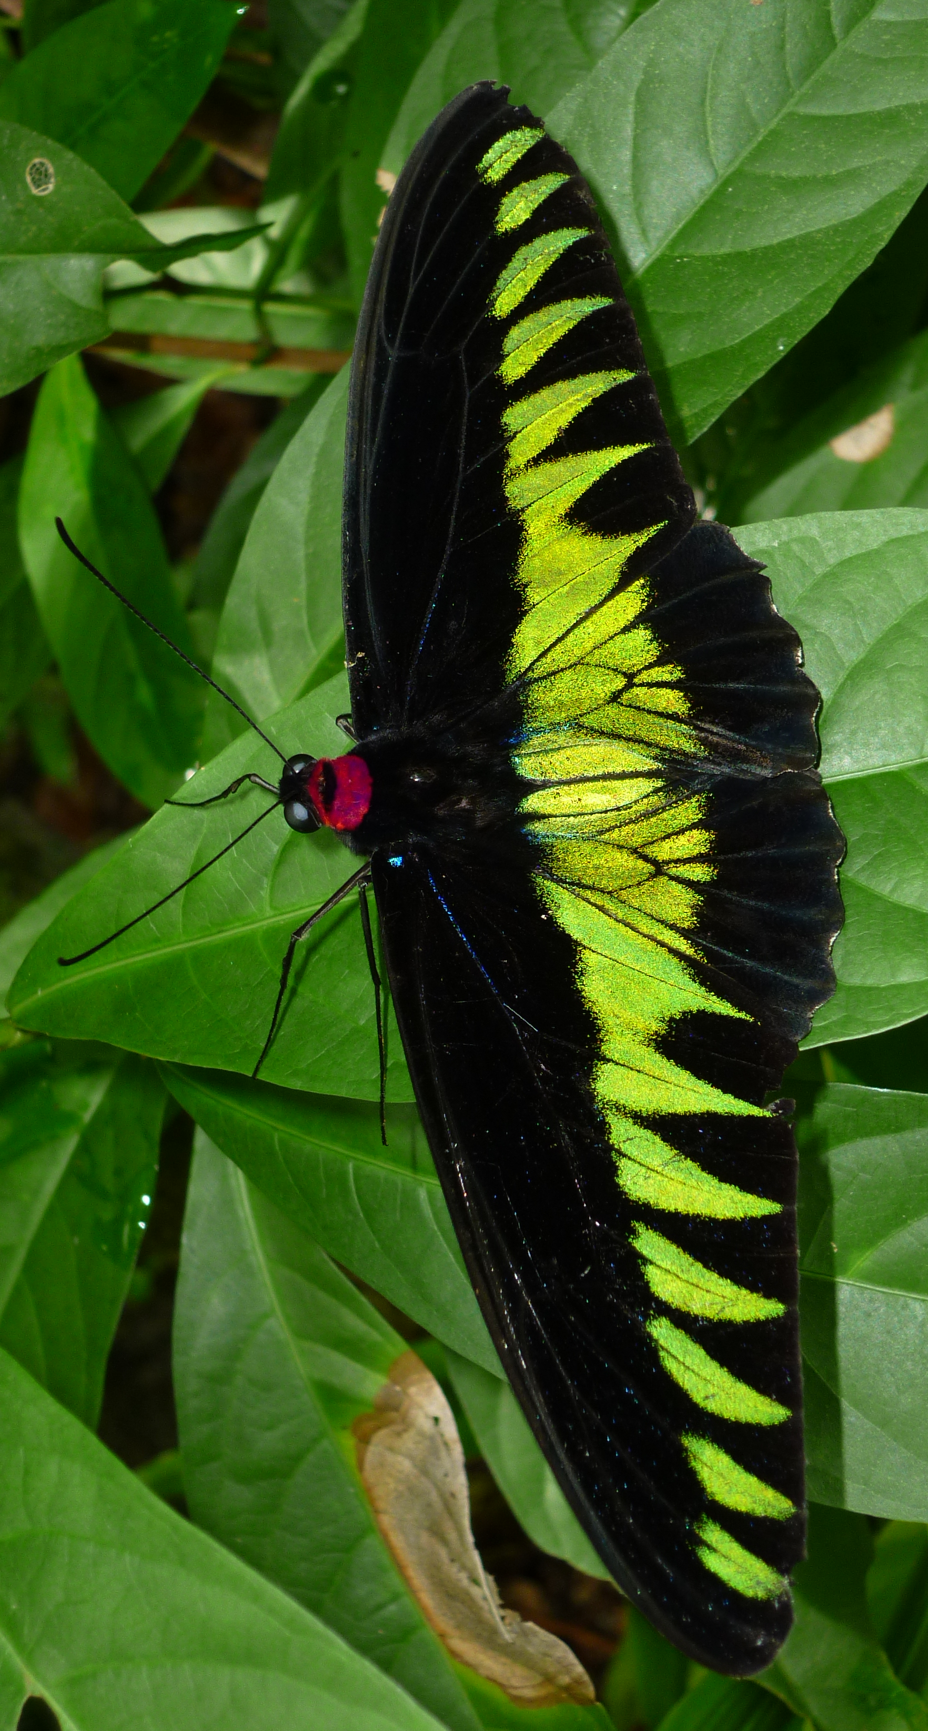
Resilience -2014/2015
Objective: To build a broad scale understanding of resilience over time using the collective ‘voices’ of survivors of sexual exploitation and trafficking
“Before I blamed myself a lot, but now I don’t. I know more and I have new ideas and I don’t dwell on my past problems.” - Female, 2013

Slide 25
Working definitions of Resilience
Resilience is personal inner strength and skills plus external resources and support that allow growth, change, and “bend but not break” during life experiences. (Goldstein 1997)
Resilience is broadly defined as the capacity of a person to withstand challenging life circumstances and persevere in the face of adversity (such as financial stress, social stigma/exclusion, violence/trauma, poor health, death of a loved one).
In this way, resilience draws on and interacts with a learned set of internal assets or skill sets, behaviors, thoughts, and actions that affect positive adaptation, growth, and/or change over time.

Slide 26
Survivor Expressions of Resilience Over Time
2015 paper
Internal Assets
External Resources
Positive Adaptation
Milestones or
Defining Moments
Resilience
Resilience
Resilience
Resilience
Interactions
“My Life”
Over Time
“My Life”
Adversity
Risk
Vulnerabilities
Negative Adaptation

Slide 27
Things to Keep in Mind Regarding Resilience
There are culturally important aspects
Resilience is comprised of many factors and measured using many scalar assessments
Generally most aftercare programs incorporate components of resilience in life skills, education and job training, and reintegration
Some groups use “resilience” components to evaluate and measure individual change and program success

Slide 28
Ten Considerations in Successful Reintegration
1⁻
Effective programming and resources are those that “envision” a survivor’s life after reintegration

Slide 29
Develop an Individual Plan
Focus on resources and life skills necessary to successfully reach significant personal milestones (developed collaboratively) such as a devoted faith, supportive marriage, family, education, stable earnings, community respect, or others
Teach Life Skills to Reach Milestones
Begin Planning Exit Transitions as a Survivor Enters a Program

Slide 30
Envisioning Fullness of Life
Although my family is poor, we are living together without arguments. -Female Survivor, Age 19, 2013

Slide 31
Ten Considerations in Successful Reintegration
2⁻
Effective programming and care targets three levels – individual, family, and community

Slide 32
Highest Functioning Survivors in Butterfly Project
Family Unit has sufficient earnings to meet family needs
Survivor has close personal supportive relationship (s)
Mutual value and acceptance between the individual / family unit and the Community

Slide 33
Ten Considerations in Successful Reintegration
Education and training programs provide hope for the future
3⁻

Slide 34
Butterfly Project – Hope for Survivors in the Community

Slide 35
Where are the jobs in Cambodia?
Most participants that indicate they are earning enough money to meet their family needs are employed by NGOs
Two survivors have their own business (family shop/restaurant and sewing business)
Cleaning/hospitality services and supervisors in the garment industry are two positions in private industry

Slide 36
What kind of job training is useful?
Rural development studies in Cambodia suggest that people who diversify job strategies improve their standard of living and are more resilient (Nuorteva 2009; Marschke and Berkes 2006)
Should we train and encourage people to diversify their livelihood in rural or urban settings?
Marschke, M. J., and F. Berkes. 2006. Exploring strategies that build livelihood resilience: a case from Cambodia. Ecology and Society 11(1): 42. [online] URL: http://www.ecologyandsociety.org/vol11/iss1/art42/
Nuorteva, P. (2009). Resilience and Adaptation Strategies of Rural Livelihoods in Tonle Sap area, Cambodia (Doctoral dissertation, Master’s Thesis. Department of Geography, University of Helsinki).

Slide 37
How do we think about livelihood strategies?
Training and education for select family members not just survivors is the best livelihood strategy for family units.
Personal Strategies:
Rice & Fishing & Collecting Recycling – man in a rural fishing village in Cambodia
Woodworking & Collecting Recycling – transgender man in NGO work program Phnom Penh
School & Selling Lottery Tickets – boy and girl reintegrated in community in Cambodia

Slide 38
Ten Considerations in Successful Reintegration
4⁻
Healthy encouraging relationships are the most important factor in sustaining successful reintegration

Slide 39
Importance of Family Relationships
One of the most important indicators of the possibility of successful reintegration is the overall quality of relationships within the family (Mann 2014)
Relationships are the most influential factor facilitating recovery (Theresa Nowak-Carter 2012)
Healthy family relationships foster resilience in children (Noltemeyer and Bush 2013)

Slide 40
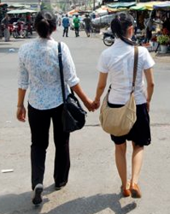
Butterfly Study: Impact of Family and Close Relationships
Study included 77 individuals and 165 assessment years in the community
Families provided acceptance, support, balance, safety
No participant described feelings of well being (satisfied and happy) when there was no positive family relationship present in his or her life

Slide 41
Butterfly Project – Family Relationships

Slide 42
The Good and The Ugly
I feel comfort when I live with my family. -Female Survivor, Age 17, 2013
Every time I have a problem my mother always comforts me. I trust my parents the most. -Female Survivor, Age 16, 2013
I am not so happy to live with my family because my mother does not allow me to go for a walk outside. When I have problem, I do not know who I can turn to /talk to. If I tell my mother, she will insult me very much. -Male Survivor, Age 13, 2013
My mother hits and curses me and my younger sister a lot...I don’t have anyone that I can trust even my mother because she always curses me every day and she doesn't allow me to go to school anymore. -Female Survivor, Age 15, 2013

Slide 43
“Focus on the Family”
Support is needed to nurture family relationships
Poverty, distance, and work make facilitating relationships a difficult objective
Not all families want to unite
Time spent understanding the quality of family relationships is time well spent guiding reintegration plans

Slide 44
Ten Considerations in Successful Reintegration
5⁻
Survivors may have difficulty forming and sustaining healthy marriages

Slide 45
Envisioning Life After Reintegration
The degree to which survivors can foster supportive and encouraging relationships with spouses will likely determine for many whether this milestone becomes a major positive or negative turning point in their lives going forward.

Slide 46
What’s Love Got To Do With It?
The vast majority of survivors in the Butterfly Project have yet to get married (75%)
Among the oldest age group Female RC 54% (15 of 28) indicated they have negative family relationships and almost all (14) are attributed to husbands and/or parents-in-law

Slide 47
This situation was too common…
I have had many arguments with my mother. So, I have decided to marry a man who lives not so far from my mother’s house. After I got married I moved to live with him and my parents-in-law. They let us live in a small shack behind their house. It does not have a roof or stairs or 4 walls. -Female Survivor, Age 18, 2012
I have lots of arguments with my husband. He gets very drunk and is emotionally and physically violent towards me. I am very sad to born into a poor family. My life is so miserable. -Female Survivor, Age 19, 2013
I have never experienced happiness since I married my husband. He never takes care of me. He never gives me any money to support our family. I have to find food to eat by picking vegetables from around the house…. I want to separate from my husband and take my child with me but my husband and family in law have said I can go but I must leave our child with them. -Female Survivor, Age 20, 2014

Slide 48
This situation was too rare…
I decided to get married to my second husband in 2012. My husband actually pursued me all along. He never got married to another woman, he wanted to marry me, so I agreed to take him. In fact, we've known each other since we were very young because we lived in the same village. Although my husband knows about my past story, he still loves me and has compassion for me. -Female Survivor, Age 29, 2012

Slide 49
Practical Considerations
Marriage and relationship training – cannot be overstated
Many women who come out of the sex industry struggle building healthy relationships with men
Women in the Butterfly Project expressed fears that they wouldn’t be able to find a good spouse and if they did they would have to keep their past a secret

Slide 50
Ten Considerations in Successful Reintegration
6⁻
Teach coping strategies to handle discrimination and domestic violence, if (when) it arises in life

Slide 51
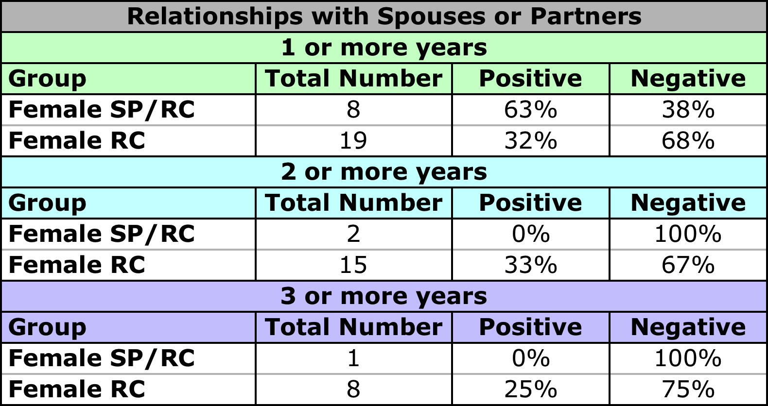
Butterfly Project – Verbal and/or Physical Abuse Among Survivors
Cambodian Domestic Violence National Average (22.5%)

Slide 52
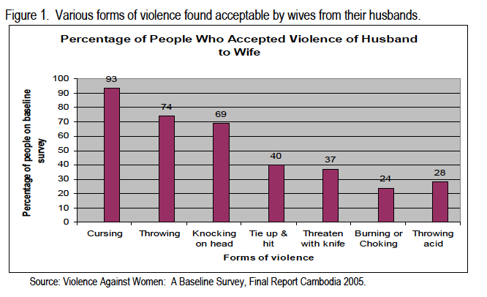
Domestic Violence is Entrenched in Cambodia

Slide 53
Butterfly Project: Discrimination Following Reintegration
Female survivors reported discrimination from families and the communities (about 30-50% of individuals)
No male survivors expressed discrimination as a result of their background
“Shelter kid” and “Poor family” were common expressions among younger female survivors in schools

Slide 54
Discrimination

Slide 55
Coping Strategies
Every night I cannot sleep unless I drink alcohol because I feel depressed with my husband, as he often does not come home and when he does he is violent toward me. –Female Survivor, Age 33, 2012

Slide 56
Butterfly Project - Greater Decision Making in the Community

Slide 57
“High” Risk Decisions in Relationships
Keeping secrets about the past creates distance in close personal relationships – “no one really knows me and how I feel”
Pursuing intimate relationships with partner without family support
Outside of marriage, pregnancy is often a significant and difficult situation

Slide 58
She Walked Through an Abortion Alone
I am pregnant with my boyfriend. My boyfriend’s family knows and they refused to accept our unborn baby and me. They wanted me to abort our child. I feel very broken-hearted and at the same time afraid of my parents. My parents will physically beat me if they know that I am pregnant. Moreover, if my neighbors know that I am pregnant they will look down on me because this brings shame to my family. -Female Survivor, Age 22, 2012

Slide 59
Practical Considerations
Survivors need to learn healthy coping strategies for discrimination and domestic violence
Link survivors with resources and support for domestic violence before they reintegrate (keychain, moto sticker, bookmark)

Slide 60
Ten Considerations in Successful Reintegration
7⁻
Strong work ethic / perseverance are especially important traits for survivors reintegrating into challenging situations and environments

Slide 61
In their Own Words
I have to work very hard picking coconuts because I am afraid that the money lender will come to take their money back and we don’t have money for them. -Male Survivor, Age 16, 2013
Running my own store is not easy work because I have to wake up early in the morning and prepare the foods to sell and spend the whole day in the store and look after the children. -Female Survivor, Age 30, 2013
I feel tired because I work as garment worker and also help my mother’s small business. -Female Survivor, Age 15, 2013

Slide 62
Practical Considerations
Hard Work / Perseverance is teachable
Many survivors are reintegrating into hard core poverty and other challenging situations
Strong work ethic is a key trait in almost all if not all survivors that now have high paying jobs

Slide 63
Ten Considerations in Successful Reintegration
8⁻
Young people from marginalized backgrounds or those who are not accepted or active in mainstream society may lack social capital
Source: Reimer, J. K. What do we think we know about... education and training for children affected by sexual exploitation and related trafficking? Working Paper. http://www.childrecovery.info

Slide 64
The Definition
Social capital is about the value of social networks, bonding similar people and bridging between diverse people, with norms of reciprocity
The goodwill that others have toward us is a valuable resource
The number of people who can be expected to provide support and the resources those people have at their disposal
http://www.socialcapitalresearch.com/literature/definition.html

Slide 65
What does it look like in the Community?
My neighbors and landlord are kind to me. I have been living alone in a rental room since I left my fiancé. -Female Survivor, Age 21, 2013
Most of the people in this community, especially the children, they like me. The village chief asked me to teach other kids here (english). -Female Survivor, Age 14, 2014

Slide 66
Demonstrated Benefits of Incorporating Social Capital in Life Skills
higher levels of trust between individuals
less sexual harassment towards girls from males at school
better self-esteem and attitude toward gender norms
girls being more likely to develop future goals for their lives
Source: Reimer, J. K. What do we think we know about... education and training for children affected by sexual exploitation and related trafficking? Working Paper. http://www.childrecovery.info

Slide 67
Butterfly Project: Many Survivors Show Signs of Lacking Social Capital
In many instances NGO programs are helpful in connecting survivors with religious institutions and even other NGOs in the local community. However, based on the assessment most survivors themselves were not knowledgeable enough or skilled enough to develop their own networks (outside their immediate neighbors).

Slide 68
My Opinions on Social Capital
This takes time to develop after reintegration
It is sometimes more difficult for people that move around frequently
Difficulty trusting and discrimination and stigma negatively affect the growth of social capital
It appears that many survivors rely on the significant network/capital they come to realize in the aftercare program but don’t understand how to do this themselves once they’re in the community

Slide 69
Practical Considerations
Fostering survivors’ abilities to develop positive social capital strengthens resilience.
They garner their own external support and resources pertaining to health, residence, employment opportunities and community support structures, such as religious institutions and other NGOs.

Slide 70
Ten Considerations in Successful Reintegration
9⁻
Engage their spiritual support

Slide 71
Butterfly Project - Study Conclusions 2015
Educating and raising up leaders and networks within their spiritual communities to provide a greater role in supporting and reaching out to survivors will provide survivors more opportunities to connect into healthy and supportive communities.

Slide 72
Ten Considerations in Successful Reintegration
Follow-up with survivors in the community and have a clear plan in place for various types of intervention – “interventions” provide hope for the future
10⁻

Slide 73
Ten Considerations in Successful Reintegration
Effective programming and resources “envision” a survivor’s life after reintegration
Effective programming and care targets three levels – individual, family, and community
Education and training programs provide hope for the future
Healthy encouraging relationships are the most important factor in sustaining successful reintegration
Survivors may have difficulty forming and sustaining healthy marriages

Slide 74
Ten Considerations in Successful Reintegration
Teach coping strategies to handle discrimination and domestic violence
Strong work ethic / perseverance are important traits for survivors
Survivors may lack social capital
Engage the local Church
Follow-up with survivors in the community and have a clear plan in place for various types of intervention.

Slide 75
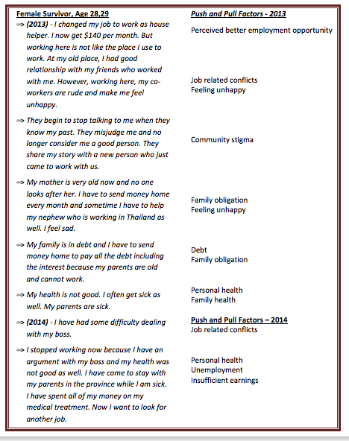
If Life is Complex, “Success” is Complex
Butterfly Project

Slide 76
Some Key Research in Cambodian and SEA
Derks et al. (2006) Review of a Decade of Research on Trafficking in Persons, Cambodia, Phnom Penh.
Reimer et al. (2007) The Road Home: Toward a Model of “Reintegration” and Considerations for Alternative Care for Children Trafficked for Sexual Exploitation in Cambodia.” Hagar & World Vision
Sandy (2009) Just choices: Rep (2009) Debt-Bonded Sex Workers in Sihanoukville, Cambodia.
Surtees (2013) After Trafficking: Experiences and Challenges in the (Re) integration of Trafficked Persons in the Greater Mekong Sub-region
Winrock (2012) Research Report on Sex and labor Trafficking Network and Pattern in Cambodia

Slide 77
www. Chabdai.org
Miles, G. and Miles, S. (2010). The Butterfly Longitudinal Research Project: End of Year Progress Report 2010, Chab Dai Coalition.
Miles, G. and Miles, S. (2011). The Butterfly Longitudinal Research Project: End of Year Progress Report 2011, Chab Dai Coalition.
Miles, S., Heang, S., Lim, V., Orng L. H., Smith-Brake, J. and Dane, S. (2012). The Butterfly Longitudinal Research Project: End of Year Progress Report 2012, Chab Dai Coalition.
Miles, S., Heang, S., Lim, V., Sreang, P. and Dane, S. (2013). The Butterfly Longitudinal Research Project: End of Year Progress Report 2013, Chab Dai Coalition.
Morrison, T., Miles, S. Heang, S. Lim, V. Etc. (2015) Resilience Thematic Paper 2014: Chab Dai. Coalition

