Slide 1
Promoting Christian Ministry to Men in order to Increase the Impact of the Church to help address the Social Issues in Cambodia

Slide 2
Introduction
NGOs and churches need focus on helping men become whole, rather than just count them as the source of all social and domestic ills. Instead of avoiding sick people, the doctor [church] need to focus on them.

Slide 3
Goals of the research
To establish the level of understanding Cambodian church leaders have of the role of men in church growth, ministry and impacting Cambodian society and its social issues.
To identify ways in which Cambodian churches are engaging men
To see if there are differences of understanding between the generations of leaders questioned.
To identify ways in which the church can find effective ways to minister to men so that they might become:
Good sons, husbands, fathers and neighbors, good model and
Positive advocates of the Christian life, who are willing to address issues in their communities and Cambodian society.
Notes:
Please make it few points that people can be easily understand.

Slide 4
Who did we survey?
The research involved questioning 39 pastors and church leaders in Phnom Penh, the capital city of Cambodia, and the following provinces, Kandal, Siem Riep, Prey Veng, Svay Rieng, Takeo, Pursat, Kampong Chhnang, and Kampong Thom.
The pastors and church leaders were engaged in small groups to consider, discuss and answer the questions - facilitated by the researcher.

Slide 5
Who did we survey?
We presented this list of issues and problem in their churches and community and we asked them to prioritise the most significant ones.
Need for sex with prostitutes
Domestic violence
Sexual abuse on children
Sexual abuse on women
Mistrust
Alcoholism
Drug addition
Dishonesty
Working excessive hours
Lack of parenting skills
Debt
Pornography
Resentment
Loneliness
Stress
Anger

Slide 6
Share Findings from our research to discuss with pastors and church leaders

Slide 7
5<10>15
Notes:
Some of them serve the ministry over 5 years, most of them 10 years, few 15 years.

Slide 8
VISION FOR THE NEXT 5 YEARS
men having the ability to reach men
sufficient income
having good relationships with their neighbors
grow in number
make more disciples
Notes:
These ideas were generated by pastors and church leaders.

Slide 9
3 Main Issues Prevent Cambodian Church from Growing
Faith vs. Food
Misunderstanding
of the Great Commission
They Plan the work,
but never work the Plan

Slide 10
What should the church do to increase the number of people believing in Jesus Christ?
Vision versus reality
Many responses were given to this question which can all be grouped into 3 strategic answers;
Model our faith personally
Be the hope in the community
Reach out to family leaders [men]

Slide 11
What methods do you normally use to bring people to faith in Christ? Are they effective?
Answer
Yesterday’s success
will not suffice today
Notes:
The explanation to this is in the next slides.

Slide 12
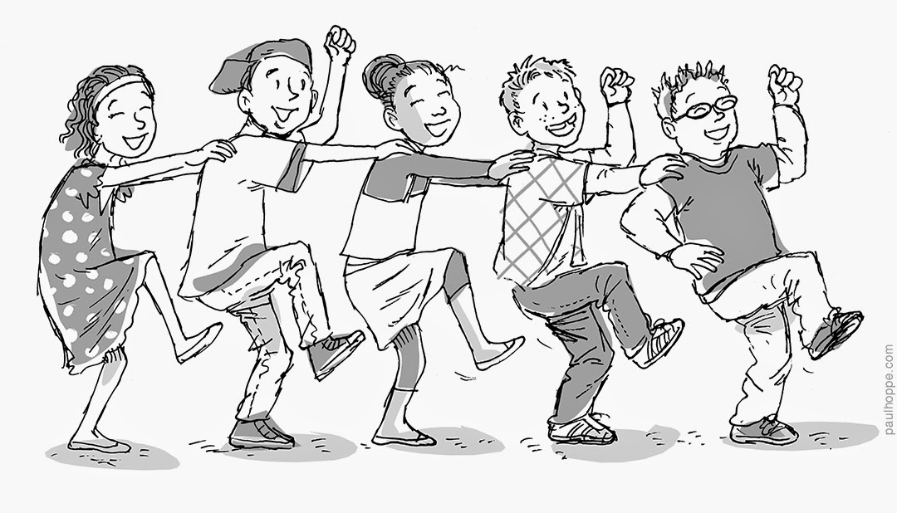
Methods to Bring People to the Church
Invitations to Christian special events
English and computer classes
Dormitories

Slide 14
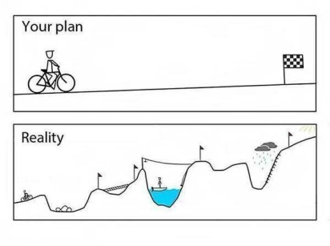
How are your church members discipled?

Slide 15
Six Issues that Most Significantly Affect Cambodian Christians
1. Domestic violence
2. Alcohol abuse
3. Drug abuse
4. Debt
5. Anger

Slide 16
Recommendations
To establish what understanding Cambodian church leaders have of the role of men in church growth, ministry and impacting Cambodian society and its social issues.
There seems to be a limited appreciation of this issue and a lack of confidence in addressing it.
1.1. Church leaders must cease being content with the status of
pastor of an ineffective church.
this may require a renewed personal commitment to Christ and his commission
this also requires a willingness to think in new ways.
there is a need for senior church figures to lead by example

Slide 17
1.2. Church leaders need to see that their main resources are;
God and his power, provision and wisdom in their own lives and ministry.
the born again members of their churches, and that they must be mobilized in ministry.
their faith that Christ will begin show them how to fulfill the Great Commission where they are with what they initially have.

Slide 18
1.3. Men have roles in society as role models and those who take
responsibility. Pastors should;
accept that men need a roles and responsibilities in the church beyond mere attendance at meetings and following their lead – or lack of lead.
focus on developing good relationships and fellowship with their men so that a positive and trusting environment grows, which will help to attract, keep and motivate men
mobilise their men beyond internal church activities to evangelise and carry out “good works” kindness to impact their communities for good with the gospel

Slide 19
1.4. Leaders must decide to overcome their fear or lack of
knowledge about ministry to men by;
recognizing that their churches will grow and their pastoral burdens will be shared if they successfully develop men to serve Christ and the church
seeking help and learning from churches and ministries that focus on this
being willing to share and delegate authority and responsibility to men who show ability in reaching and serving men

