Slide 2
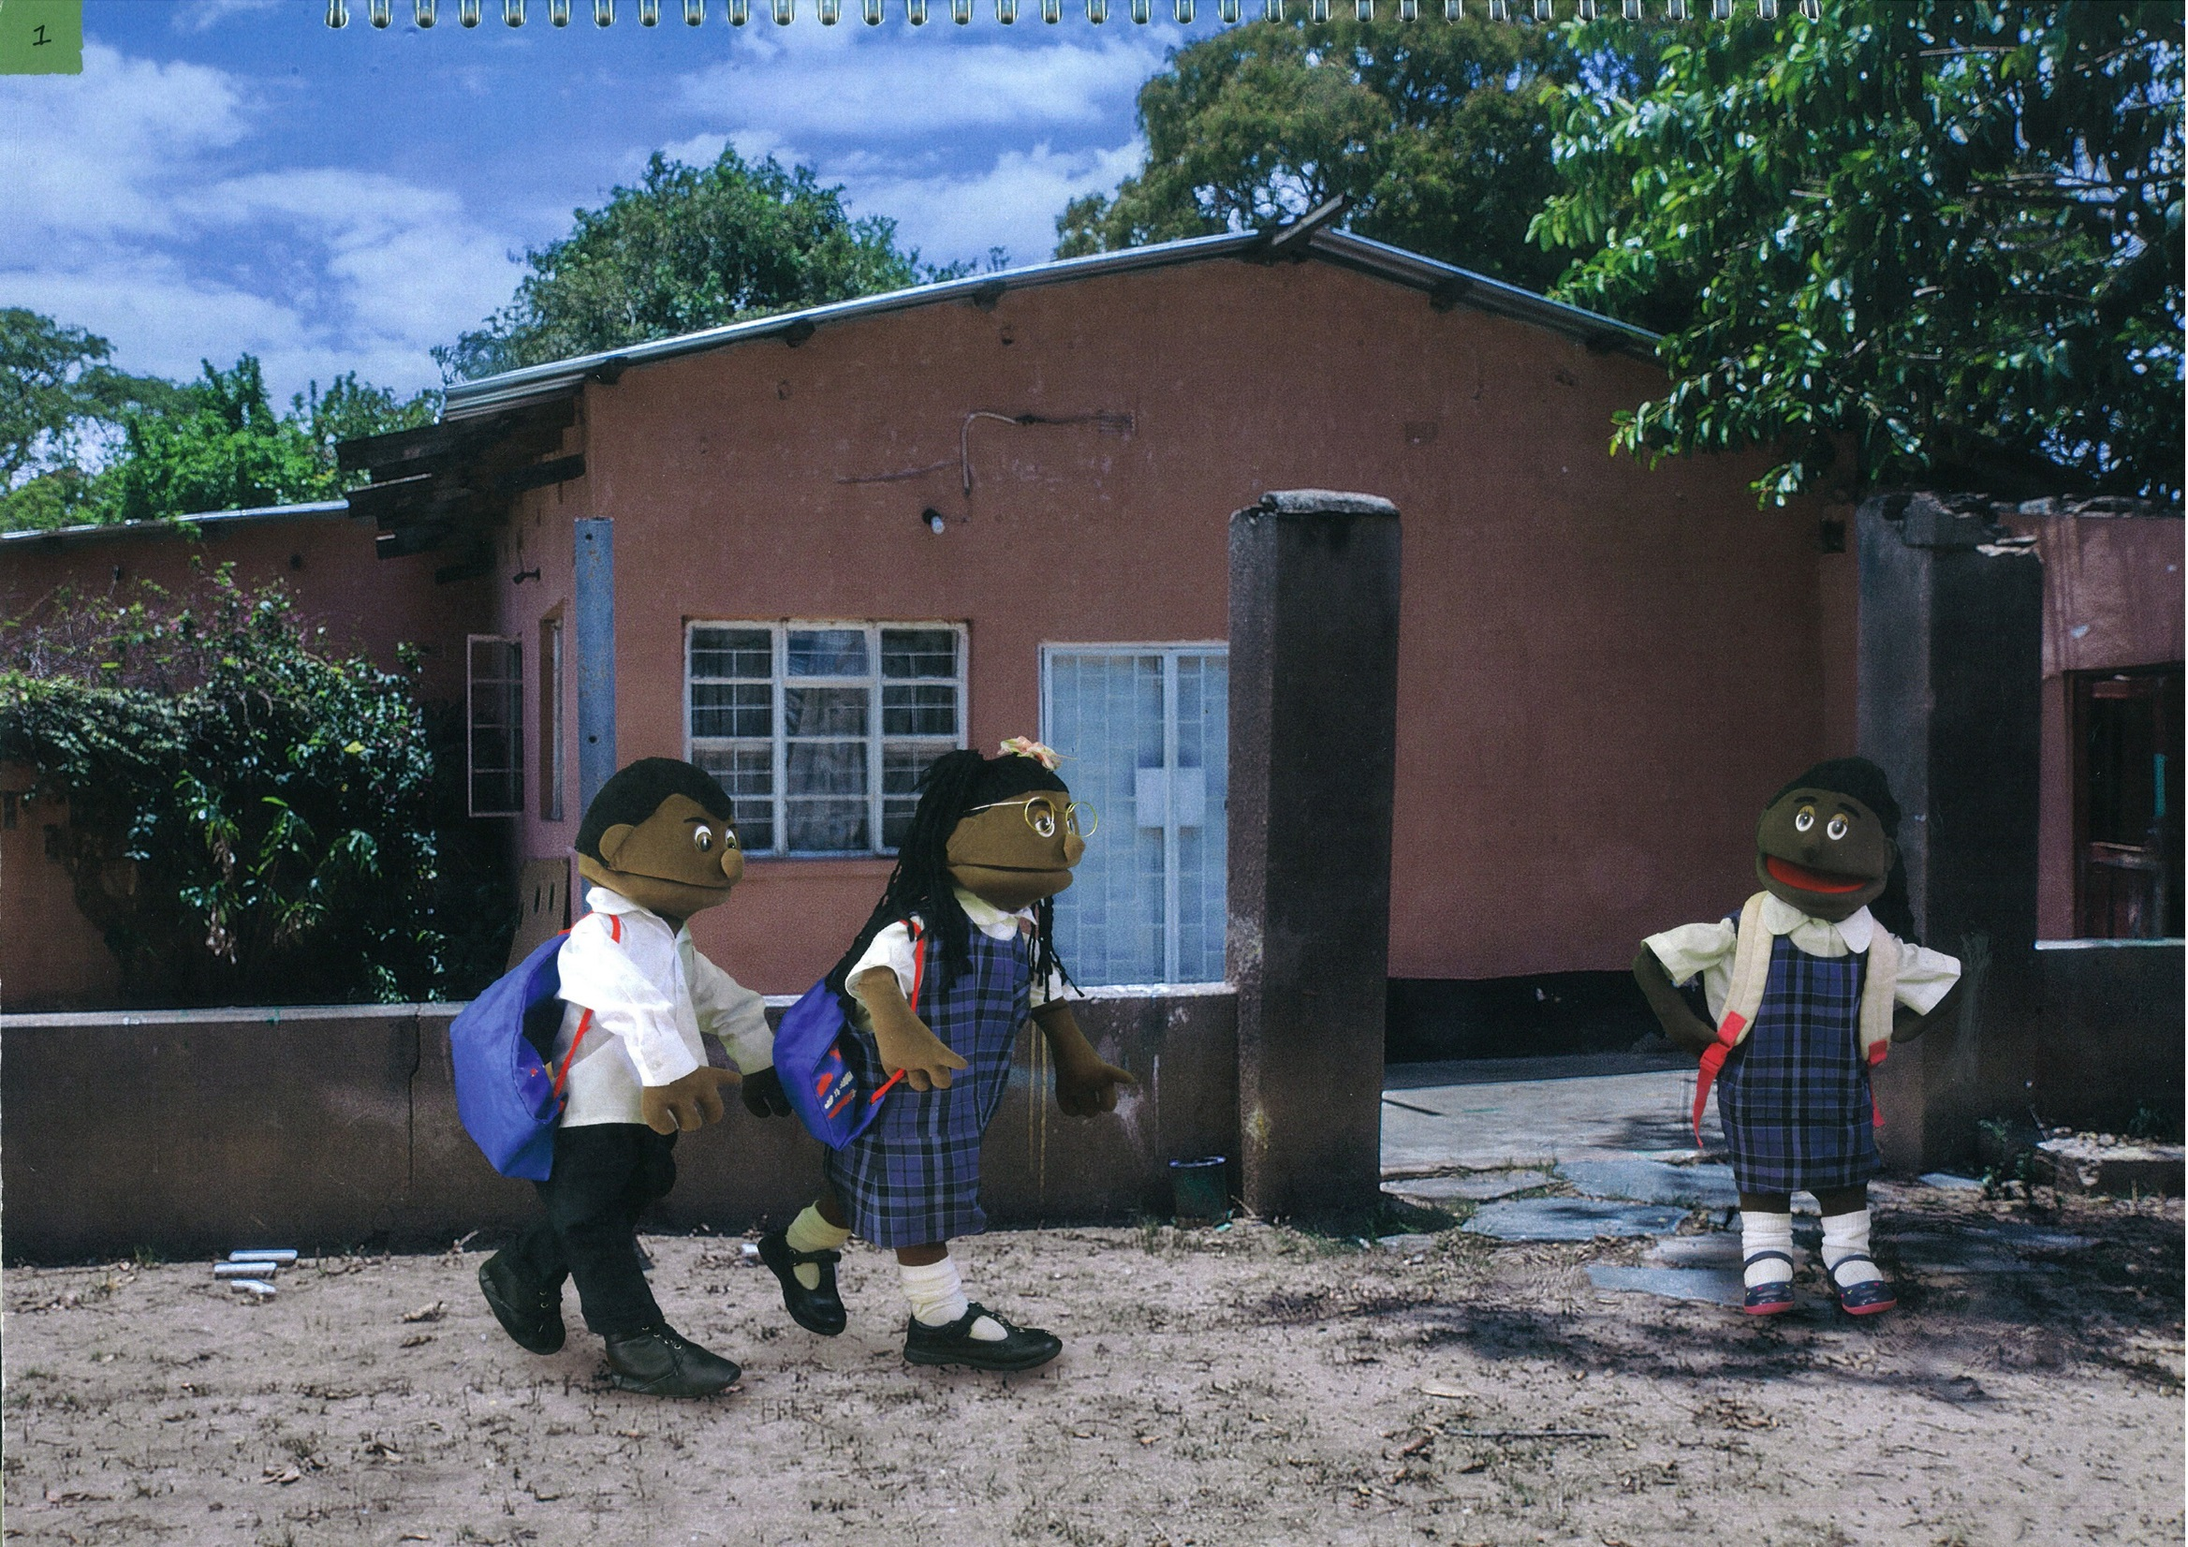

Slide 3
Picture 1: Friendship
Story:
This is the story of three friends, Precious, Gift and Mercy. They all live in the same community and are in the same class at school. One day, just like every day, Precious and her brother Gift walk to Mercy’s house to pick her up and walk to school together.
Discussion
Answers
Suggestions for Facilitator
Friendship is very important in our communities. Helping each other strengthens our friendships.
How can children help each other?
How can they be a good friend like Nary and Nak?
Children can help each other by:
Ask the children what other things they and their friends often need help with and what they do in their community and at school to help each other.
Going to school together.
Explaining to friends
when they don’t
understand something at school.
Letting the teacher know
if someone is sick or in
need.

Slide 4
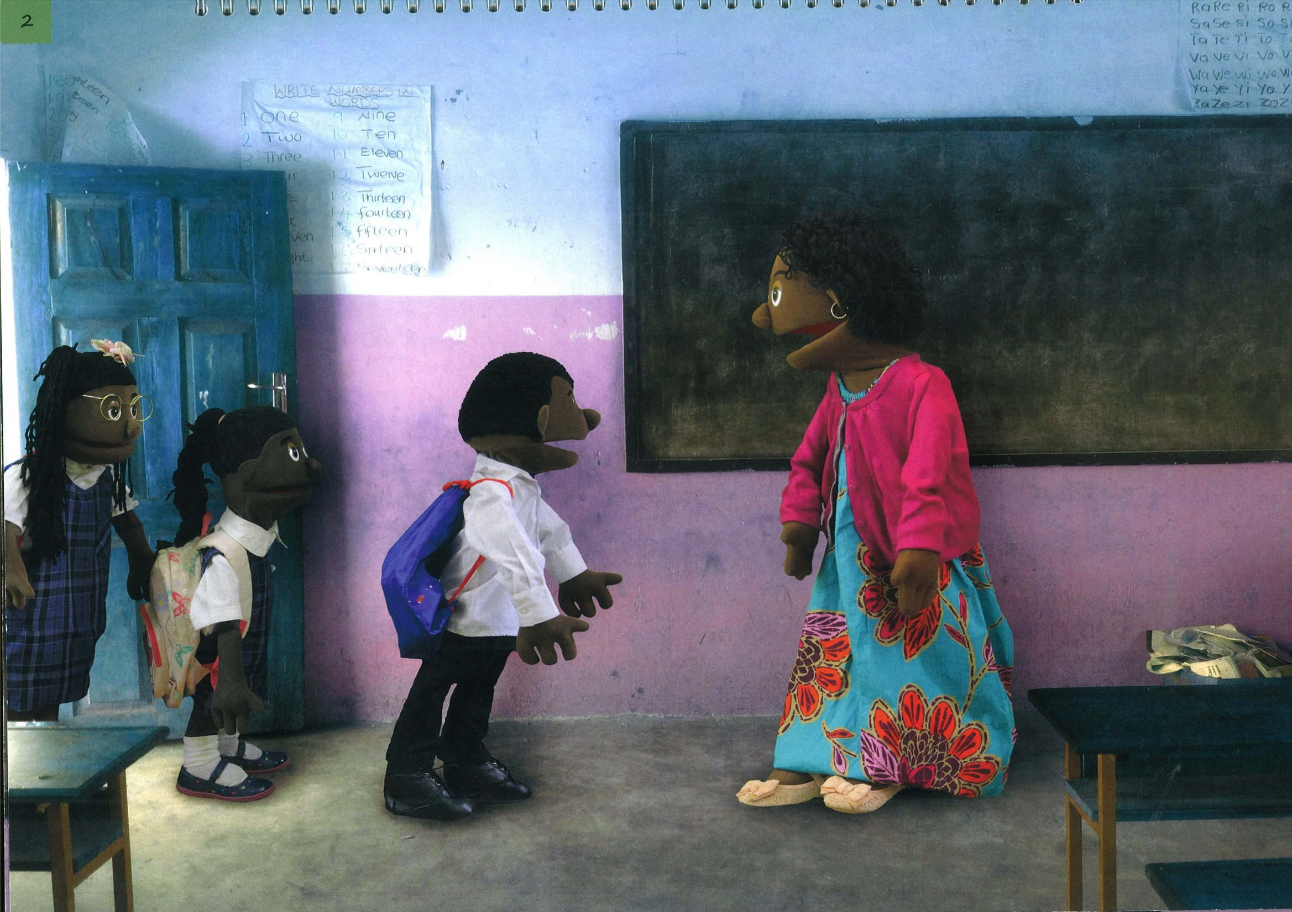

Slide 5
Picture 2: School.
Story:
When Precious, Mercy and Gift arrived at school their teacher greeted them just like every day. She was a good teacher and they all liked her. That morning she told the class that they would be learning four important messages so they needed to listen and pay attention.
Discussion
Answers
Suggestions for Facilitator
Make the point that:
Good students listen to their teachers.
Every child has the right to a good education for a good future.
Why do children have to listen to their teacher?
Children need to listen to their teacher:
To do well in class.
To learn important lessons in life.
And also say how important it is that:
Good teachers listen to their students.

Slide 6
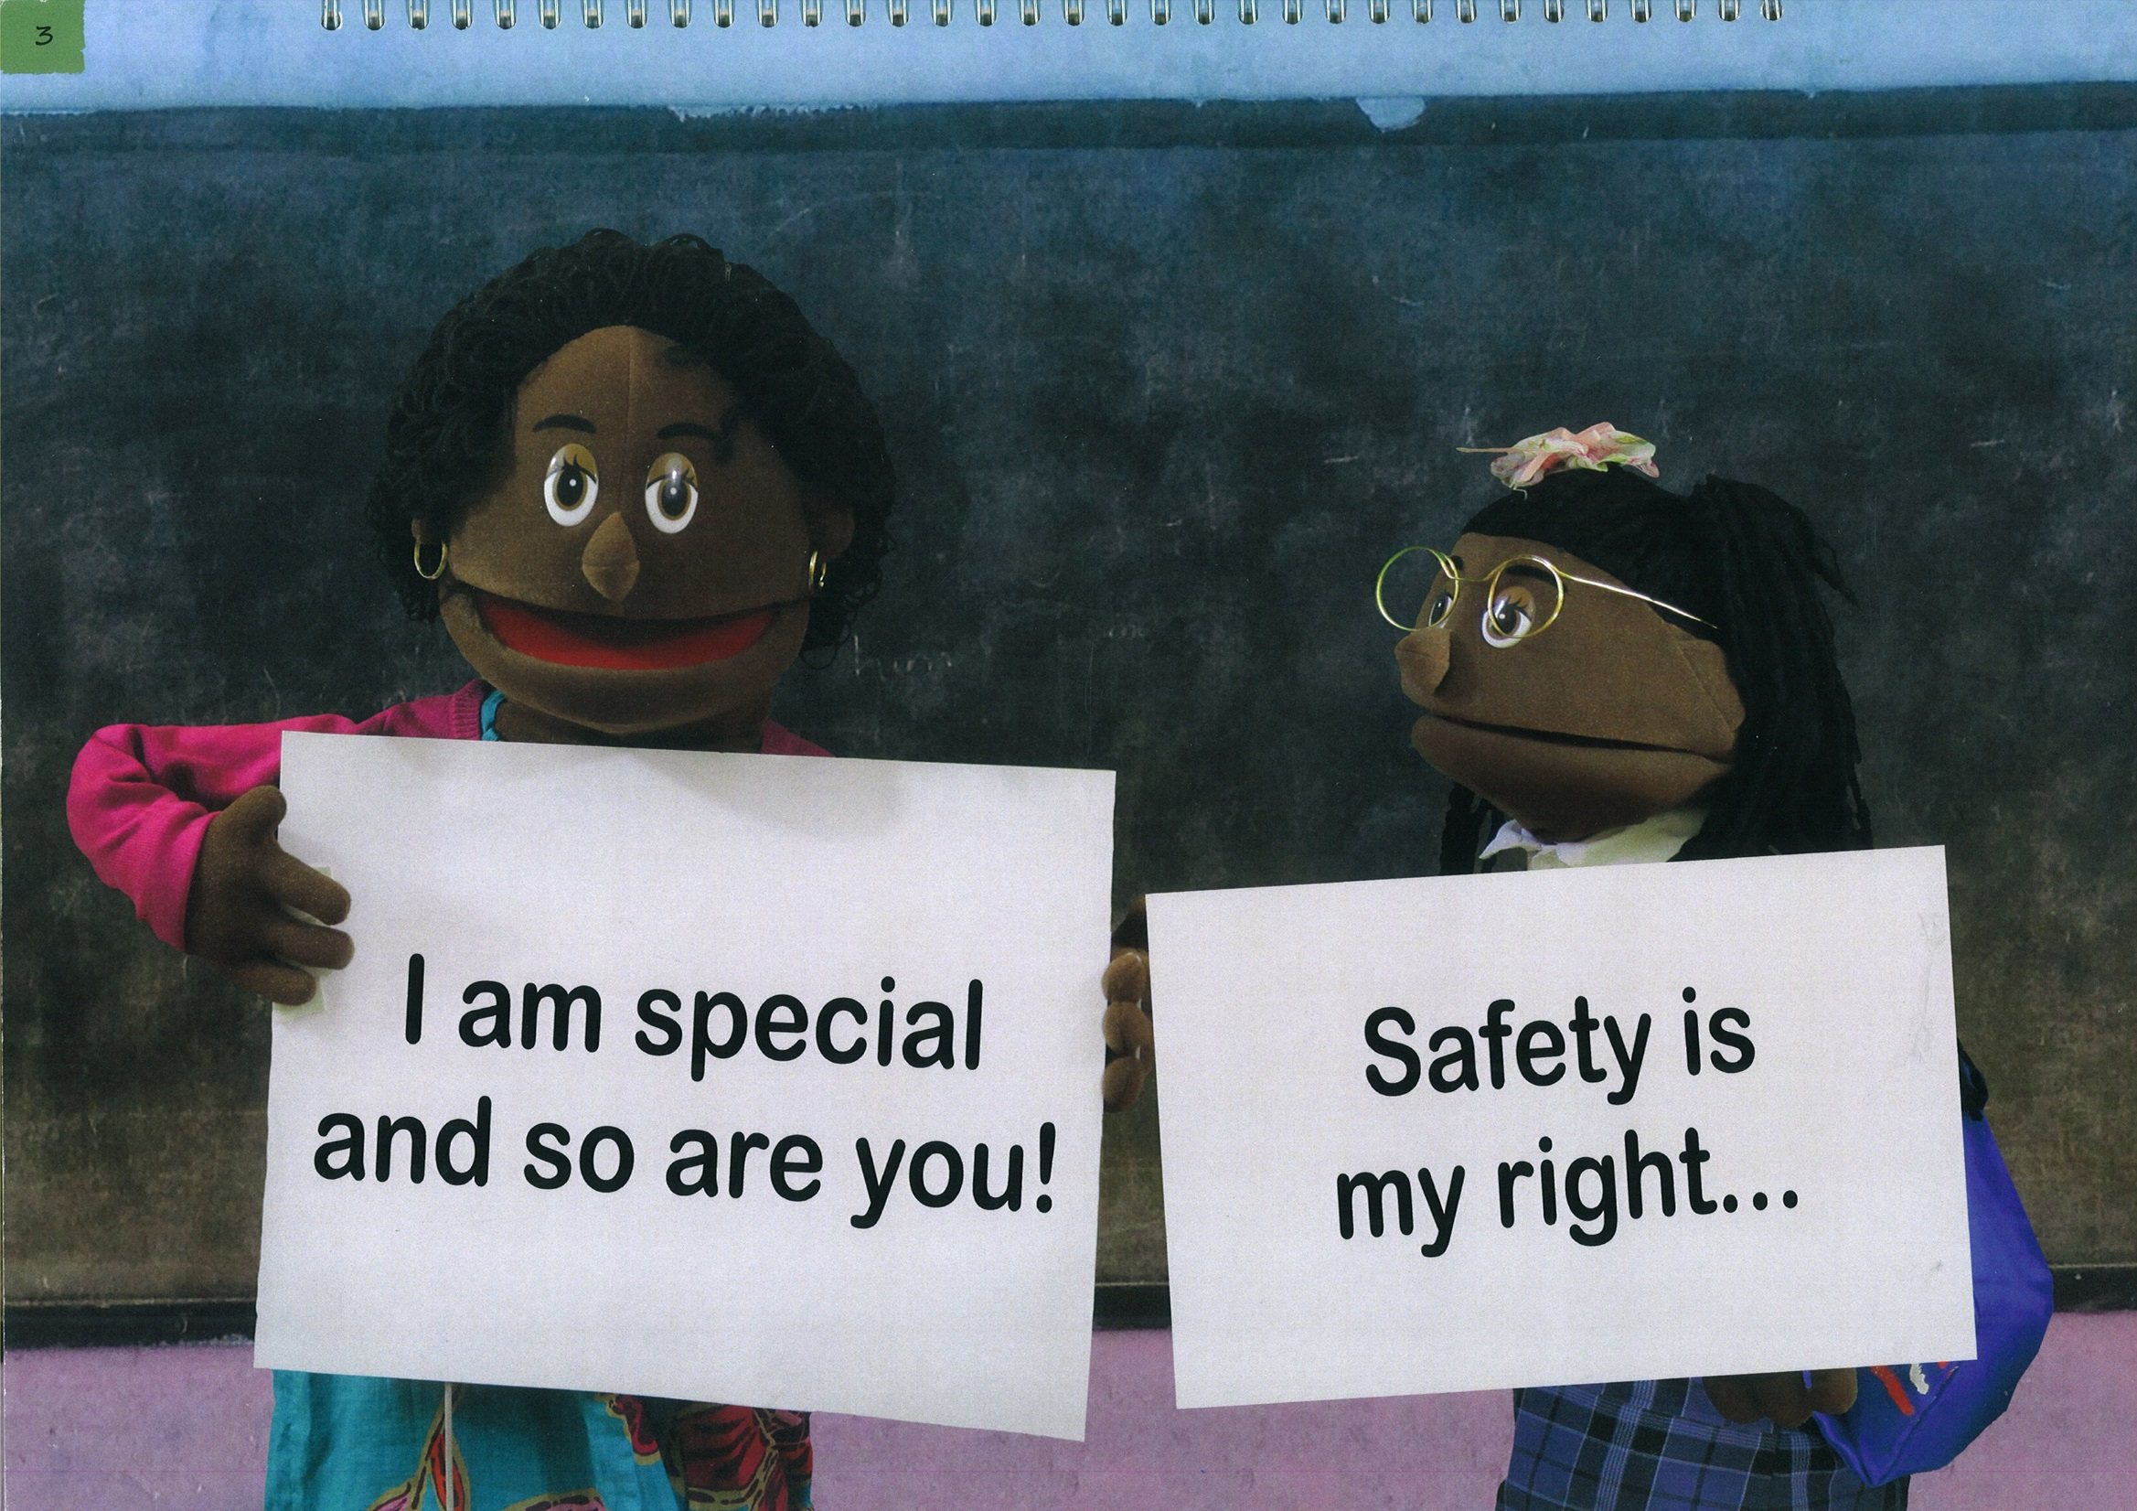

Slide 7
Picture 3:
Message 1 and Message 2
Story:
Then the teacher explained that the four messages would help them understand why they need to look after themselves and how to keep safe. First she held up the first message which said: “I am special and so are you!” And then Precious helped her hold up the second message which said: “Safety is my right”
Discussion
What is Message 1?
What does the message mean?
What is Message 2?
What does the message mean?
Answers
Message 1: You are special!
Whoever you are and wherever you come from, you are special!
It doesn’t matter if you are poor or rich, dark or light, able or disabled, you are special!
Message 2: Safety is my right!
You have the right to say no
when someone asks you to do something that feels unsafe.
For example, if someone asks you to climb up a tree, dive into water, go somewhere remote or do something dangerous you can say no because these things are not safe.
Suggestions for Facilitator
Message 1:
Get the children to say together:
“I am special (and so are you)!”
Ask them what they will say if someone mocks them:
“I am special (and so are you)!”
And why they shouldn’t mock others because they are valuable too:
“I am special (and so are you)!”
Message 2:
Explain to the children that if they are asked to do something that feels unsafe they need to say:
“No!! Safety is my right.”
Get the children to say together:
“Safety is my right!!!”

Slide 8
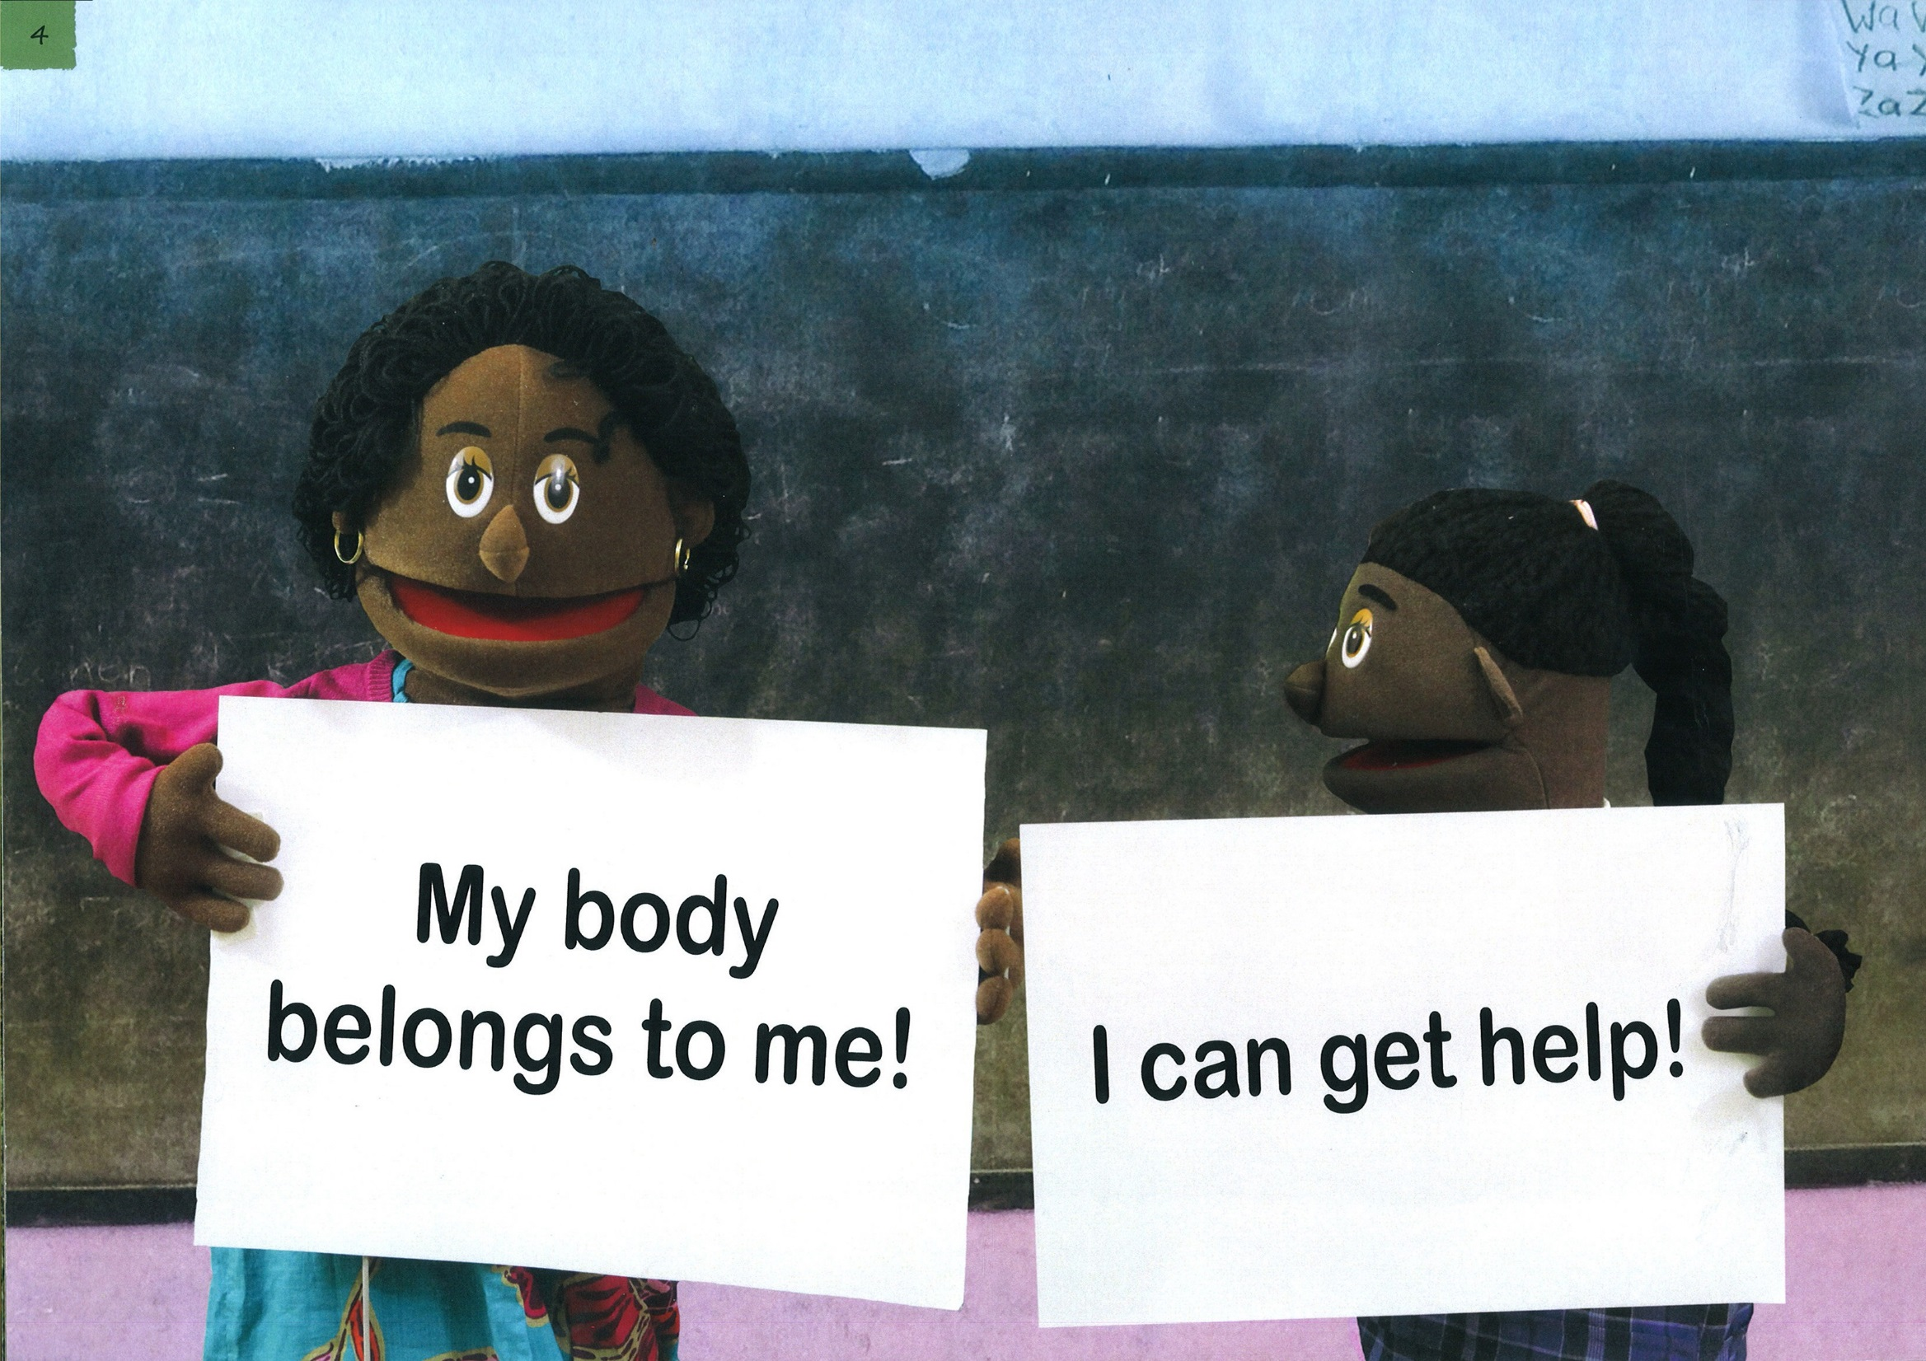

Slide 9
Picture 4:
Message 3 and Message 4
Story:
Mercy was next and helped the teacher hold up the third message which said:
“My body belongs to me!” Finally, the teacher held up the fourth message which said: “I can get help!”
Discussion
Answers
Suggestions for Facilitator
What is Message 3?
What does the message mean?
What is Message 4?
What does the message mean?
1. Message 3 - My body belongs to me!
2. No one can touch you without you
agreeing to it. Your body belongs to you and no one can tell you to do something with it that you don’t agree with.
Message 3 –
Get the children to say together: “My body belongs to me.”
Say to the children that there is a difference between good touch and bad touch which we will look at in more detail on the next page.
Message 4 - “I can get help!”
If we are forced or threatened to do something, we need to remember NOT to keep these a secret. We can
get help by telling our parents,
other relatives, village leaders, teachers or the police or call the free Child Helpline on 116.
Message 4 -
Get the children to say together:
“I can get help!!!”
Ask the children where they can get help.

Slide 10
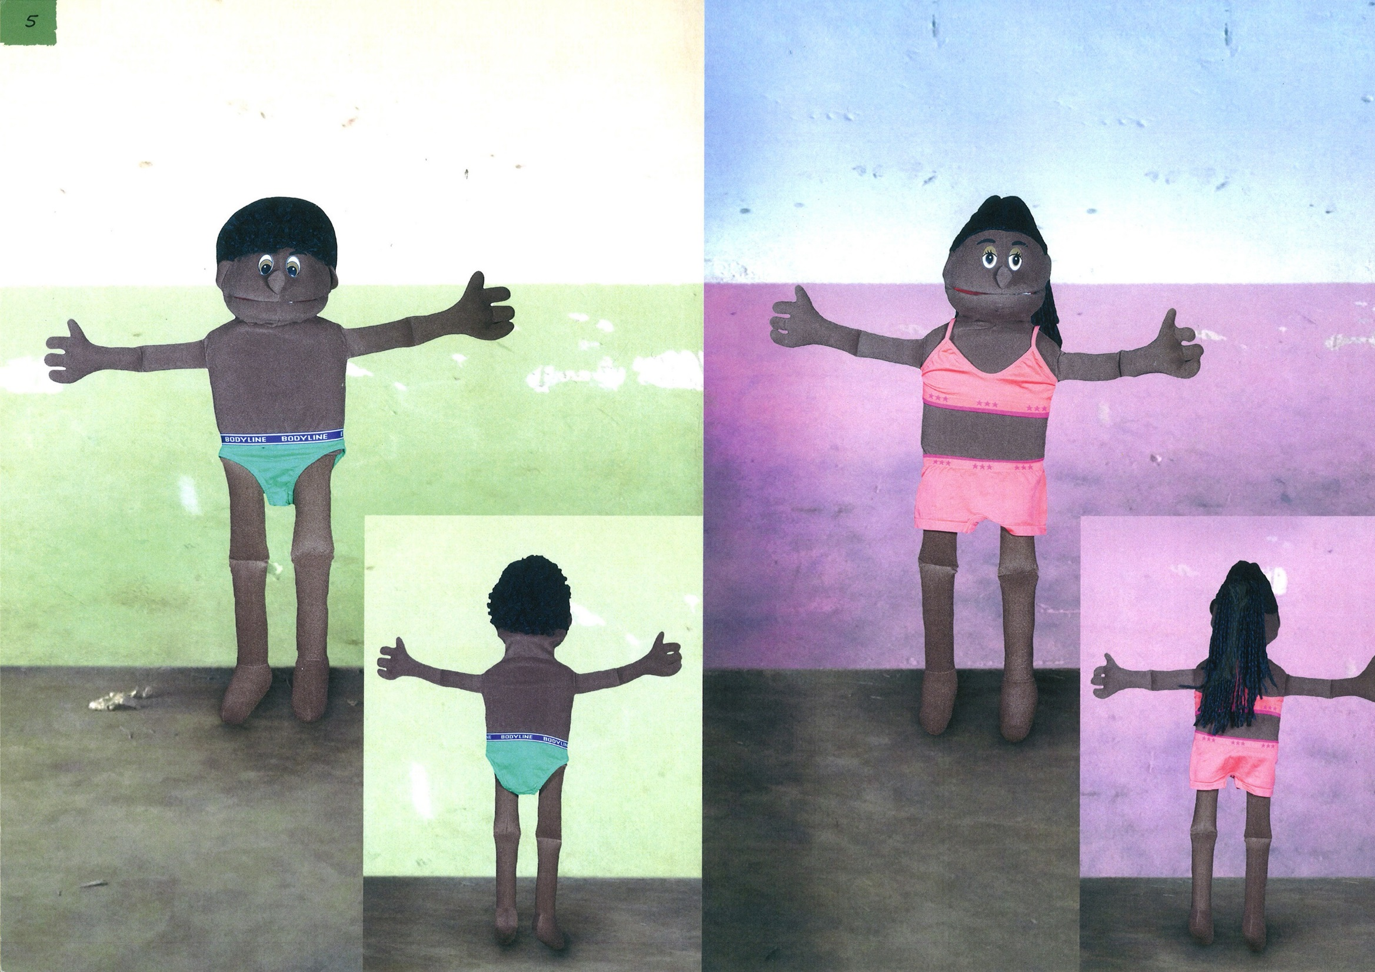

Slide 11
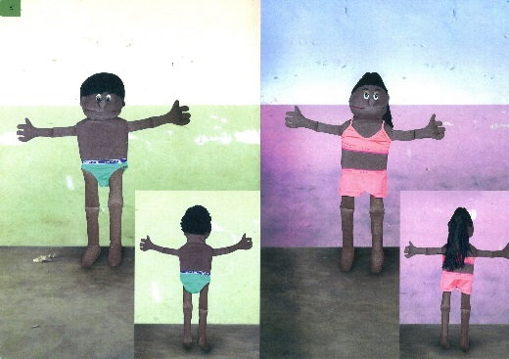
Picture 5: Good touch and bad touch
Story: Now we are going to look at which areas where it is OK to be touched and where it is not.
Discussion
Answers
Suggestions for Facilitator
1. Boys –
Where is it OK to be touched and not OK to be touched?
What are private parts?
1. It is not OK to be touched on the areas that are usually covered.
It is OK when someone pats you on the shoulder or when the doctor examines you when your parent is with you.
2. Girls –
Where is it OK to be touched and not OK to be touched?
2. It is not OK to be kissed on the mouth.
But it is not OK when someone touches you on your private parts or anywhere else on your body in a way that makes you feel uncomfortable.

Slide 12
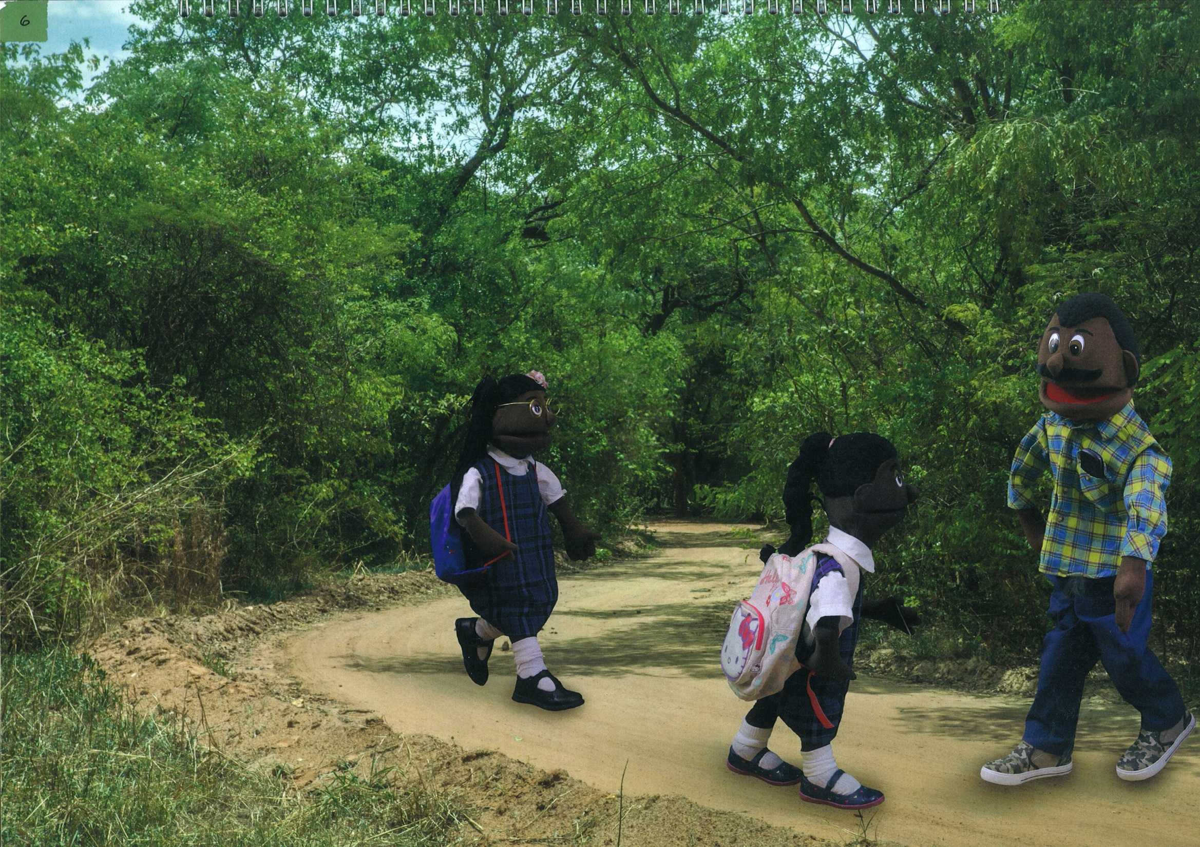

Slide 13
Picture 6: The Neighbor
Story:
Later on their way home from school, Mercy and Precious met Mr. Banda. They knew him from the village but he had never spoken to them before so they were surprised when he stopped to talk to them.
Discussion
Answers
Suggestions for Facilitator
Can we tell if someone is a good or bad person just by their appearance?
1. No, we cannot tell a person’s character by their appearance.
Explain to the children that sometimes they need to be careful. Although most adults are kind, friendly and helpful, there are some adults who are not safe.
Sometimes an adult can
appear to be friendly but really they are trying to trick a child into doing something that is unsafe for them.

Slide 14
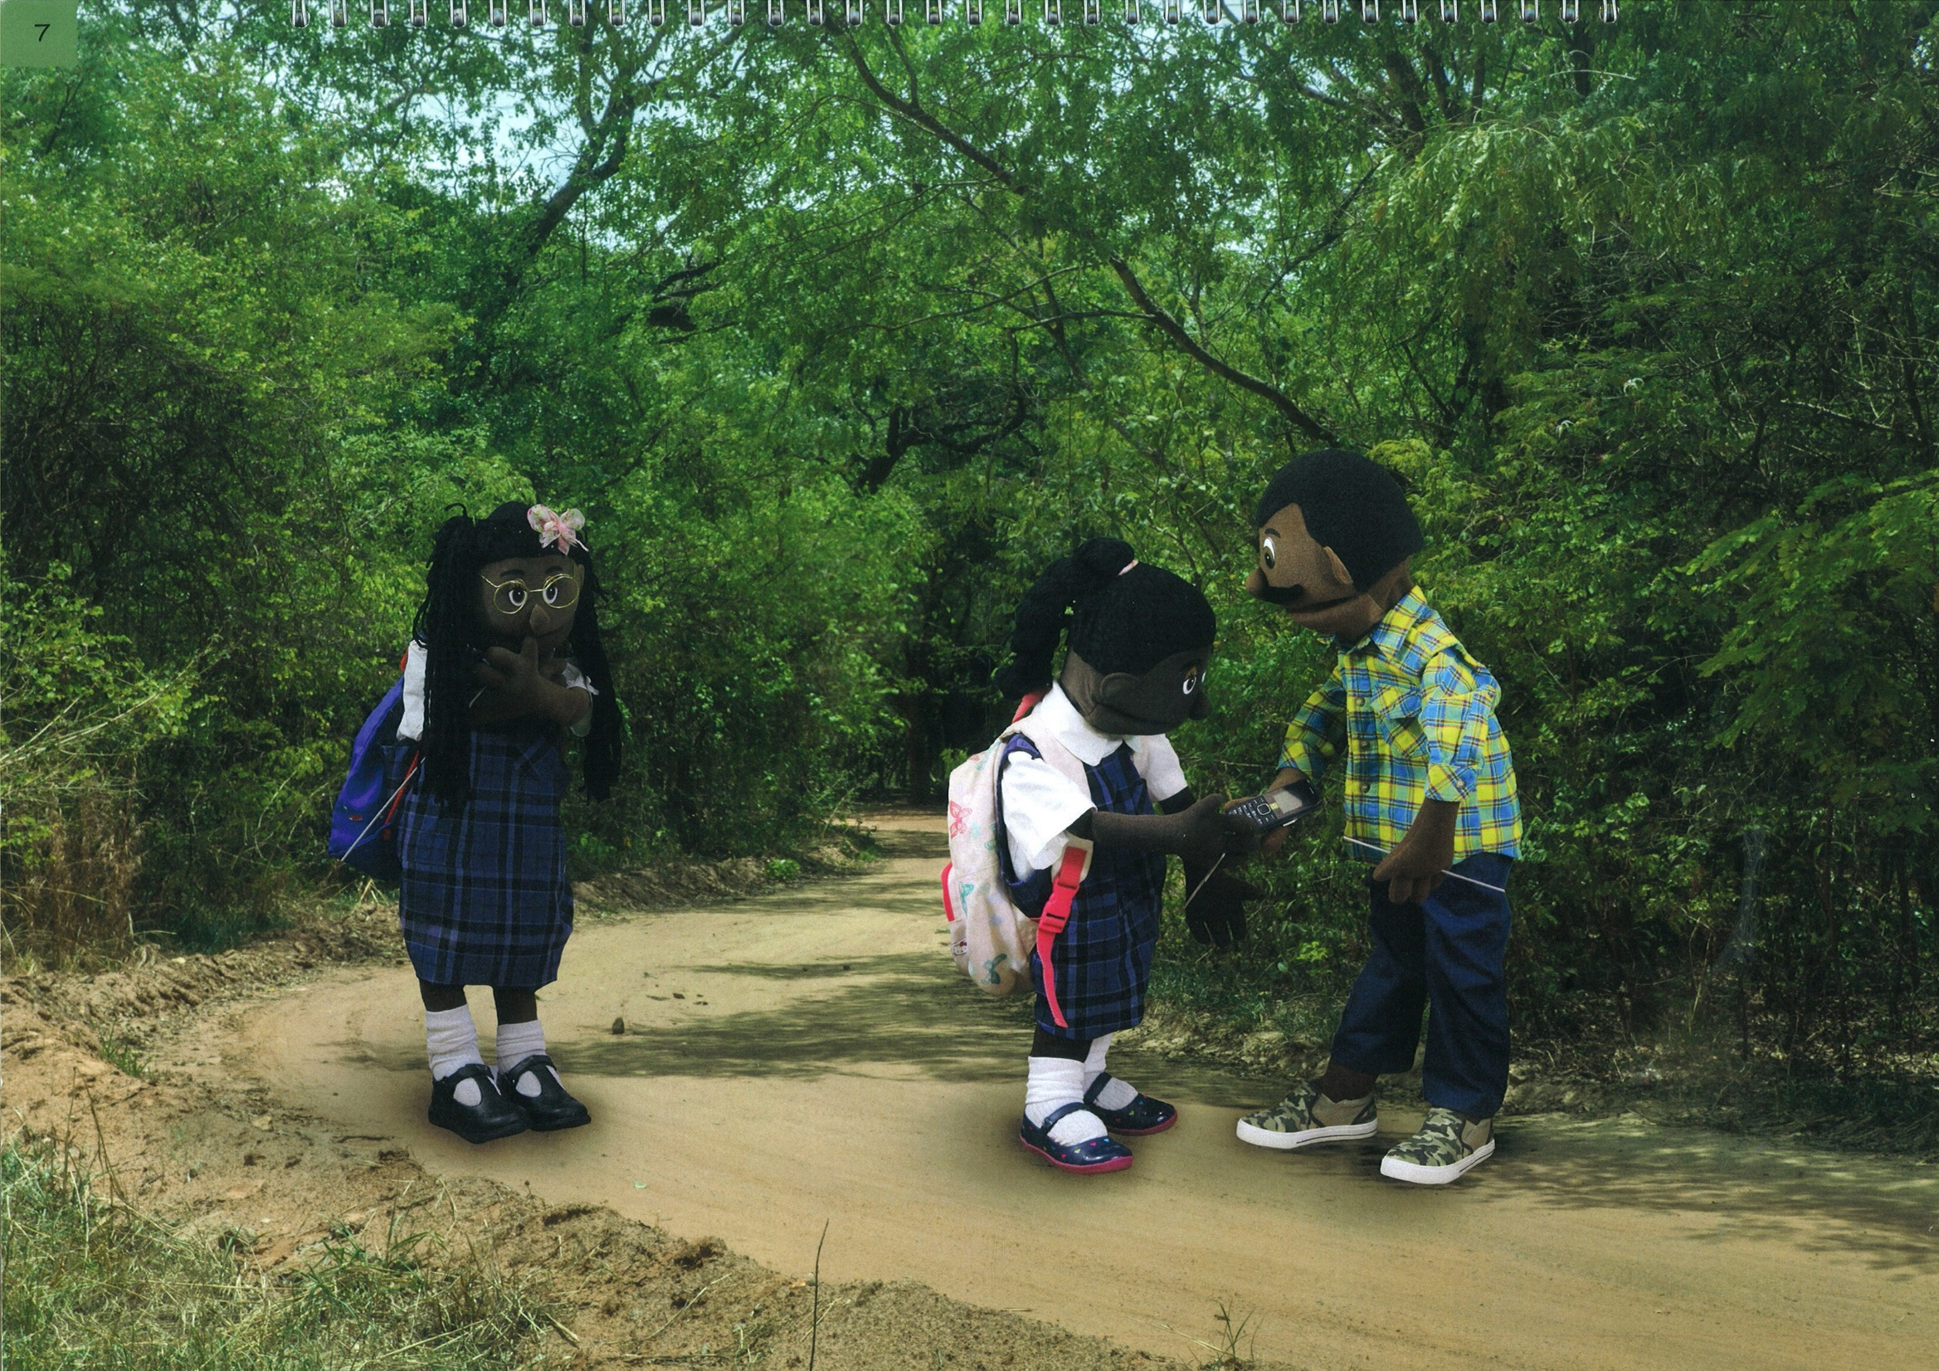

Slide 15
Picture 7: Feeling unaccepted
Story:
As they chatted, the man showed Mercy the new phone he’d just bought in the market. But he didn’t seem to notice Precious so she just stood on her own looking at the two of them.
Discussion
Answers
Suggestions for Facilitator
How do you think Precious was feeling?
What key message did she forget?
1. Precious felt sorry for herself because Mr. Banda was not showing her a phone, not giving her any attention. Also lonely, unaccepted and poor.
- Remind the children that every child is special in their own way.
- Talk to them about ways that they might feel insecure about themselves
and remind them that they are special anyway.
2. She forgot Message 1:
“I am special and so are you!”

Slide 16
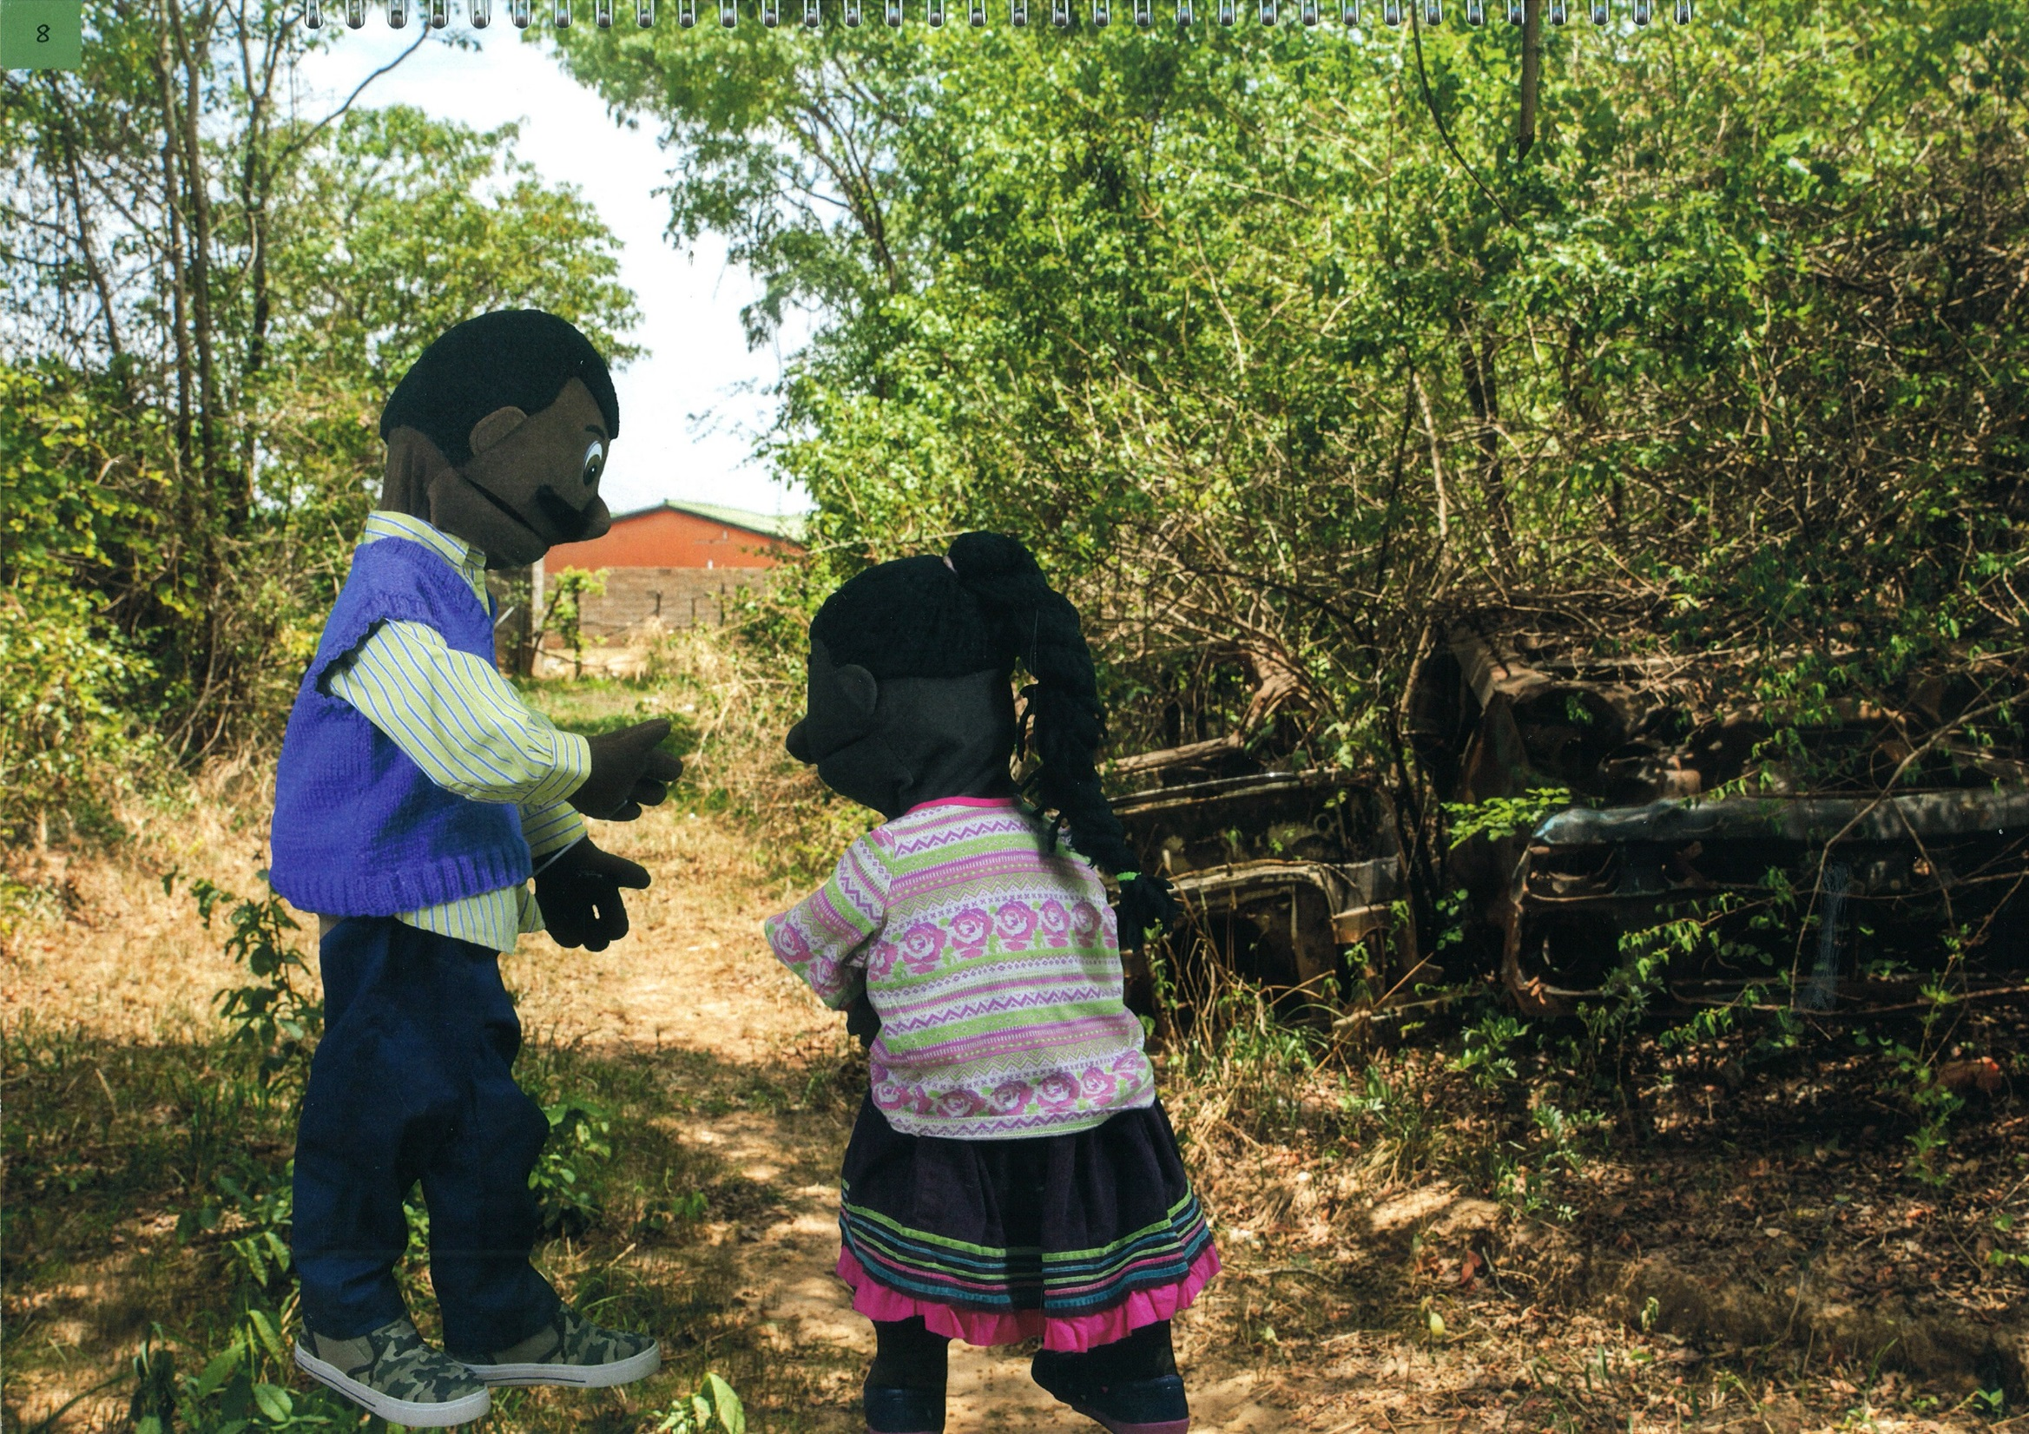

Slide 17
Picture 8: Unsafe
Story:
The next day Mercy saw Mr. Banda near her house. He asked her to follow him on a shortcut to the market. He offered to buy her a lollypop. Her mum did not have money to buy her a lollypop. Mr. Banda seemed like a very kind man.
Brainstorming Questions
Answers
Suggestions for Facilitator
What kind of danger could Mercy be facing?
Which of the key messages had Mercy forgotten?
It is unsafe to go with someone somewhere without informing a parent or carer.
Mercy had forgotten the key message:
“Safety is my right!”
Ask the children what Mercy could have done when Mr. Banda invited her to follow him on a shortcut to the market. Say that he could have said:
“No! Safety is my right!”
Invite the children to say the key message together: “Safety is my right!”

Slide 18
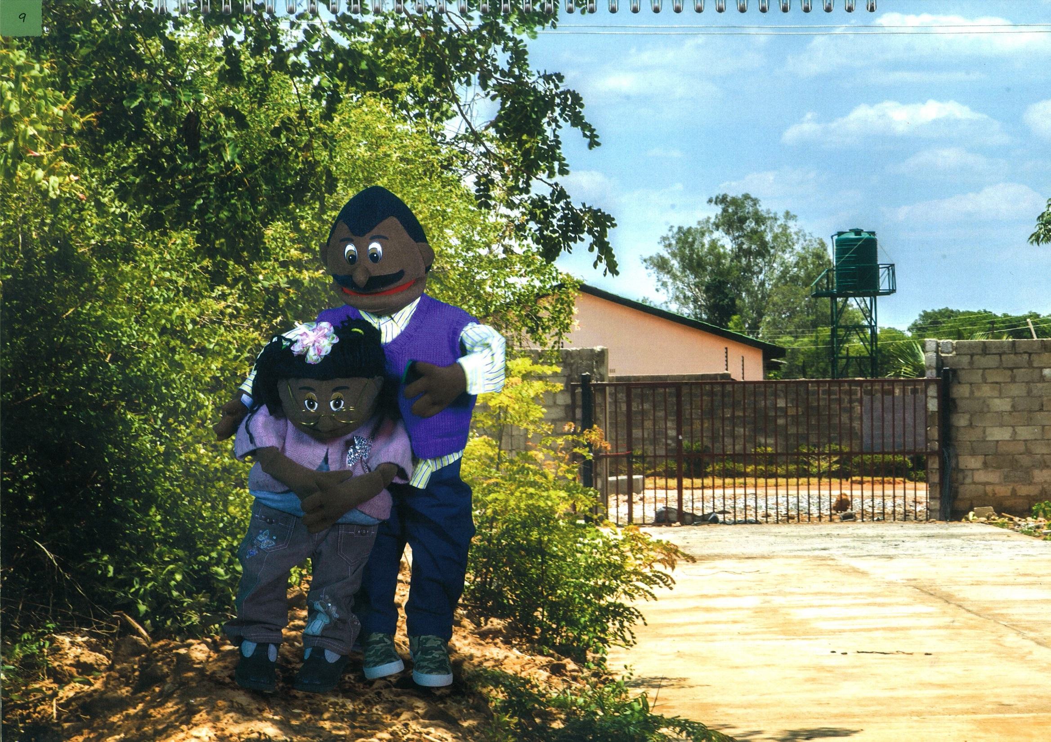

Slide 19
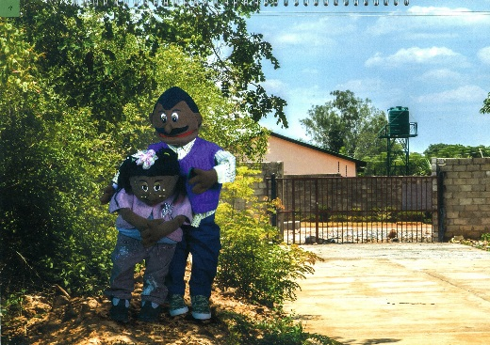
Picture 9: Precious
Story:
Later that day Mr. Banda went to see Precious near her home. She was surprised to see him after he had ignored her the day before. This time though he was very friendly and offered her a mobile phone before hugging her closely. Precious felt pleased about the phone but did not feel comfortable when he hugged her.
Discussion
Answers
Suggestions for Facilitator
Why did Precious feel uncomfortable after Mr. Banda offered to show her his phone?
Mr. Banda gave her the phone to trick her so he could touch her body. What other things can adults use to trick children?
Which key message did Precious forget?
He hugged her closely/ touched her body.
Money, clothes, jewelry
Precious forgot Message 3: “My body belongs to me!”
Ask the children what they would do if someone tried to give them something and they felt it might be a trick.
How would they respond to that person? What would they say?
Get the children to say together:
“My body belongs to me!”

Slide 20
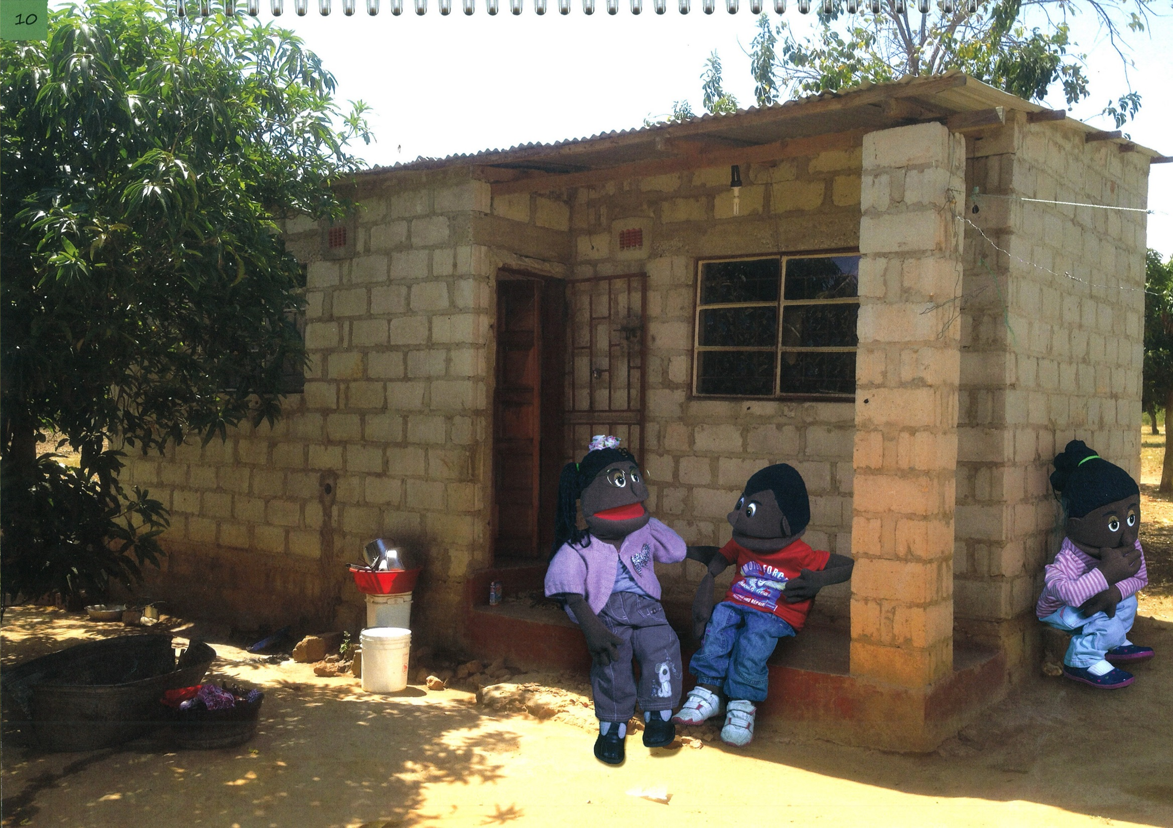

Slide 21
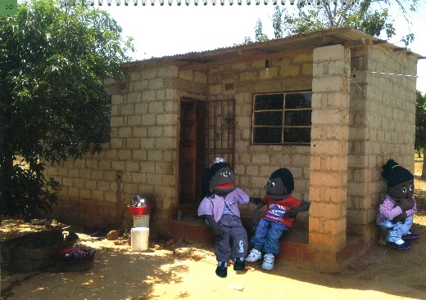
Picture 10: Precious is unhappy.
Story:
Later that day Precious told her brother, Gift, about Mr. Banda’s visit and how he had hugged her after giving her the mobile phone. She was not happy about it and felt scared in case he tried to touch her again.
Discussion
Answers
Suggestions for Facilitator
Why is Precious unhappy?
What message did Precious forget?
Discuss with the children why Chan feels unsafe and who else she should tell about Mr. Banda.
Ask them if they would tell other people if something similar happened to them.
Say to the children that if they get a feeling that someone is touching them and it might lead to something worse, they must tell someone as soon as possible so that it can be stopped.
Make it very clear that it wasn’t Precious’s fault that Mr. Banda touched her, even though she forgot the message.
Because she felt uncomfortable when Calib hugged her and now she feels unsafe.
Precious forgot Message 2:
“Safety is my right!”

Slide 22
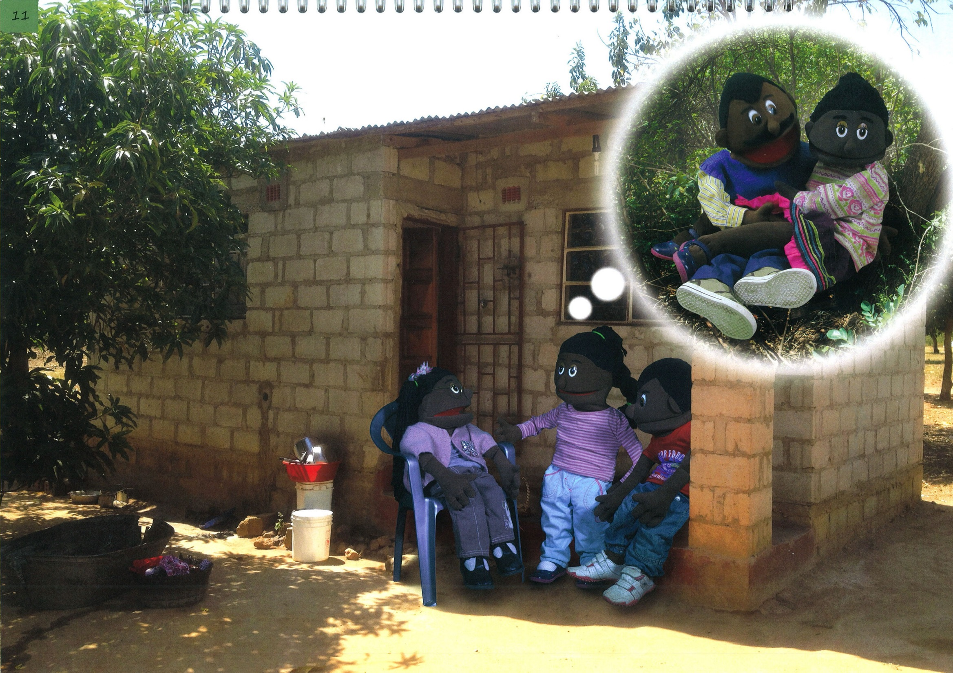

Slide 23
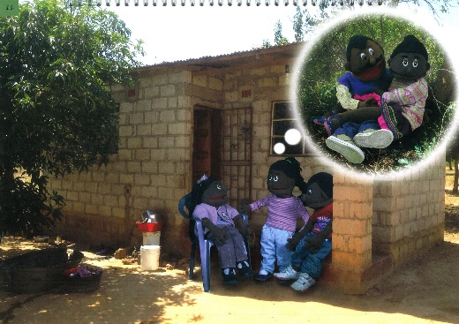
Picture 11: Precious describes what happened to her
Story:
Whilst Precious was talking to Gift, Mercy was hiding behind the wall. She had been feeling unhappy too so when she heard Precious’ story, she came out from behind the door and told Precious what had happened to her after she had gone for walk with Mr. Banda.
Discussion
Answers
Suggestions for Facilitator
What happened to Mercy?
How do you think Nak feels?
Mr. Banda touched her private parts.
Sad, guilty, scared, embarrassed, anxious.
Remind the children that it is not Mercy’s fault that Mr. Banda touched her private parts.
Say that Mercy did the right thing in telling his friends. Now they can seek help together.

Slide 24
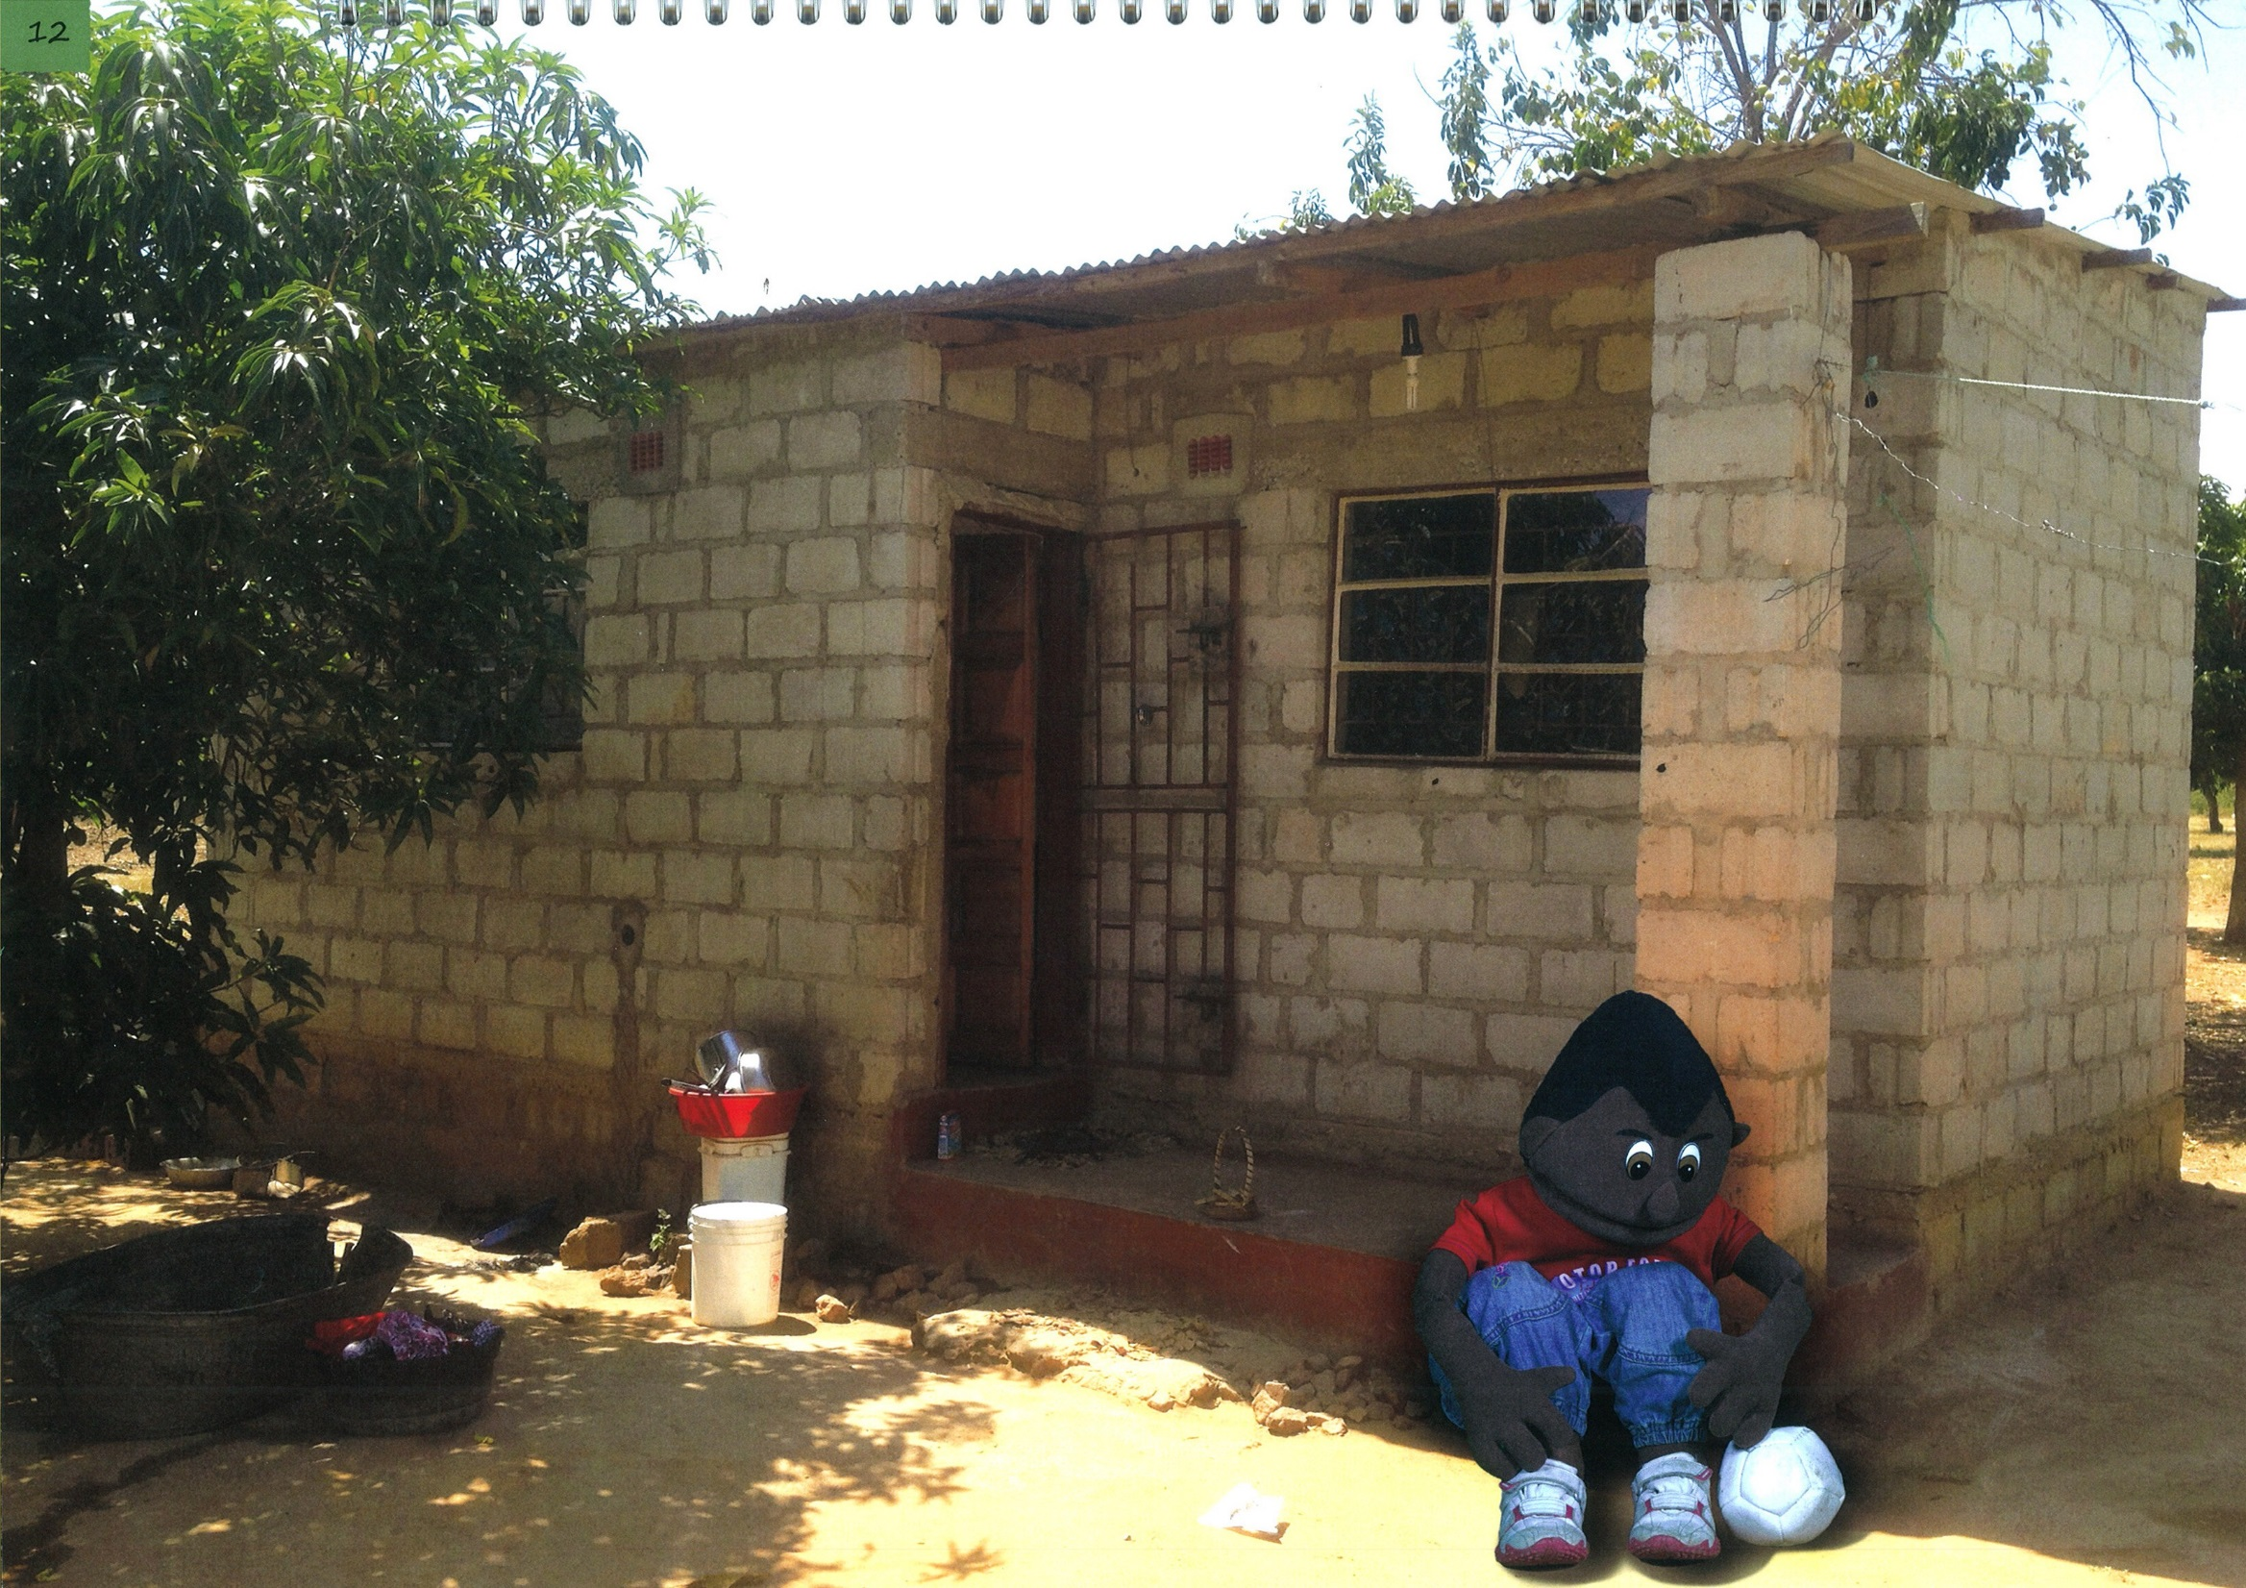

Slide 25
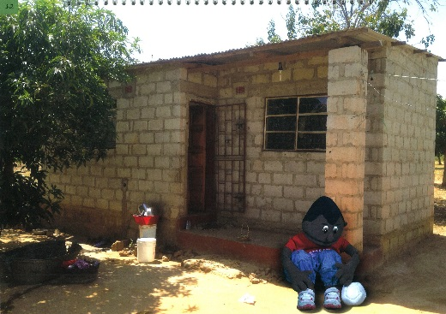
Picture 12: Gift worries about his situation
Story: Gift was upset when he heard both their stories. What Mr. Banda did was wrong. It made her think that if he had touched Mercy on her private parts and touched Precious in a wrong way too, he might do the same to other girls and maybe even boys.
Discussion
Answers
Suggestions for Facilitator
Ask the children what key message Mercy, Precious and Gift need to remember. Get the children to say together:
“I can get help!”
Ask them what they think Mercy, Precious and Gift should do now: Inform a safe adult.
If the abuse had happened to Mercy and is happening to Precious, could it happen to Gift too?
Yes, it could happen to Gift as well.

Slide 26
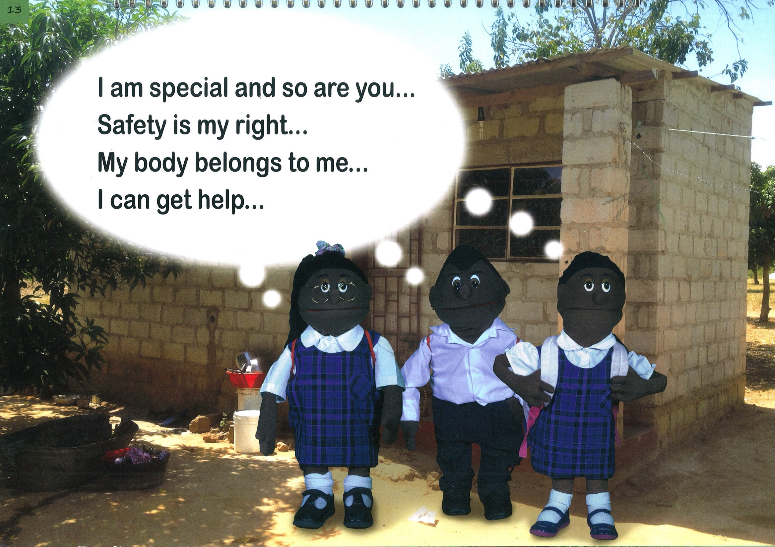

Slide 27
Picture 13: Remembering the key messages Story:
After talking, Mercy, Precious and Gift remembered the messages they had learnt at school and wished they hadn’t forgotten them when they met Mr. Banda. But even though Mercy had already been touched on her private parts, she knew she could still seek help. And even though Precious had already been touched in a bad way, she knew she could still get help. And even though Gift was only worried about being touched, he knew it was still right for him to seek help.
Discussion
Answers
Suggestions for Facilitator
What were the four messages the children remembered?
- I am special and so are you!
Safety is my right!
My body belongs to me!
I can get help!
Discuss with the children what they would do if they were in a situation like Precious, Mercy and Gift
Tell the children they can get help by informing their parents, other relatives, teachers, village leaders or local authorities or by calling 116.

Slide 28
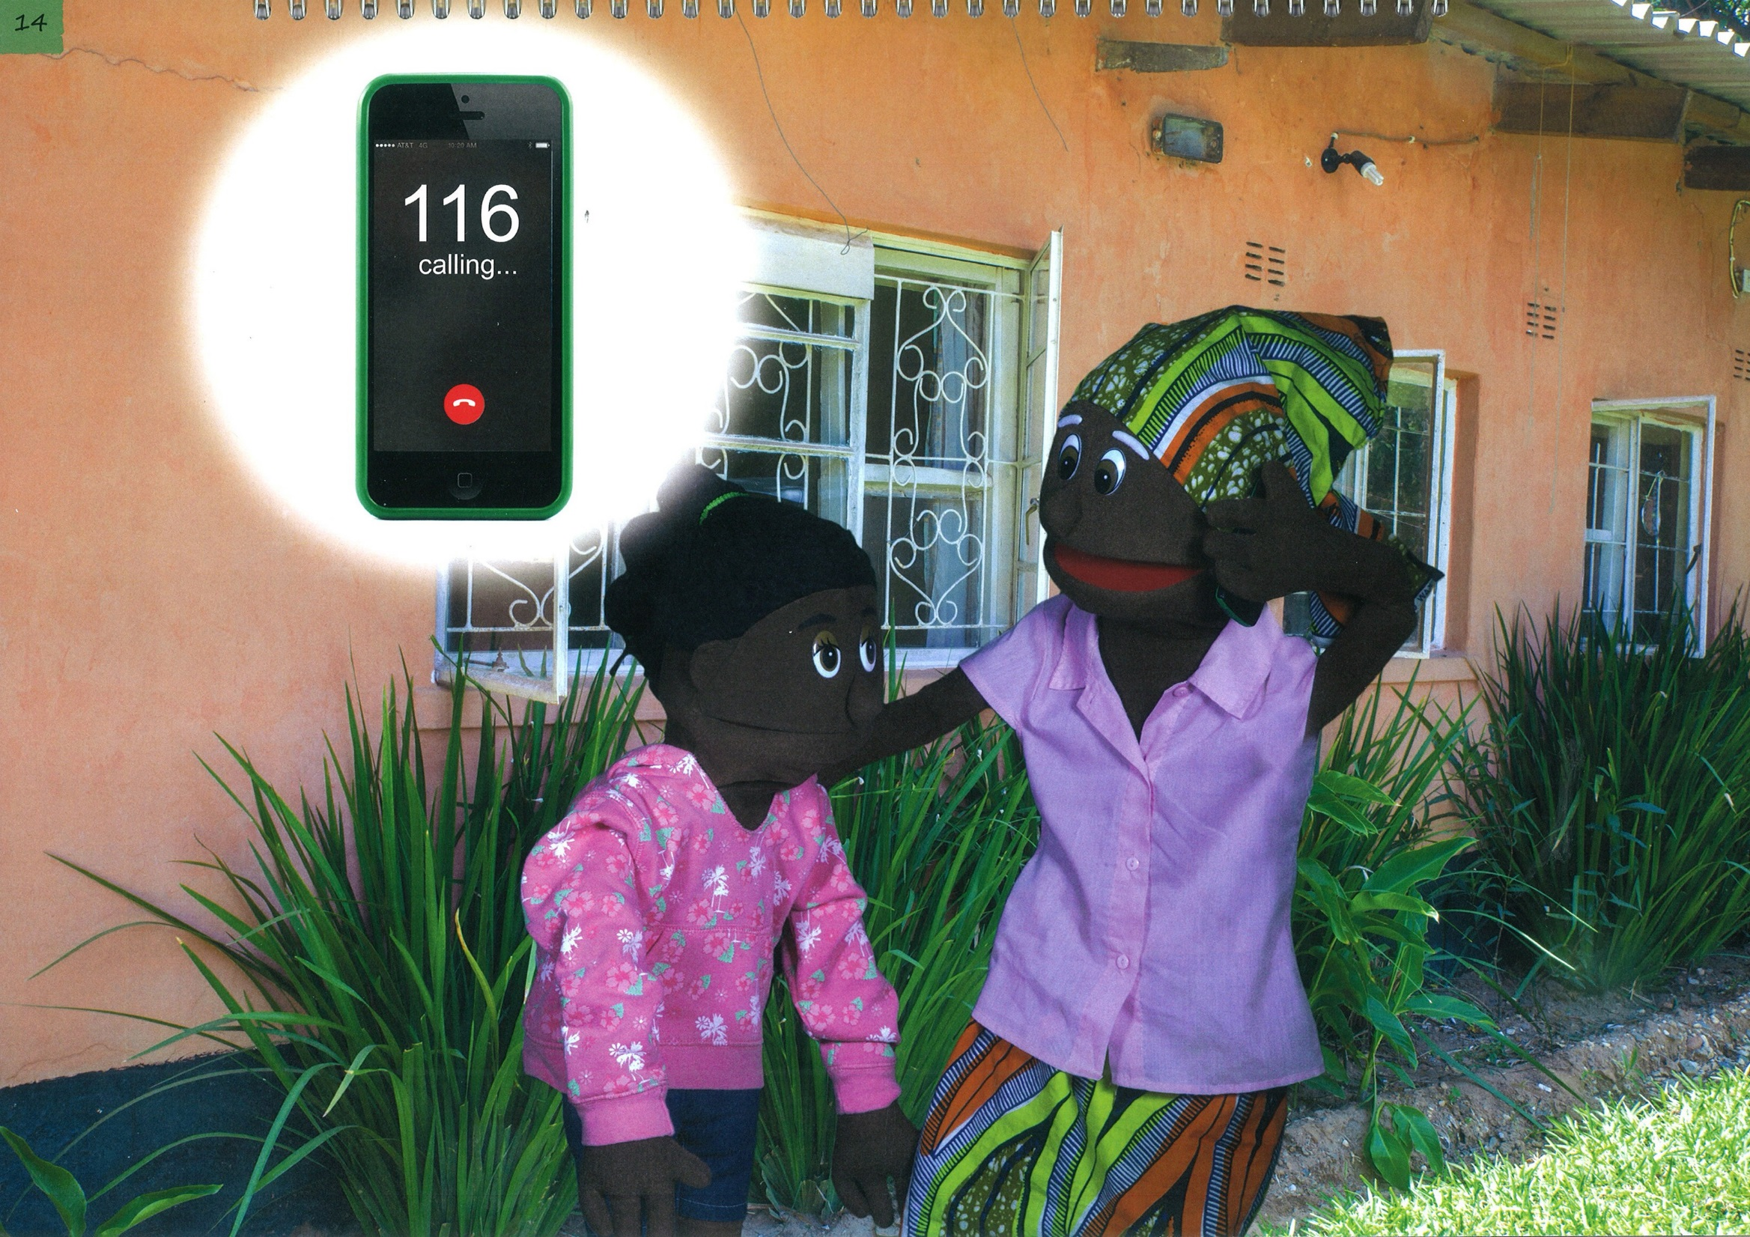

Slide 29
Picture 14: Taking Action
Story: Mercy told her grandmother about Mr. Banda and together they called the free Child Helpline number.
Answers
Key message 4: I can get help!
Mercy is calling the free Child Helpline number where she can get help.
The number is 116.
Suggestions for Facilitator
Here are some actions to help us remember the Child Helpline number and the four key messages:
I am special (hold finger up for number one)
Safety is my right- for me (point at me)
I can get help I can think of up to 6 people who I can contact if I feel unsafe or are afraid, for example: Mum, Dad, Uncle, Aunt, older brother, older sister, village leader and teacher (count on fingers from 1 to 6).
My body belongs to me. No-one can touch me without my permission (dance and move your body).
Discussion
What key message was used?
What is Chan doing and why is she doing it?
What is the number she is phoning?

Slide 31
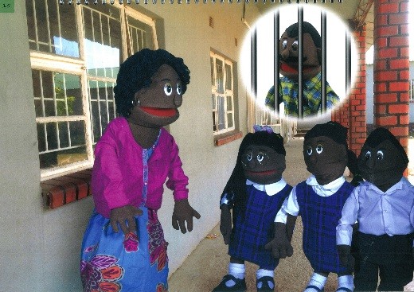
Picture 15: Implementation of Key Messages
Story:
After Mercy had called Child Helpline, Precious, Mercy and Gift also spoke to their teacher and their teacher told the police what had happened. Then the police arrested Mr. Banda.
Discussion
Answers
Suggestions for Facilitator
Calib had to go to prison to keep Precious, Mercy and Gift safe.
Tell the children that no one should go unpunished for attempted abuse or sexually abusing children. If it happens to them or a friend of theirs, they must get help. Even if they are not believed the first time, they need to keep looking until they get help.
What happened when they looked for help?
What happened to the person who tricked them?
People helped them.
The person who tricked them was punished.

