Slide 1
A DECADE OF SURVIVOR VOICES
Butterfly Longitudinal Re/integration Research Project
Chab Dai Coalition

Slide 2
A DECADE OF SURVIVOR VOICES
Butterfly Longitudinal Re/integration Research Project
Chab Dai Coalition

Slide 3
ABOUT THE PROJECT
Beginning in 2010
128 Survivors Recruited from 15 NGOs
2010:
13 Shelters
2 Community Based Programmes
2019
high level of programmatic diversification
7 Shelters Programmes
8 Community Based Programmes
3 Vocational Training Programmes
13 Publications so far

Slide 4
PROJECT’S CORE OBJECTIVES
1. Actively engage a single cohort of survivors of exploitation and trafficking over a 10 year project about their life experiences, challenges, and perceptions towards service providers
2. Facilitate roundtable discussion, forums, and workshops with anti-trafficking partners and stakeholders on findings, themes, and recommendations
3. Disseminate the findings of publications to global, regional, and local audiences of practitioners, programmes, policy makers, government bodies and academics

Slide 5
ETHICAL PROTOCOLS
Ministry of Health’s National Research Ethics Committee Annual Review
Referral-Based Services
Active Listening to Participants leading to advice on services from NGO partners
Voluntary Participation
No monetary incentives
Participants willing to answer or not answer any contact or questions of the Project
Confidentiality
No pictures and media
Data management
Secure interviews
Researcher never alone with participants

Slide 6
SELECTION CRITERIA
Experienced sex trafficking defined in the UN’s 2000 Polermo Protocol.
From and re/integrating back to one of five main provinces throughout Cambodia; Phnom Penh, Siem Reap, Battambang, Kampong Som, Kampong Cham.*
From NGOs who agreed to sign MoUs with the Butterfly Project that work in Aftercare for human trafficking survivors.
*Participants ended up moving across the country, requiring the team to travel extensively to conduct interviews

Slide 7
ATTRITION
Year | Active partici-pants | Lost from study (running total) | Inactive partici -pants | # of participants provided interview | M | F
2012 | 128 | 0 | 12 | 116 | 20 | 96
2013 | 128 | 0 | 20 | 108 | 17 | 91
2014 | 128 | 0 | 40 | 88 | 15 | 73
2015 | 106 | 22 | 16 | 90 | 16 | 74
2016 | 94 | 34 | 1 | 93 | 18 | 75
2017 | 93 | 35 | 8 | 85 | 16 | 69
2018 | 91 | 37 | 12 | 79 | 14 | 65
71% of Original 128 Remain Active in Study
70% of the Boys
68% of the Girls
Stopped Participating because…
Stigma of Anti-trafficking NGOs
Jailed
Fleeing Debt
Move out of Country
Court Case in the West
Repatriation to Vietnam
Illegal Work in Thailand
Married Foreigner
Chronic Illness
Drug Addiction
Suicide

Slide 8
52 QUANTITATIVE LONGITUDINAL PARTICIPANTS
Responded to all quantitative longitudinal survey questions in years 2012, 2013, 2017, and 2018.
This is the base cohort for this morning’s presentation

Slide 9
ABOUT THIS PRESENTATION
This is a quantitative summary of data has been collected from 52 Butterfly participants from 2012-2018
This presentation cannot represent:
All sexually exploited individuals in Cambodia nor the original 128 participants
All of the experiences recorded throughout the 10 year Butterfly Project
It can show patterns that help us to consider how we can improve policy and programming
To benefit the most from this research, it is necessary for all stakeholders to read through our publications.
Find all of Buttefly’s Reporting (KH & ENG) on our website www.chabdai.org/butterfly

Slide 10
DEMOGRAPHICS

Slide 11
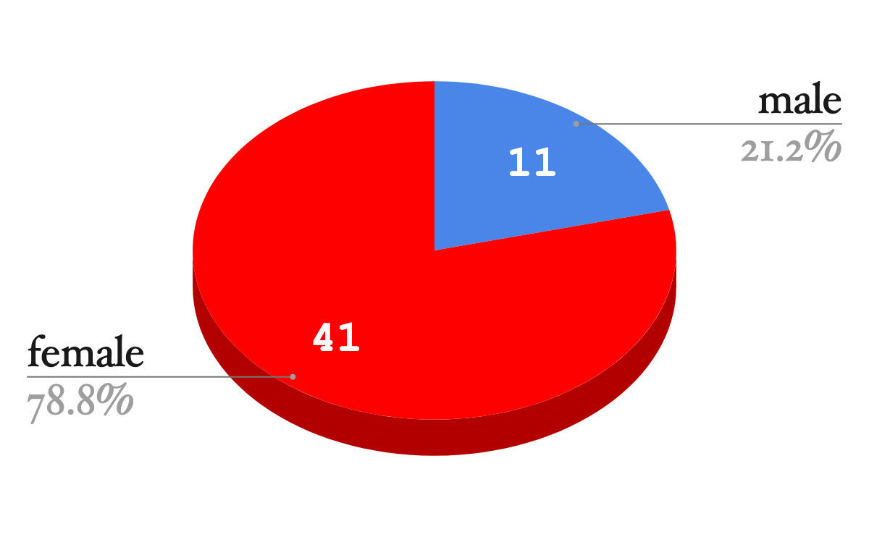
GENDER

Slide 12
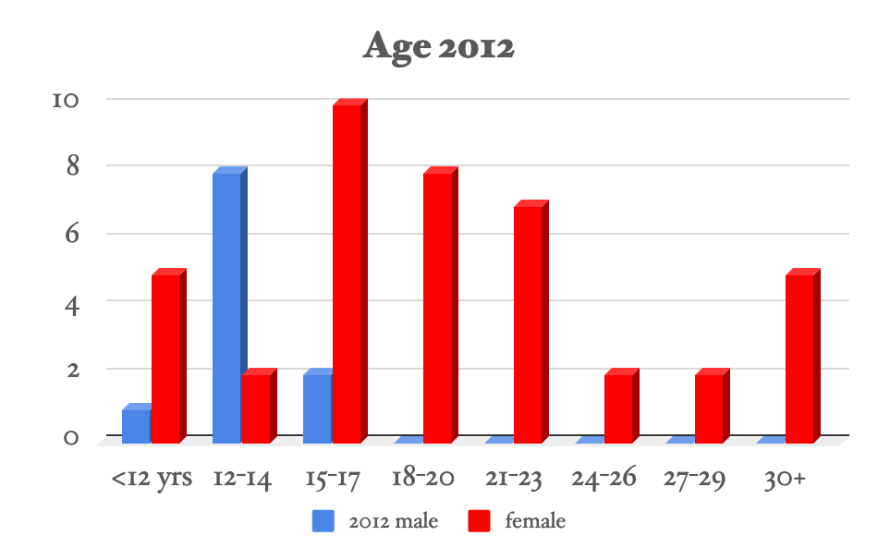

Slide 13
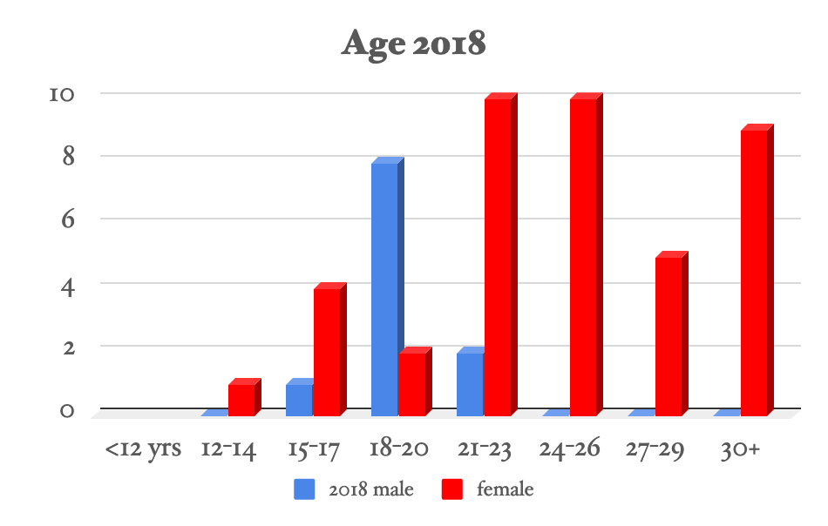

Slide 14
Aftercare Program Services at Time of Interviews |  | Year of Data Collection
 |  | 2012 | 2018
 | Shelter | 33 | 2
 | Declined Assistance | 1 | 4
 | Non-Residential Vocational Training | 2 | 0
 | Shelter Reintegration Assistance | 2 | 4
 | Community-Based Program | 10 | 8
 | Family Group Home | 3 | 0
 | Reintegration Completed | 1 | 32
 | Church Assistance | 0 | 2
Total |  | 52 | 52
2012: 33 Participants in Shelters located in PP, BTB, & SR
2018: Two of the Respondents in Community-Based Programming ended up Declining Assistance specifically because of their experience with the NGO

Slide 15
MOBILE COHORT
Location of Residence |  | Year of Data Collection
 |  | 2012 | 2018
 | Banteay Meanchey | 0 | 1
 | Battambang | 3 | 4
 | Kandal | 0 | 1
 | Koh Kong | 0 | 3
 | Phnom Penh | 41 | 24
 | Siem Reap | 8 | 9
 | Kompong Som | 0 | 5
 | Svay Rieng | 0 | 3
 | Takeo | 0 | 1
 | Oddar Meanchey | 0 | 1
Total |  | 52 | 52
41 Participants were in Phnom Penh in 2012
This number is almost halved by 2018 with most of the participants now living in 9 provinces other than Phnom Penh

Slide 16
RESULTS & LESSONS LEARNED

Slide 17
ETHNICITY
 | Self-Reported Ethnic Group | 2012 | 2013 | 2017 | 2018
 | Ethnic Cambodian | 40 | 40 | 47 | 45
 | Kampuchea Krom | 2 | 3 | 0 | 0
 | Vietnamese | 4 | 4 | 4 | 5
 | Khmer and Vietnamese | 3 | 3 | 1 | 0
 | Khmer and Chinese | 1 | 1 | 0 | 1
 | Khmer and Cham | 2 | 1 | 0 | 0
 | Other | 0 | 0 | 0 | 1
Totals |  | 52 | 52 | 52 | 52
Changing self-reported ethnicity after re/integration back into communities
Reasons for change
To obtain documents to legally work or attend school in Cambodia
To fit better into social structures as personal business grew
To become the same ethnicity as their partner

Slide 18
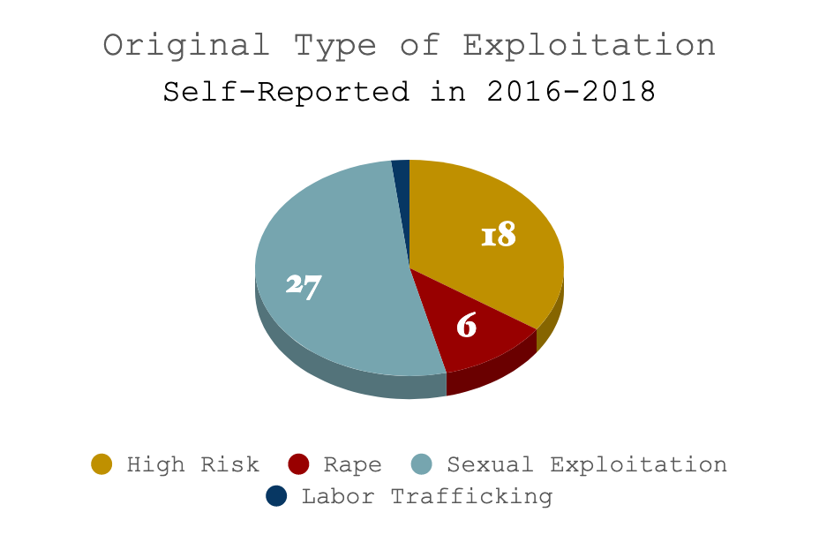
N=52
Initially all potential participants in the study were vetted to have had an experience of sexual exploitation.
However, as relationships between the researchers and participants grew, better clarity about their exploitation histories were given.

Slide 19
LESSON LEARNED
“Truth” is dependent on context and relationship
Longitudinal research & evaluative projects, are more likely to provide accurate information in the long term
However, this means earlier results very well may change as relationships and trust deepens, so certain questions and topics should be understood with caution in the early stages.
NGOs need to be aware that trust between staff and clients may take a while to develop,
This trust is also a value to be continually nurtured throughout a client’s aftercare programming

Slide 20
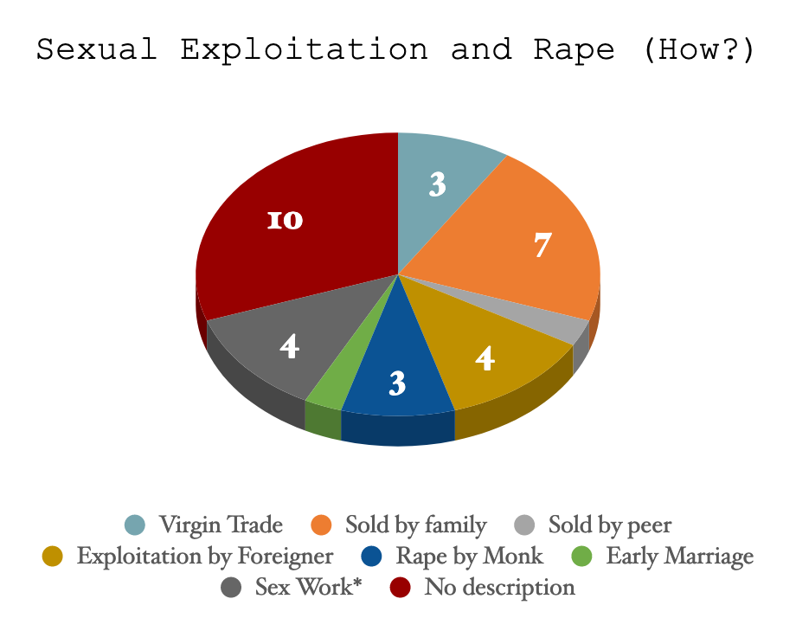
N=33: Participants who have experienced sexual exploitation and/or rape.
*Some participants who were a part of sex work did not consider themselves to have been sexually exploited

Slide 21
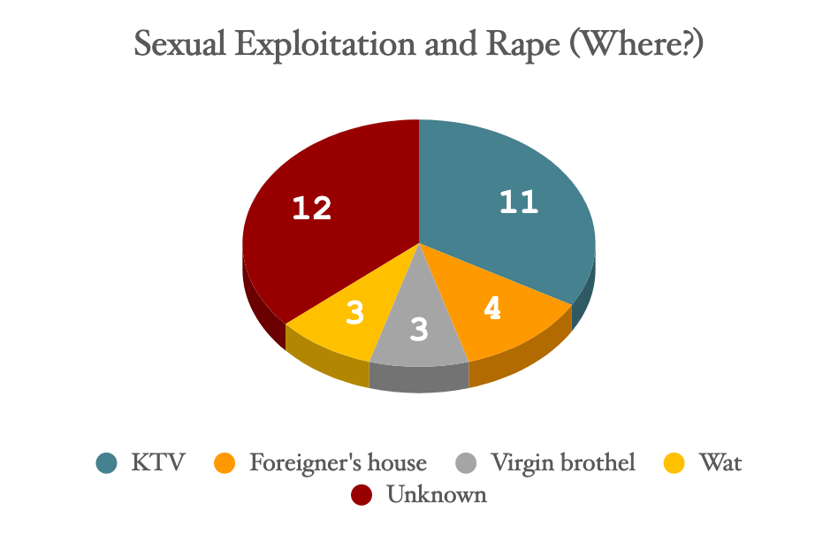
N=33: Participants who have experienced sexual exploitation and/or rape.

Slide 22
LESSON LEARNED
Due to the research’s ethical protocols and scope of study, these questions and topics were not approached until 2016, years after the incidents happened
The context of where & how sexual exploitation occurs in Cambodia has changed since the original experiences of this cohort
Prevention efforts need to stay up-to-date with current trends to remain relevant in their programming

Slide 23
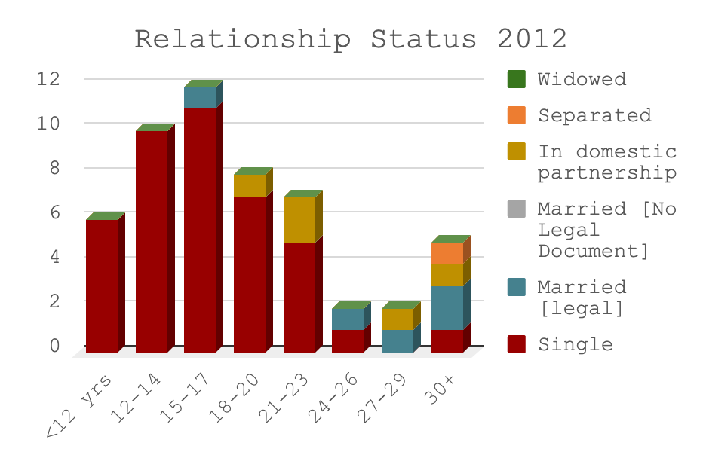
28/52 were under the age of 18
41/52 were single
1 participant under the age of 18 was legally married

Slide 24
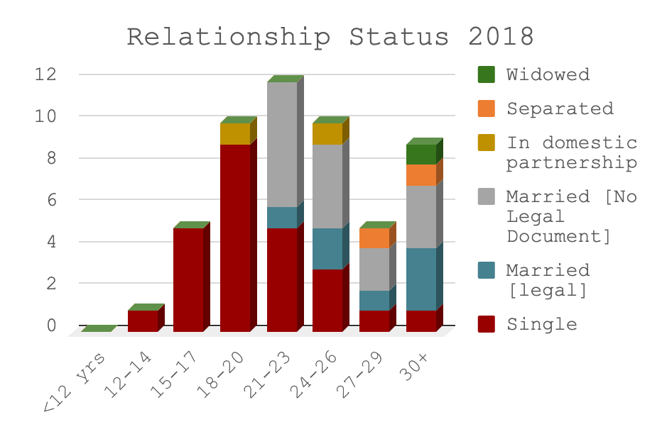
25 participants remain single
15/52 of participants married with no legal documents, reasons given:
Legal Marriage costs money
Separation is more complicated.
However, individuals in a legal marriage have rights awarded to them in case of a divorce.

Slide 25
HEALTH

Slide 26
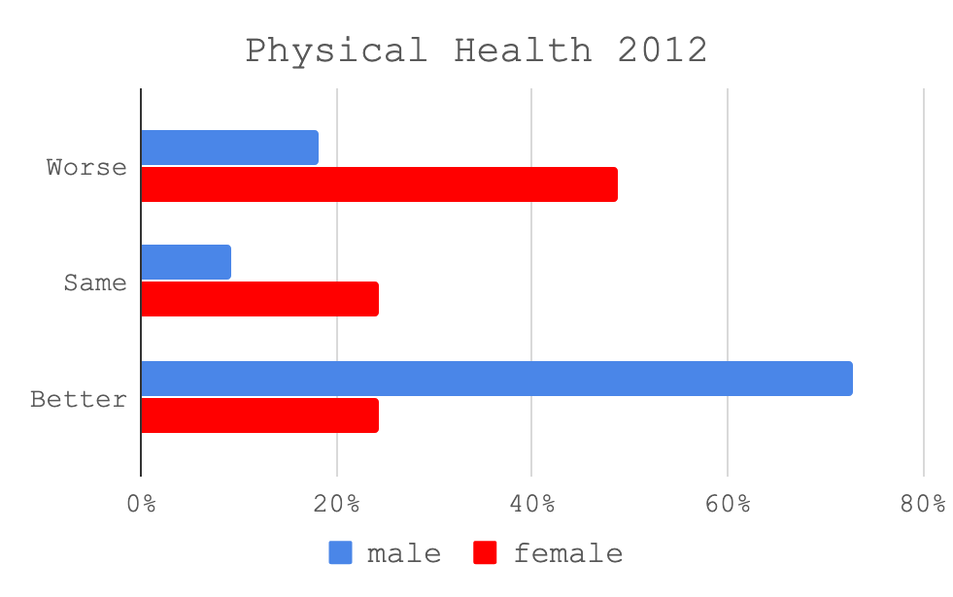
Self-Reported
N=51
One female respondent answered “I Don’t Know”
Boys overwhelmingly responded feeling “Better”, this may have been because:
This cohort was younger
Have recently gone into the shelter from their impoverished homes

Slide 27
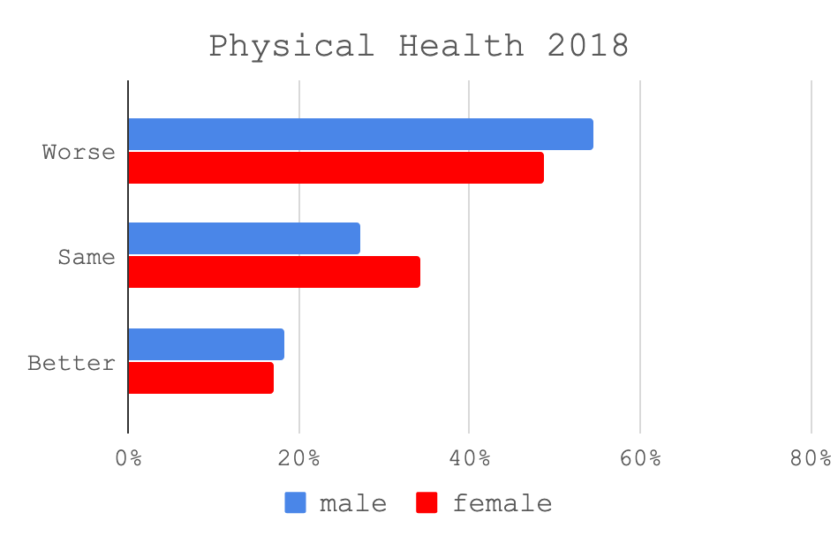
Self-reported
N=52
Consistently hard for both genders
No significant differences in the responses of the female cohort
Over half of the boys responded that their health was worse over the past year than in previous years

Slide 28
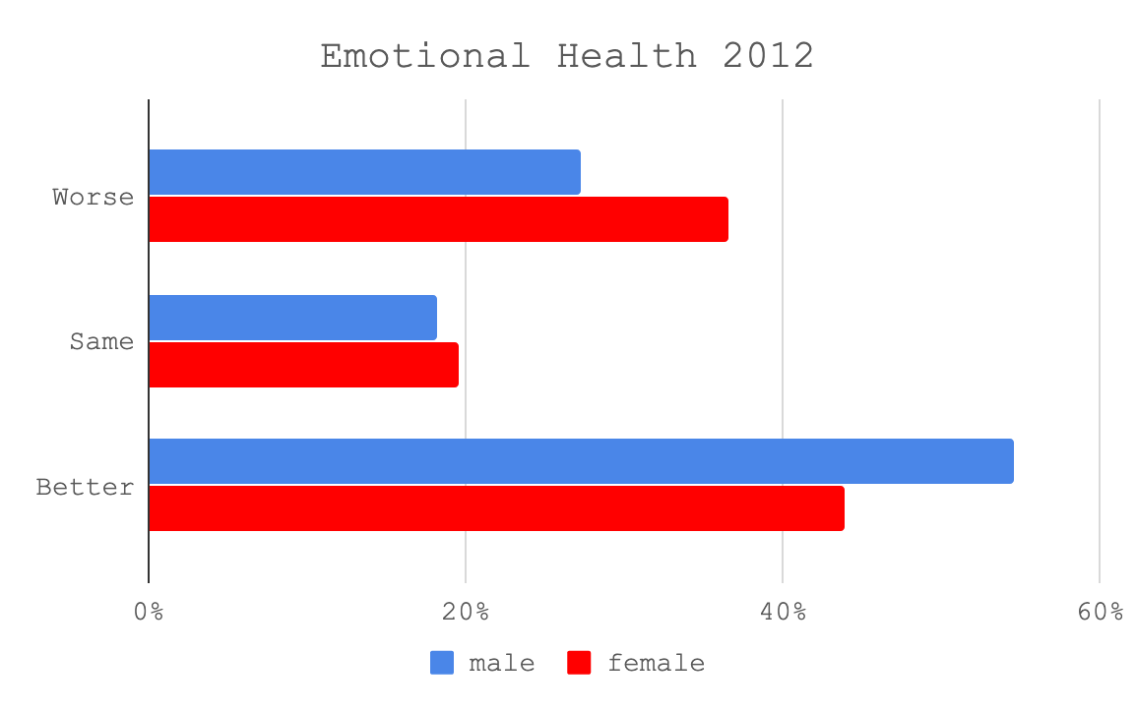
Self-Reported
N=52
Again, Boys overwhelmingly responded feeling “Better”, this may have been because:
This cohort was younger
Have recently gone into the shelter from their impoverished homes

Slide 29
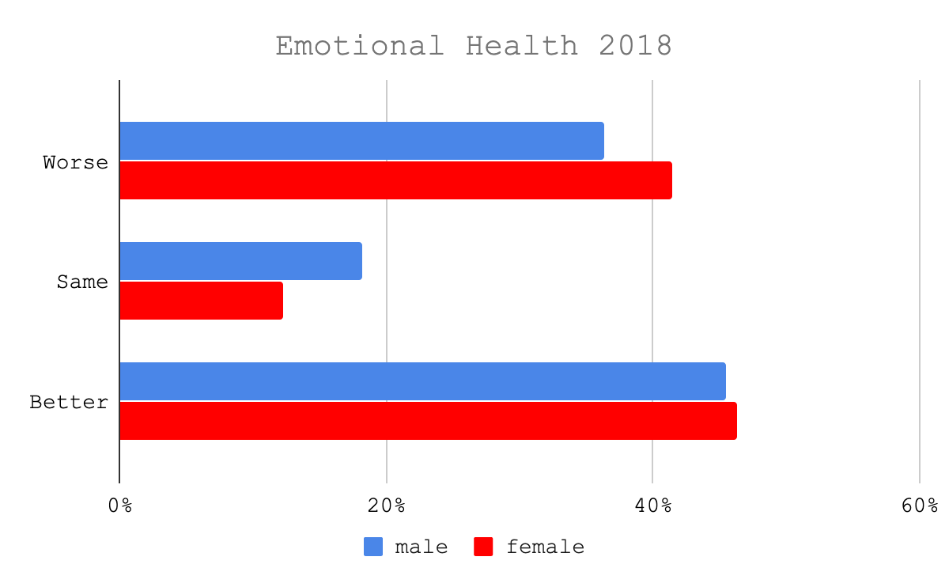
Self-reported
N=52
Consistently hard for over a third of participants among both genders
5 participants have disclosed suicidal ideations over the years
1 of these participants did commit suicide

Slide 30
LESSON LEARNED
Poverty and sexual violence have long-term impacts on both physical and emotional health vulnerabilities
Programming should anticipate physical & emotional needs over the long-term to ensure sustained health
More qualitative analysis is to be done on:
Physical and Emotional Health Factors
Substance Abuse & Incarceration

Slide 31
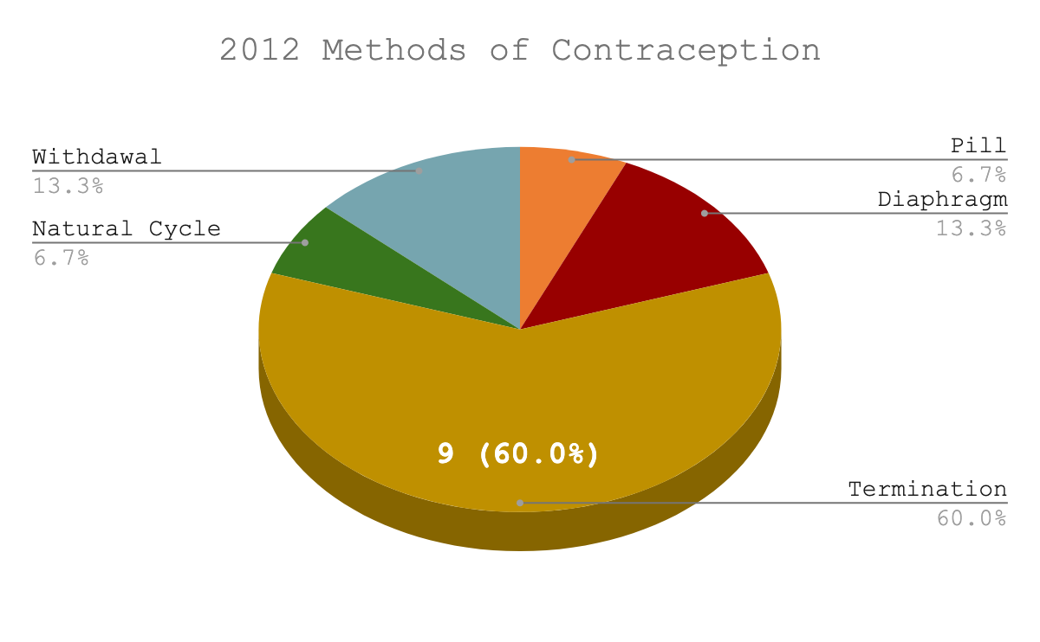
Self-reported
N=15 out of 25 females who were over 18 at the time of the interview in 2012
All boys were underage
Natural Cycle and Withdrawal are high-risk to unwanted pregnancy

Slide 32
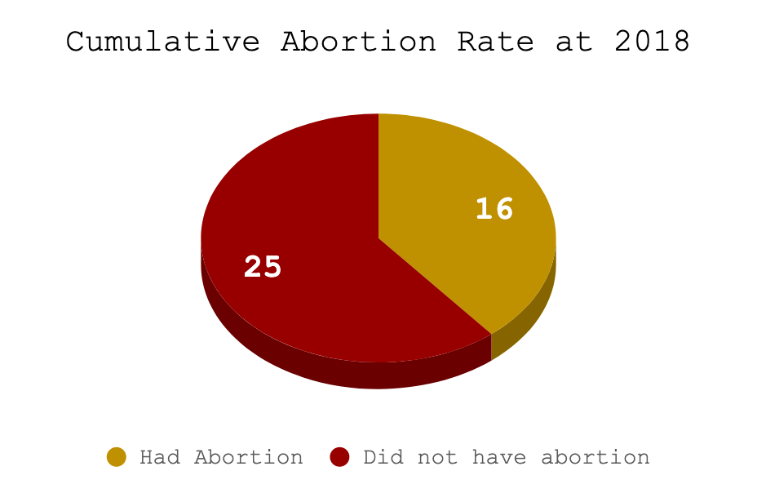
Self-reported
N=All 41 females
16/41=39%
Some participants have reported multiple abortions throughout the years.
Increase of 7 participants over the six years of quantitative data collection

Slide 33
LESSON LEARNED
Contraception education should be a vital part of aftercare programming
Women should be informed about programs that offer care to expectant mothers e.g. Mother’s Heart
Women should be informed about the legal situation that abortions can be performed up to 12 weeks (and after 12 weeks in cases of rape and/or when the woman’s life is at risk). This is to avoid women seeking dangerous and illegal abortions outside of professional care

Slide 34
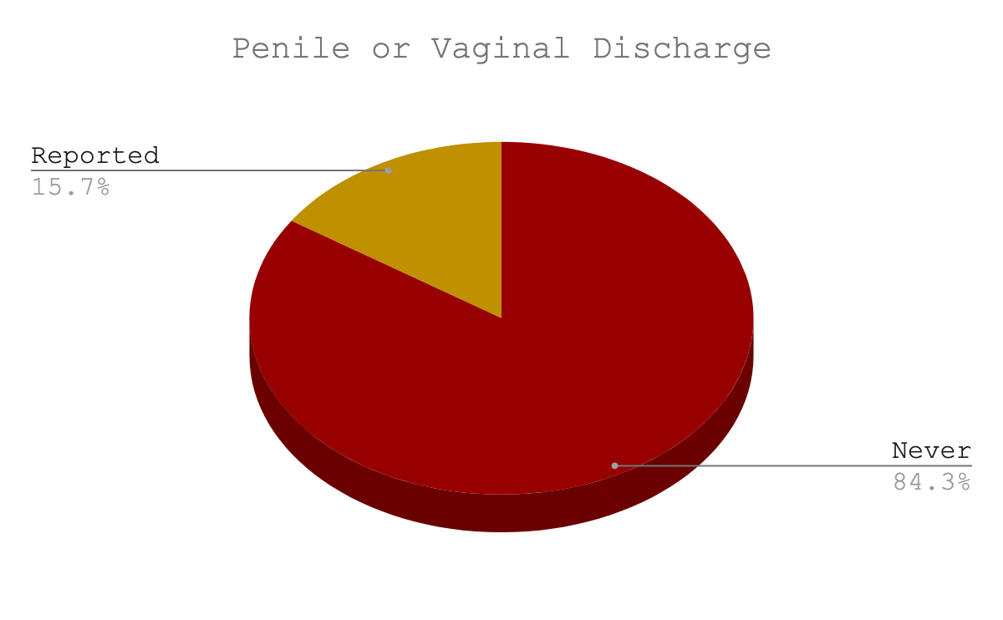
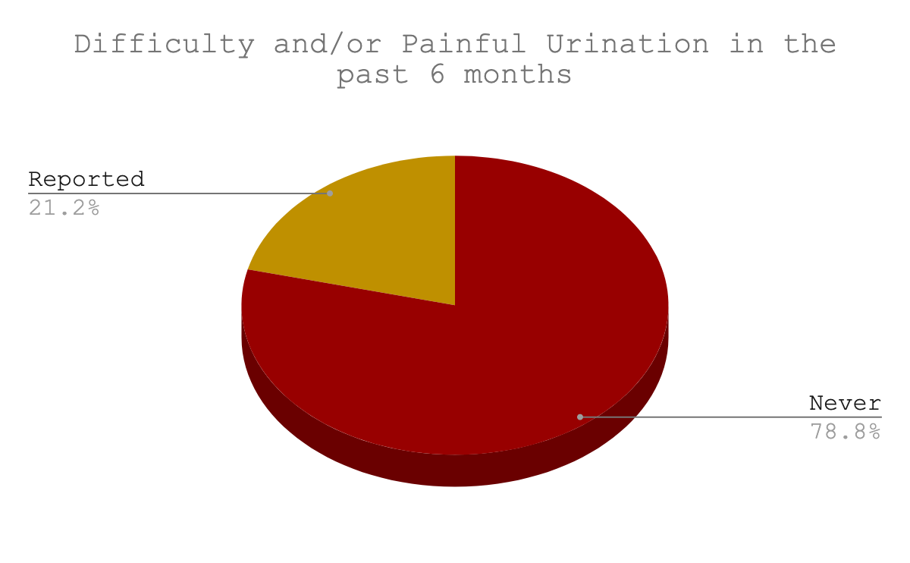
SEXUAL HEALTH SYMPTOMS
Self-reported in 2018
N=52

Slide 35
LESSON LEARNED
Sexual Health Education should be a vital part of Aftercare programming equally for boys & men, women & girls
While it is understood that women cannot control the sexual activity of their partners they need to be aware of how to use condoms to protect themselves where possible (this includes long term partnerships)
When symptoms occur, clients should understand the importance of seeking medical help for early treatment, so that the risk of complications are minimized

Slide 36
BASIC FOUNDATIONAL NEEDS
Self-Reported in 2018:
3: do not live in stable housing
4: stated difficulty getting regular meals
10: participants report difficulty accessing clean water (most live in urban areas)

Slide 37
LESSON LEARNED
It is necessary for organizations to advocate and support local community initiatives that address foundational needs among both rural & urban communities e.g. shelter, water, and food security.

Slide 38
SOCIO-ECONOMICS

Slide 39
FORMAL EDUCATION & VOCATIONAL TRAINING

Slide 40
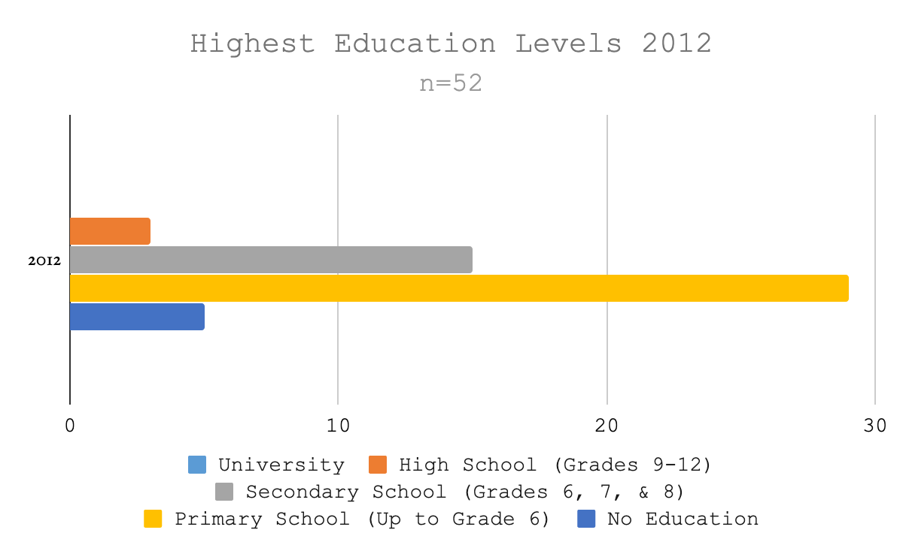
Self-reported
5 participants with no education
29 up to grade 6
14 of these participants under the age of 14
The 3 participants who received a high school education did not go on to university

Slide 41
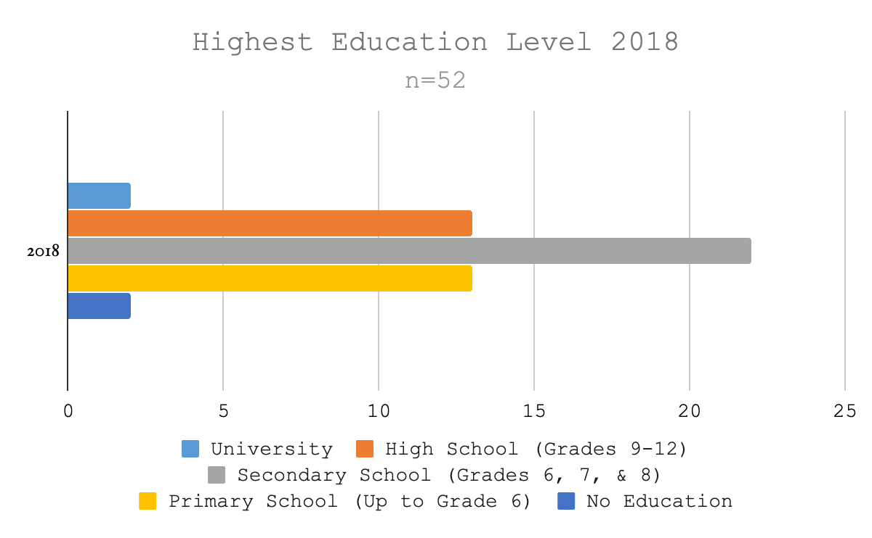
Self-reported
N=52
2 still reporting no formal education at all
30 eligible participants have not received a grade 9 education
Half (15) of these participants have a Secondary level education
10 of these went on to do Vocational Training
Many participants stated that they felt too old to complete formal schooling

Slide 42
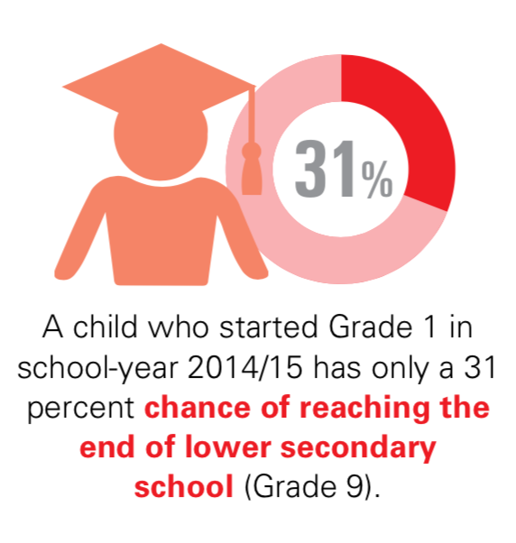
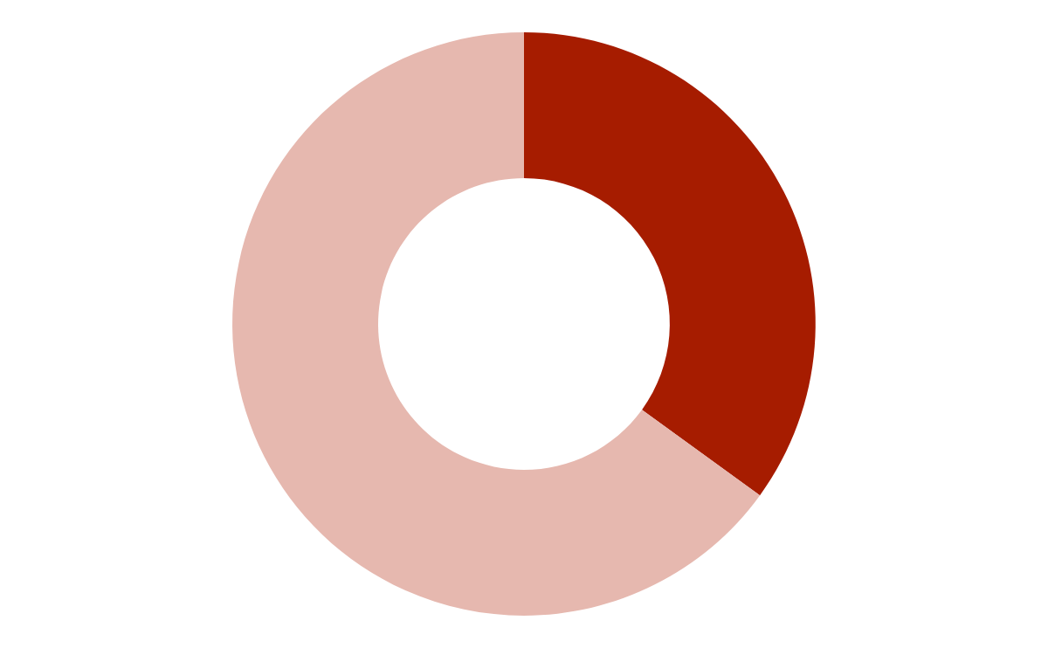
35%
Compared to 35% of Butterfly Participants who have completed lower secondary school (Grade 9)
UNICEF, “INCLUSIVE QUALITY EDUCATION: Country Programme Report 2016-2018

Slide 43
LESSON LEARNED
Completing Grade 9 education through standard schooling or catch-up tutoring, should be a baseline priority for all aftercare programs.
Grade 9 education is a right given to all Cambodians under The Constitution’s Article 36.
A recent trend among vocational training programs throughout Cambodia requires Grade 9 [equivalency] completion
Aftercare programs should consider the long term requirements of a client achieving higher level education up through university, where possible.
Market-driven & Accredited Vocational Training resulting in employment should be available as an alternative to Formal Education for all Children and Adults

Slide 44
CURRENT EMPLOYMENT & FINANCIAL SECURITY

Slide 45
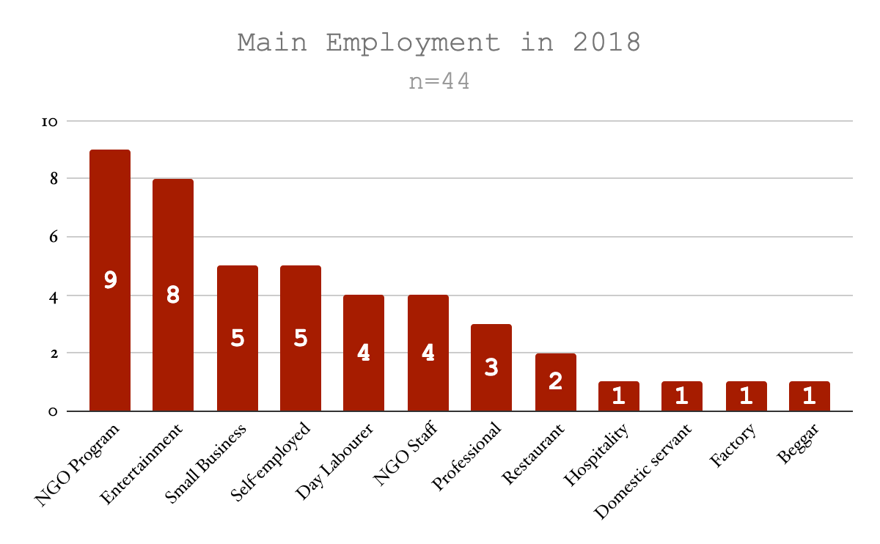
Self-reported
9 continued to still work in an NGO training program
4 have become full-time staff in NGOs
Although 8 are working in the Entertainment Industry, two continue to sell sex
Those who are not working to earn income:
6 are students and too young to work
1 is a homemaker
1 is a monk

Slide 46
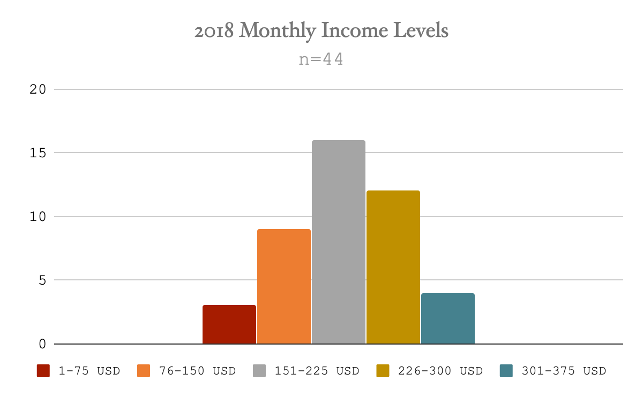
Self-reported
Average (Mean) Income: $204/month
$182.00 per month is the current salary for garment factory workers recommended by the government of Cambodia
16/44 participants did not make this amount
The lowest income in 2018 was $18.50 per month by a person who sold their labour.

Slide 47
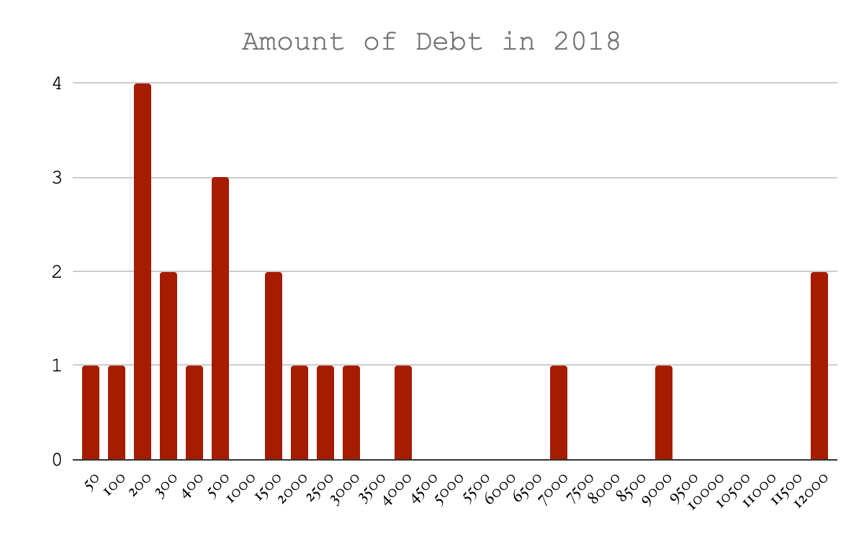
Self-reported
N=22 out of 52
Highest amount of $12,000 reported by two participants
45% of participants who reported has debt amounting over $1500

Slide 48
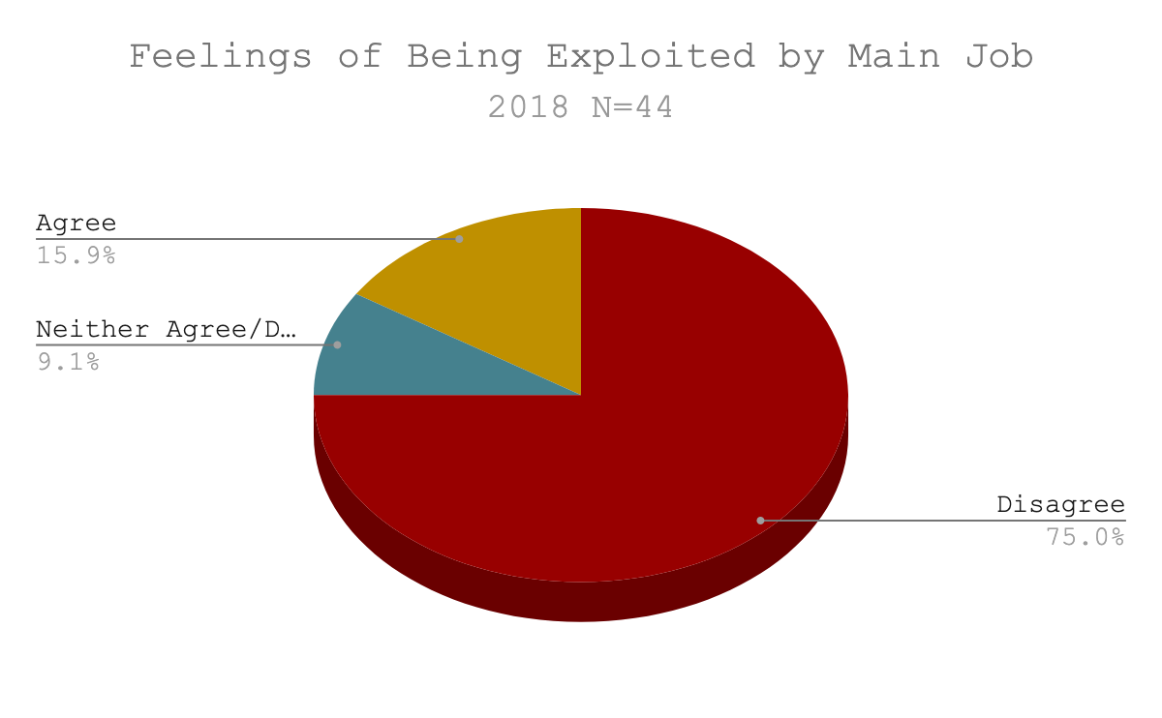
Self-reported
Over the years, a total of 6 participants have stated feelings of being exploited while working in NGO programs
However, 28/52 (54%) Participants stated in 2018 that they enjoyed their main job

Slide 49
LESSON LEARNED
Aftercare programs should continue to provide career and financial literacy advice to clients.
Especially alternative employment opportunities that are away from industries that are high risk of exploitation.
This employment opportunity resource should remain open to former clients over years after formal intervention services complete.
Vocational Trainings and Apprenticeships should ideally lead to employment outside of the NGO community.
Household budgeting and Debt Management should be foundational in a client’s life-skills education within aftercare programming.

Slide 50
Q&A WITH BUTTERFLY’S TEAM MEMBERS

Slide 51
ABOUT THE PROJECT
Beginning in 2010
128 Survivors Recruited from 15 NGOs
2010:
13 Shelters
2 Community Based Programmes
2019
high level of programmatic diversification
7 Shelters Programmes
8 Community Based Programmes
3 Vocational Training Programmes
13 Publications so far

Slide 52
PROJECT’S CORE OBJECTIVES
Actively engage a single cohort of survivors of exploitation and trafficking over a 10 year project about their life experiences, challenges, and perceptions towards service providers
Facilitate roundtable discussion, forums, and workshops with anti-trafficking partners and stakeholders on findings, themes, and recommendations
Disseminate the findings of publications to global, regional, and local audiences of practitioners, programmes, policy makers, government bodies and academics

Slide 53
ETHICAL PROTOCOLS
Ministry of Health’s National Research Ethics Committee Annual Review
Referral-Based Services
Active Listening to Participants leading to advice on services from NGO partners
Voluntary Participation
No monetary incentives
Participants willing to answer or not answer any contact or questions of the Project
Confidentiality
No pictures and media
Data management
Secure interviews
Researcher never alone with participants

Slide 54
SELECTION CRITERIA
Experienced sex trafficking defined in the UN’s 2000 Polermo Protocol.
From and re/integrating back to one of five main provinces throughout Cambodia; Phnom Penh, Siem Reap, Battambang, Kampong Som, Kampong Cham.*
From NGOs who agreed to sign MoUs with the Butterfly Project that work in Aftercare for human trafficking survivors.
*Participants ended up moving across the country, requiring the team to travel extensively to conduct interviews

Slide 55
ATTRITION
Year | Active partici-pants | Lost from study (running total) | Inactive partici -pants | # of participants provided interview | M | F
2012 | 128 | 0 | 12 | 116 | 20 | 96
2013 | 128 | 0 | 20 | 108 | 17 | 91
2014 | 128 | 0 | 40 | 88 | 15 | 73
2015 | 106 | 22 | 16 | 90 | 16 | 74
2016 | 94 | 34 | 1 | 93 | 18 | 75
2017 | 93 | 35 | 8 | 85 | 16 | 69
2018 | 91 | 37 | 12 | 79 | 14 | 65
71% of Original 128 Remain Active in Study
70% of the Boys
68% of the Girls
Stopped Participating because…
Stigma of Anti-trafficking NGOs
Jailed
Fleeing Debt
Move out of Country
Court Case in the West
Repatriation to Vietnam
Illegal Work in Thailand
Married Foreigner
Chronic Illness
Drug Addiction
Suicide

Slide 56
52 QUANTITATIVE LONGITUDINAL PARTICIPANTS
Responded to all quantitative longitudinal survey questions in years 2012, 2013, 2017, and 2018.
This is the base cohort for this morning’s presentation

Slide 57
ABOUT THIS PRESENTATION
This is a quantitative summary of data has been collected from 52 Butterfly participants from 2012-2018
This presentation cannot represent:
All sexually exploited individuals in Cambodia nor the original 128 participants
All of the experiences recorded throughout the 10 year Butterfly Project
It can show patterns that help us to consider how we can improve policy and programming
To benefit the most from this research, it is necessary for all stakeholders to read through our publications.
Find all of Buttefly’s Reporting (KH & ENG) on our website www.chabdai.org/butterfly

Slide 58
DEMOGRAPHICS

Slide 59
GENDER

Slide 62
Aftercare Program Services at Time of Interviews |  | Year of Data Collection
 |  | 2012 | 2018
 | Shelter | 33 | 2
 | Declined Assistance | 1 | 4
 | Non-Residential Vocational Training | 2 | 0
 | Shelter Reintegration Assistance | 2 | 4
 | Community-Based Program | 10 | 8
 | Family Group Home | 3 | 0
 | Reintegration Completed | 1 | 32
 | Church Assistance | 0 | 2
Total |  | 52 | 52
2012: 33 Participants in Shelters located in PP, BTB, & SR
2018: Two of the Respondents in Community-Based Programming ended up Declining Assistance specifically because of their experience with the NGO

Slide 63
MOBILE COHORT
Location of Residence |  | Year of Data Collection
 |  | 2012 | 2018
 | Banteay Meanchey | 0 | 1
 | Battambang | 3 | 4
 | Kandal | 0 | 1
 | Koh Kong | 0 | 3
 | Phnom Penh | 41 | 24
 | Siem Reap | 8 | 9
 | Kompong Som | 0 | 5
 | Svay Rieng | 0 | 3
 | Takeo | 0 | 1
 | Oddar Meanchey | 0 | 1
Total |  | 52 | 52
41 Participants were in Phnom Penh in 2012
This number is almost halved by 2018 with most of the participants now living in 9 provinces other than Phnom Penh

Slide 64
RESULTS & LESSONS LEARNED

Slide 65
ETHNICITY
 | Self-Reported Ethnic Group | 2012 | 2013 | 2017 | 2018
 | Ethnic Cambodian | 40 | 40 | 47 | 45
 | Kampuchea Krom | 2 | 3 | 0 | 0
 | Vietnamese | 4 | 4 | 4 | 5
 | Khmer and Vietnamese | 3 | 3 | 1 | 0
 | Khmer and Chinese | 1 | 1 | 0 | 1
 | Khmer and Cham | 2 | 1 | 0 | 0
 | Other | 0 | 0 | 0 | 1
Totals |  | 52 | 52 | 52 | 52
Changing self-reported ethnicity after re/integration back into communities
Reasons for change
To obtain documents to legally work or attend school in Cambodia
To fit better into social structures as personal business grew
To become the same ethnicity as their partner

Slide 66
N=52
Initially all potential participants in the study were vetted to have had an experience of sexual exploitation.
However, as relationships between the researchers and participants grew, better clarity about their exploitation histories were given.

Slide 67
LESSON LEARNED
“Truth” is dependent on context and relationship
Longitudinal research & evaluative projects, are more likely to provide accurate information in the long term
However, this means earlier results very well may change as relationships and trust deepens, so certain questions and topics should be understood with caution in the early stages.
NGOs need to be aware that trust between staff and clients may take a while to develop,
This trust is also a value to be continually nurtured throughout a client’s aftercare programming

Slide 68
N=33: Participants who have experienced sexual exploitation and/or rape.
*Some participants who were a part of sex work did not consider themselves to have been sexually exploited

Slide 69
N=33: Participants who have experienced sexual exploitation and/or rape.

Slide 70
LESSON LEARNED
Due to the research’s ethical protocols and scope of study, these questions and topics were not approached until 2016, years after the incidents happened
The context of where & how sexual exploitation occurs in Cambodia has changed since the original experiences of this cohort
Prevention efforts need to stay up-to-date with current trends to remain relevant in their programming

Slide 71
28/52 were under the age of 18
41/52 were single
1 participant under the age of 18 was legally married

Slide 72
25 participants remain single
15/52 of participants married with no legal documents, reasons given:
Legal Marriage costs money
Separation is more complicated.
However, individuals in a legal marriage have rights awarded to them in case of a divorce.

Slide 73
HEALTH

Slide 74
Self-Reported
N=51
One female respondent answered “I Don’t Know”
Boys overwhelmingly responded feeling “Better”, this may have been because:
This cohort was younger
Have recently gone into the shelter from their impoverished homes

Slide 75
Self-reported
N=52
Consistently hard for both genders
No significant differences in the responses of the female cohort
Over half of the boys responded that their health was worse over the past year than in previous years

Slide 76
Self-Reported
N=52
Again, Boys overwhelmingly responded feeling “Better”, this may have been because:
This cohort was younger
Have recently gone into the shelter from their impoverished homes

Slide 77
Self-reported
N=52
Consistently hard for over a third of participants among both genders
5 participants have disclosed suicidal ideations over the years
1 of these participants did commit suicide

Slide 78
LESSON LEARNED
Poverty and sexual violence have long-term impacts on both physical and emotional health vulnerabilities
Programming should anticipate physical & emotional needs over the long-term to ensure sustained health
More qualitative analysis is to be done on:
Physical and Emotional Health Factors
Substance Abuse & Incarceration

Slide 79
Self-reported
N=15 out of 25 females who were over 18 at the time of the interview in 2012
All boys were underage
Natural Cycle and Withdrawal are high-risk to unwanted pregnancy

Slide 80
Self-reported
N=All 41 females
16/41=39%
Some participants have reported multiple abortions throughout the years.
Increase of 7 participants over the six years of quantitative data collection

Slide 81
LESSON LEARNED
Contraception education should be a vital part of aftercare programming
Women should be informed about programs that offer care to expectant mothers e.g. Mother’s Heart
Women should be informed about the legal situation that abortions can be performed up to 12 weeks (and after 12 weeks in cases of rape and/or when the woman’s life is at risk). This is to avoid women seeking dangerous and illegal abortions outside of professional care

Slide 82
SEXUAL HEALTH SYMPTOMS
Self-reported in 2018
N=52

Slide 83
LESSON LEARNED
Sexual Health Education should be a vital part of Aftercare programming equally for boys & men, women & girls
While it is understood that women cannot control the sexual activity of their partners they need to be aware of how to use condoms to protect themselves where possible (this includes long term partnerships)
When symptoms occur, clients should understand the importance of seeking medical help for early treatment, so that the risk of complications are minimized

Slide 84
BASIC FOUNDATIONAL NEEDS
Self-Reported in 2018:
3: do not live in stable housing
4: stated difficulty getting regular meals
10: participants report difficulty accessing clean water (most live in urban areas)

Slide 85
LESSON LEARNED
It is necessary for organizations to advocate and support local community initiatives that address foundational needs among both rural & urban communities e.g. shelter, water, and food security.

Slide 86
SOCIO-ECONOMICS

Slide 87
FORMAL EDUCATION & VOCATIONAL TRAINING

Slide 88
Self-reported
5 participants with no education
29 up to grade 6
14 of these participants under the age of 14
The 3 participants who received a high school education did not go on to university

Slide 89
Self-reported
N=52
2 still reporting no formal education at all
30 eligible participants have not received a grade 9 education
Half (15) of these participants have a Secondary level education
10 of these went on to do Vocational Training
Many participants stated that they felt too old to complete formal schooling

Slide 90
35%
Compared to 35% of Butterfly Participants who have completed lower secondary school (Grade 9)
UNICEF, “INCLUSIVE QUALITY EDUCATION: Country Programme Report 2016-2018

Slide 91
LESSON LEARNED
Completing Grade 9 education through standard schooling or catch-up tutoring, should be a baseline priority for all aftercare programs.
Grade 9 education is a right given to all Cambodians under The Constitution’s Article 36.
A recent trend among vocational training programs throughout Cambodia requires Grade 9 [equivalency] completion
Aftercare programs should consider the long term requirements of a client achieving higher level education up through university, where possible.
Market-driven & Accredited Vocational Training resulting in employment should be available as an alternative to Formal Education for all Children and Adults

Slide 92
CURRENT EMPLOYMENT & FINANCIAL SECURITY

Slide 93
Self-reported
9 continued to still work in an NGO training program
4 have become full-time staff in NGOs
Although 8 are working in the Entertainment Industry, two continue to sell sex
Those who are not working to earn income:
6 are students and too young to work
1 is a homemaker
1 is a monk

Slide 94
Self-reported
Average (Mean) Income: $204/month
$182.00 per month is the current salary for garment factory workers recommended by the government of Cambodia
16/44 participants did not make this amount
The lowest income in 2018 was $18.50 per month by a person who sold their labour.

Slide 95
Self-reported
N=22 out of 52
Highest amount of $12,000 reported by two participants
45% of participants who reported has debt amounting over $1500

Slide 96
Self-reported
Over the years, a total of 6 participants have stated feelings of being exploited while working in NGO programs
However, 28/52 (54%) Participants stated in 2018 that they enjoyed their main job

Slide 97
LESSON LEARNED
Aftercare programs should continue to provide career and financial literacy advice to clients.
Especially alternative employment opportunities that are away from industries that are high risk of exploitation.
This employment opportunity resource should remain open to former clients over years after formal intervention services complete.
Vocational Trainings and Apprenticeships should ideally lead to employment outside of the NGO community.
Household budgeting and Debt Management should be foundational in a client’s life-skills education within aftercare programming.

Slide 98
Q&A WITH BUTTERFLY’S TEAM MEMBERS

