Slide 1
Journeys of Faith – Children of the Wood & the Stone -Spirituality of Survivors of Sexual Exploitation in Cambodia
The Butterfly Longitudinal Research Project in Cambodia
Glenn Miles PhD

Slide 2
Donors that Fund Butterfly 2018-19
Stronger Together Foundation
Tenth Church
Imago Dei
Love 146
Stronger Together Foundation
Tenth Church
A anonymous donor

Slide 3
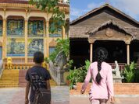
The Butterfly Longitudinal (Re-) integration Research in Cambodia Children of the Wood, Children of the Stone

Slide 4
Background
Chab Dai coalition members/practitioners working in Anti trafficking wanted to understand the long term impact of their programs on survivors leaving their programs so Longitudinal Research suggested.
15 Assistance Programs partner Chab Dai and allow access to their clients after rigorous MOU process.
10 years -2010 until now - currently in year 10
Ministry of Health ethical process - annually
Notes:
Despite widespread support for this research it still took significant time to agree on MOUs partnerships allowing us access to potential participants

Slide 5
‘Voice’ of Participants
Sexually exploited > shelters > re-integration
Positive and Negative-
Resilience and Vulnerabilities
Actual experiences and reflections
Inform local programming and policy, wider debates locally, regionally and globally.
Dialogue with partners and stakeholders
Roundtable-Annual Reports-Confidential Feedback
Series of Issue based Reports
Notes:
A lot of research about victims and survivors
Their perspective about their lives and experiences

Slide 6
Longitudinal design, methods and ethics
Exploratory, broad, and descriptive
mixed
Challenges
Attrition –maintaining contact
Supervision
Distances-time
Benefits
evolving trust and disclosure over ten years significant
Researcher effect
Deep friendships wih participants
Ethics
Notes:
Voluntary
Assent/Consent
Resource/ referral
Child protection issues
National Ethics committee

Slide 7
Sample
128 Participants in total
80% Female and 20% Male
Age range - <12 - >30
72% Ethnic Cambodian and 13% Vietnamese
Around 84 were contactable in 2017. Now all adults.
Notes:
Mixture: Khmer Vientamese, Khmer Chinese, Khemr Thai , Khmer Cham- the rest
Took a year to obtain this sample

Slide 8
Making sense of life
Although the wider cultural religious context in Cambodia is predominantly Buddhist (Delaney and Scharff 2010), over the past decade it has been largely Christian FBO groups who have taken a leading role in addressing sexual exploitation (Delaney and Scharff 2010; Jordanwood and Lim 2011)

Slide 9
What does Faith mean to Survivors?
that they are the second and third generation following the Khmer Rouge period and that they have been raised in a post conflict society,
that following their experiences of exploitation they encountered Christian influences largely through CFBO,
that they live in a context of a wider dominant Buddhist milieu,
and that whilst they live in a neo-liberal culture that is ever modernizing and changing, still there are traditional cultural beliefs, values and practices such as gender expectations/reality and filial piety?

Slide 10
Marx, Freud, et.al.
Marx, in 1844, argued that religion was `the opium of the people’ (1959:263).
Freud (1949:42, 74) believed religion to be nothing more than an `infantile’ response and `the adult’s reaction to his own sense of helplessness’ .
Social science literature historically has tended to refer to spirituality and religions as belief systems based on myths, whose overall negative effect on society would be replaced eventually by sound scientific thinking.

Slide 11
Scientific vs. Spiritual
Development practitioners can avoid the topic of spirituality more from a `respect’ of local culture and out of an awareness of the dangers of imposing their view.
But there is a certain degree of condescension implicit in withholding what one believes to be a superior understanding of reality so as not to offend or impose.
People’s spirituality is viewed as weak and to be protected, in the way that quaint traditions should be protected.

Slide 12
Spirituality & Development
However, Spirituality is central to many of the daily decisions people in the `South’ make about their own and their community’s development.
Despite its importance, development literature and development practices have systematically avoided the topic of spirituality.
Kurt Alan Ver Beek (1990)“Spirituality A Development Taboo”

Slide 13
UNCRC – (Child friendly version)
Article 14: You have the right to choose your own religion and beliefs.
Your parents should help you decide what is right and wrong, and what is best for you.

Slide 14
Constitution of Cambodia, Article 43: State Religion and Freedom of Belief
Khmer citizens of either sex shall have the right to freedom of belief. Freedom of religious belief and worship shall be guaranteed by the State on the condition that such freedom does not affect other religious beliefs or violate public order and security.
Buddhism shall be the religion of the State.
The constitution prohibits discrimination based on religion, and the government does not tolerate abuse of religious freedom, either by Governmental or private actors

Slide 15
Western perspective
60% Americans currently believe it is ‘extreme’ to attempt to convert others to your faith.
57% say whatever is right or works best for you is the only truth you can know.
Barna Research. (2018) ‘Spiritual Conversations in a Digital World’.

Slide 16
Proselytizing
“For Buddhists proselytizing is an unimportant, worldly activity resulting neither in merit nor in improved karma”
“For Christian child welfare organisations, child beneficiaries tend to be included in faith based activities as a matter of course, although this is looked on by others with suspicion”.
But Christianity is evangelical – “forbidding Christians to share the good news is like telling a tree not to grow” Judith Ennew, 2015

Slide 17
Coercion
However “What Jesus intended was that his followers should communicate to others…sacrificial other person centred respect and love. There is no suggestion of coercion.”
“ Human beings, especially children can be compelled (or induced by related benefits) to follow rituals and obey religious practices. But it is unlikely that anyone can be forced to believe something against their wishes” Judith Ennew, 2015

Slide 18
Spiritual rights
Rebecca Hay (1998) suggests we have 4 major responsibilities which can be applied to any faith
To help children keep an open mind
To explore with children different ways of perceiving the world.
To encourage children’s awareness of their own spirituality and that of others
To become aware of social and political dimensions of spirituality

Slide 19
Spiritual abuse
“Spiritual nurture rather than conversion must be the core of faith based activities…One human right is not to have the existence of spiritual dimension regarded as a delusion or neurosis…Spiritual lives of children must be neither abused nor distorted through power relationships” Judith Ennew, 2015
“The child has the right to commune with God” Janusz Koreczak, 2004

Slide 20
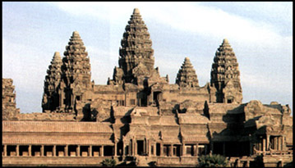
Angkor Wat

Slide 21
Buddhism in Cambodia
The early history of religion in Cambodia Mahayana and Hinduism predominated until the 13th century.
After then, Theravada became the main type of Buddhism.
In 1975 when the communists took control of Cambodia they tried to completely destroy Buddhism - nearly every monk and religious intellectual had been either murdered or driven into exile, and nearly every temple and Buddhist library were destroyed.

Slide 22
Buddhist Practice
Eightfold Path
– right view, right thinking, right speech, right action, right livelihood, right diligence, right mindfulness and right concentration
Buddhism sees children as connected to a long chain of re-births. Karma drives re-birth. A birth depends on past actions.

Slide 23
Christianity in Cambodia
Portuguese 17th century
Catholic church – more in Vietnam not so much Cambodia
Protestant church -100 years ago
Before Pol Pot – surge of interest in Christianity – then many died in genocide
When constitution being written churches campaigned for freedom of religion.
After 1993 many Christian FBOs and churches came to Cambodia

Slide 24
Reflexivity
Christian
Quaker background – tolerance of other beliefs
Evangelical background – believe that God’s love is unconditional and Jesus welcomes everyone especially children and vulnerable people

Slide 25
Figures
At the time of one of the 2017 surveys (n=84)
54 considered themselves primarily Christian
42 said they expected to remain in the future
30 considered themselves primarily Buddhist
27 said they expected to remain in the future.
This is some time after leaving faith based programs. Their answers are not about pleasing the researchers.

Slide 26
Quotes

Slide 27
Some always Christian
“Since I was young I believe in Jesus. Even though I sell something on the street or go to the pagoda but in my heart I still believe in God. This faith didn’t start recently but I had it many years already even before I came into the centre. Since I grew up I heard about Jesus. I only believed in one religion only. All my family are Buddhist but I don’t care.”

Slide 28
Some always Buddhist
“I think all religions are good but my family respect Buddha since before. I am in the incense holder at home. I use the incense every day. I didn’t ask for anything. I join in the events at the temple. When I was in the organization I also prayed to Buddha about my future and my family”.

Slide 29
Conversion?
Some changed from Buddhism to Christianity
Some changed from Christianity to Buddhism
Some say don’t have time or energy for Faith
Some believe in both

Slide 30
Why Believe? Helps me when pray
“I pray to God always as I meet the issues and all circumstances. Even when I ask God and he didn’t answer me I pray to him. I pray to him in good and bad feeling”.

Slide 31
Key beliefs? Christianity - Forgiveness
“The Bible encourages to forgive others including the perpetrator. I learned to forgive those who abused me a lot and it helped me to find peace in my heart. This made me stronger.”

Slide 32
Why Believe? Christian – Love and Care
“ I love the staff very much. I used to meet the bad situation in my life. I met some Christians and some who are not Christian and they are different. The Christians talked a lot about love and care but other people who are not Christian talk about it without love and they don’t care about us. It is different”.

Slide 33
Key beliefs Christianity – Service
“Jesus teaches us not to discriminate to anyone else. Even if we clean the bathroom or dog manure we are doing it to serve God. God told me not to look down on the dirty person. Last night a man’s hand was bleeding and I got my olive oil to put on him. I just follow God’s command”.

Slide 34
Key beliefs Buddhism - Respect
“When I believe in Buddha I respect monks, elderly and the people who are older; parents, siblings and relatives. We respect each other.”

Slide 35
Key beliefs Buddhism Do good, receive good
“The most famous quote in Buddhism is that if people do good then they will receive good things. If they do bad things then they will receive bad things too. This helps me”.

Slide 36
Key beliefs Buddhism. Good vs. bad deeds.
“For those who plant a tree the tree will grow; if you plant a gourd , it doesn’t grow a pumpkin. Some people cause me problems. If they plant Kdart then they get Kdart... it will never come out with Trav. So I mean that even if I didn’t do bad to that person but one day another person who has experience like me will do back to them”.

Slide 37
Why Believe? Buddhist - Healing
“Buddha helps me a lot. Jesus did not help me anything. In Buddhism I just went to the master (Kru Khmer) and he solved the issue for me. I was healed in just a few minutes I did not want to go to the place but I was instructed to go there”.

Slide 38
Why believe? Strength/Courage thru hardships
“I consider myself a Jesus follower rather than a Christian. God did many miracles in my life. He changed me. He gave me strength and courage to struggle through the hardships of life today”.

Slide 39
Why believe? Love from Christian faith
“Most people have love from four ways. Love from lover. Love from friends. Love from family and love from faith. If we lack these we cannot survive. I do not have love from family, lover or friends I have only from faith which makes me to survive right now. I hope in faith a lot”.

Slide 40
Why believe? God saved me from suicide
“I was about to kill myself before I went into the Centre as I did not have a mother. I was about to throw myself off the roof of the building. I closed my eyes and was about to jump but then I didn’t do it. I prayed “if my life is valuable please save me. If it has no value please allow me to die”. I did not kill myself and felt refreshed and happy”.

Slide 41
Why believe? Christianity - Family re-united
“My family started to be broken. I prayed to God and I felt stronger. I prayed to God for my family to be re-united. I then heard my family were living together again. I then thought there is nothing bigger than God”.

Slide 42
Why believe? Buddhism – Relieved, Healed
“When I go to the temple I feel relieved. I came to the temple to ask for a blessing to relieve me. When I have disease I pray to be healed and I have been healed. I offer the things that I promised to give”.

Slide 43
Why believe? Importance of Faith
In the Centre a few of the staff really believed and had a strong belief but some did not care much about the property and cheated. But when we live among them we can tell who strongly believe and who don’t.
Before I went there I didn’t understand how important faith is for us.

Slide 44
Communicating Faith Can’t force anyone else
“When I see other people make a mistake I told them not to do it because it is not good and God doesn’t like it. If they believe it, or not, it is up to them. You can’t force anyone with their own faith”.

Slide 45
Communicating Faith Shine the light
“If we want others to believe I need to do good things. There is no Christian in the village so I must shine so that is why I stay in the village. To shine the light on them. I think that this is the plan of God”

Slide 46
Discrimination Stone vs. Wood
“Before I felt I got into arguments with other people when they believe in Jesus because I was a Buddhist. They said Buddha is only a stone for people to bow down to and I said how about the cross, it is only wood!”

Slide 47
Discrimination: Threaten divorce
“I used to get in an argument with my husband and he would tell me to leave God and if I continue to believe he would divorce me but I told him that I would not go away from God. He said if you choose Jesus you and I will separate. He asked me to leave God but I didn’t. I don’t care if he wants a divorce”.

Slide 48
Coercion or Choice
“Because the staff were Christian they were open to everyone and helped us to get to know more about God but the choice was ours. Before I told myself that I wouldn’t go if they forced me but when I saw their action they gave me a choice so I agreed to do it”.

Slide 49
Coercion or Choice?
“The centre didn’t force the children. They asked if someone would like to go to church and they could choose if they wanted to go or not. If someone wanted to go home to do a Buddhist ceremony they just let them go as normal. They seemed to give us freedom.

Slide 50
Coercion or Choice?
In the Centre they prayed before eating and when we went to sleep. We needed to read the Bible even when we are watching the movie. I wondered if we needed to read the Bible and pray when we were sitting on the swing?!

Slide 51
Discrimination: Centre staff
“Sometimes in the Centre, they speak badly about the Buddha I used to get into argument with the caregiver there. She said it is like praying to the stone (Buddha). I said didn’t you respect the wood?(cross). She didn’t give me value and she looked down on my religion.I felt disappointed with Christian people since that time but I didn’t want to make things worse. I spoke to my counselor and she encouraged me to believe on what I wanted to believe and don’t mind other people’s speech”.

Slide 52
Discrimination Pastor excluded me
“I hated the pastor at X church. He expelled me. He forced me out like an animal. I don’t want to go there again but I will go to other churches. I don’t even want to see the fence of that church. Even though God doesn’t want me to hate (the pastor), I still hate him”.

Slide 53
Monks phones and guesthouse
“Some of my neighbours understood. Others did not. The important thing is that my heart has God. I do not believe in Buddha as some of the monks went to the ”guesthouse”. I do not want to talk about that. They have the smartphones too. I do not respect them”.

Slide 54
Change of Faith Feel tied to both
My family are Buddhists . I can’t cut the tie with Jesus either. I still think about God. I sometimes pray to Him when I face trouble in my life. I don’t use the incense. I just close my eyes and talk to Him. God is always close to me.

Slide 55
Change of Faith Love Jesus
“As long as I am still alive I will love Jesus. I will tell my grandchildren to believe in Jesus more. Every time I call on God He comes to me. God knows what is happening to me and He blesses me in what I am doing. I cannot do this without God and no one else can heal besides God”.

Slide 56
Conclusions
Spirituality is a significant contribution to development
For the majority of children>adults it had a strong impact on the way they saw themselves and in their healing and re-integration process.
For many children>adults it also positively affected the way they related to others.
However, many children>adults had negative discrimination when they got home from family and community

Slide 57
Buddhism
Seen as important, traditional, cultural, respectful
Lighting incense seems a positive way to be mindful, quieten the body/mind, meditate, pray, ask for protection, ask for favour.
Not helpful to talk about worshipping a rock or cement or create a negative attitude to Buddhism
Blessings from monks seen as helpful and may help acceptance by community on return home.

Slide 58
Christianity
What applied theology is important to emphasize? e.g. image of God. ?non-discrimination ? Forgiveness ? God is always with us ? God is concerned for injustice ?serving others ? God in times of suffering
Western Christianity can be very individualistic but it is also about justice

Slide 59
Training
It is important but not enough for an organization to have a developed theological grounding of what they believe and why they do what they do.
It is more important for all those who come in direct contact with the girls/boys e.g. House mothers, community workers to understand about Christianity and also Buddhism

Slide 60
Spiritual Abuse
All Child Safeguarding policies should include the importance of prevention against spiritual as well as other kinds of abuse.
Spiritual abuse is when spirituality is used to manipulate or force someone into doing or thinking something rather than providing them with space to decide for themselves.
All those working with survivors should sign the child safeguarding /protection policy.

Slide 61
Misunderstandings about Christianity
Prosperity Gospel > God is not a ‘sugar daddy’ if ‘not answered’ disappointment?
Intercession and praying good, asking God like the persistent widow but is the request for the best?
Prayer for healing – is God’s response inconsistent?
Prayer is being able to talk to God and know he loves us whatever happens

Slide 62
Proximity (closeness) of God
Many participants said they felt close to God or far away from God
Christians, desire intimacy with God. The psalmist says, “for me it is good to be near God”
(Psalm 73:28) and they learn “Draw near to God, and he will draw near to you” (James 4:8).
Our experience of God’s nearness or distance is not a description of his actual proximity to us, but of our experience of intimacy with him. Scripture shows us that God is intimate with those who trust him.

Slide 63
Isolation
Children returning home to villages where may not have church – feel anxiety, isolation from community and judgment from others. Sometimes prejudice or even persecution. Need to be prepared for that.
Need to anticipate and respond to e.g. about funerals – misunderstanding that people cannot cry at funerals

Slide 64
Misunderstandings of churches
Some churches open and welcoming
Others prejudicial and negative
Some unhelpfully suggest that clients only want to come to get something.
Others afraid they will negatively influence men.
Church pastors need educating in why important to reach out and help victims.

Slide 65
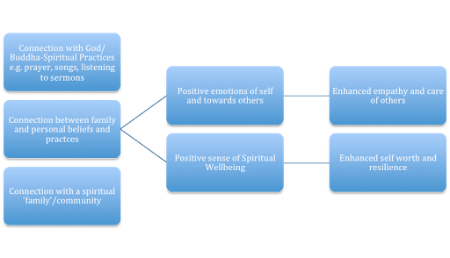
Figure 1: Spiritual Wellbeing as a result of connections leading to resilience and empathy.

Slide 66
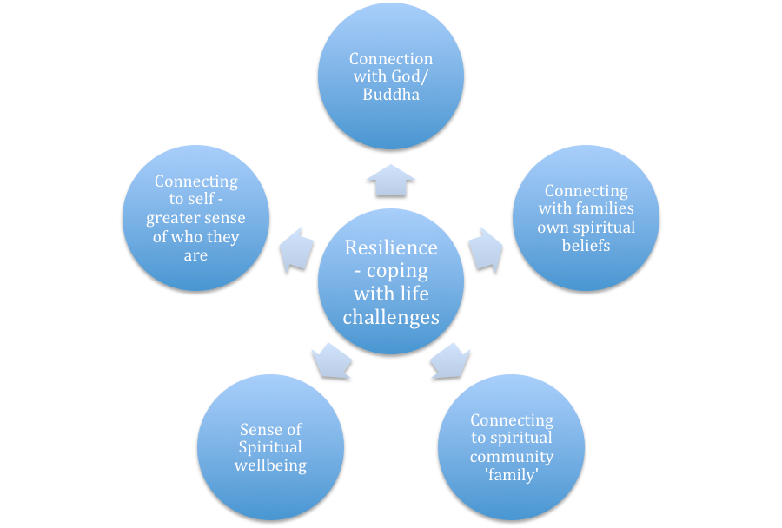
Figure 2: Resilience and its connection to spirituality

Slide 67
Recommendations
Faith based organizations should continue to provide spiritual care. We cannot say we are providing holistic care if we are not considering it.
They should continue to give participants choice about involvement in activities and what they choose to believe.
Churches, Wats and families and communities should be educated about how to welcome survivors better.

Slide 68
A positive religious faith does not offer an illusion that we shall be exempt from pain and suffering, nor does it imbue us with the idea that life is a drama of unalloyed comfort and untroubled ease. Rather, it instills us with the inner equilibrium needed to face strains, burdens, and fears that inevitably come, and assures us that the universe is trustworthy and God is concerned.
—Martin Luther King, Jr., The Strength to Love

Slide 69
Korewzak Januse ‘Declaration of Children’s Rights’ CYC – online 2004
Hay Rebecca
Marshall, Kathleen, and Paul Parvis. 2004. Honouring Children: The Human Rights of the Child in Christian Perspective. Edinburgh: Saint Andrew Press.
Narisetti, Innaiah. 2009. Forced into Faith: How Religion Abuses Children’s Rights. Amherst, NY: Prometheus Books.

