Slide 3
as
Welcome to the story of Jesus. He was born 2000 years ago but his story is still important for children and adults today. This book tells some of his story from the Bible (scripture) and it also encourages you to use the imagination that God has given to you to fill some of the gaps between what we do and what we don’t know about him. We don’t know what Jesus looked like, but we know he was born in Bethlehem in Israel of Mary, a Jewish woman, so he probably looked something like this. In this book you will meet Jesus as a baby, as a child and an adult and you will learn things about who he was like and who he still is and most of all how much he loves you. You will also learn how even vulnerable children can participate in Gods mission to the world.
Introductory information for adults Perhaps you could encourage the children to draw a picture of what they think Jesus would have looked like at the age they are now. What do they think he would have been like as a friend if he lived in their community? | Scripture to read Jesus grew in wisdom and in stature and in favour with God and all people | Introductory Information for children Perhaps you could draw a picture of what you think Jesus looked like at your age. What do you think he would have been like as a friend if he lived in your community?

Slide 4
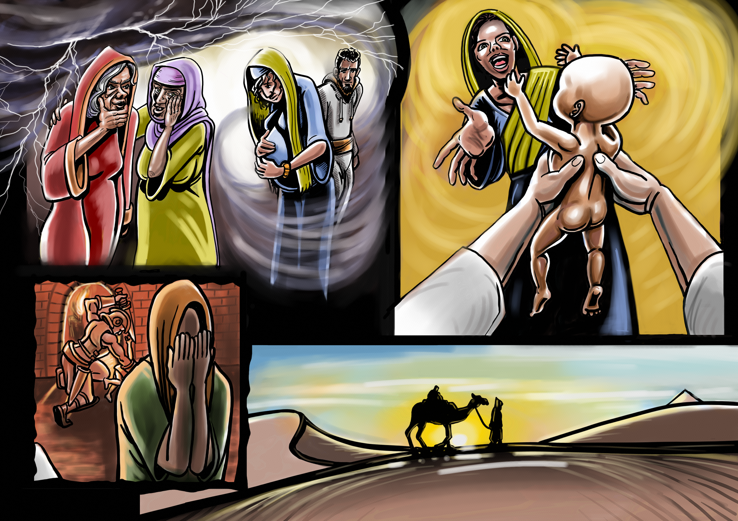
The story so far…
Jesus knew what it was like to be a child at risk. -The Christmas story wasn’t as simple as it sometimes portrayed. The incarnation is the story of God sending Jesus into the world to become a child at risk. Born to a teenage mother and an adopted father, Jesus started his human life in extremely uncertain circumstances. When Mary became pregnant few believed it was a virgin birth. This descendant of God, the Son of God, the King of Kings was born in the lowly squalor of a barn. Narrowly escaping the genocidal attacks of a paranoid dictator, who ordered all the baby boys to be killed, his young family was forced to seek asylum in a foreign country when he was still quite young. But this was no ordinary child. This was our almighty-vulnerable, omniscient-developing, infinite-mortal God, wrapped in a blanket and crying for his mother’s milk. At the center of our faith is the mystery of how the God of the universe became a child-at-risk in order to fulfil God’s mission, which was nothing less than to change all of human history.
Questions for adults How are you challenged by this story as you read it in this new light of Jesus being a vulnerable child? | Scriptures to read Matthew 1: 18 to 2:18 tells the story of the birth and early years of Jesus life. | Questions f Many children are at risk and experience different challenges as they grow up. What does it feel like to know that Jesus was also at risk?

Slide 5
The story so far…
Jesus knew what it was like to be a child at risk. -The Christmas story wasn’t as simple as it sometimes portrayed. The incarnation is the story of God sending Jesus into the world to become a child at risk. Born to a teenage mother and an adopted father, Jesus started his human life in extremely uncertain circumstances. When Mary became pregnant few believed it was a virgin birth. This descendant of God, the Son of God, the King of Kings was born in the lowly squalor of a barn. Narrowly escaping the genocidal attacks of a paranoid dictator, who ordered all the baby boys to be killed, his young family was forced to seek asylum and be a refugee in a foreign country when he was still quite young. But this was no ordinary child. This was our almighty but vulnerable, infinite but mortal God, wrapped in a blanket and crying for his mother’s milk. At the center of our faith is the mystery of how the God of the universe became a child-at-risk in order to fulfil God’s mission, which was nothing less than to change all of human history.
Questions for adults How are you challenged by this story as you read it in this new light of Jesus being a vulnerable child? | Scriptures to read Matthew 1: 18 to 2:18 tells the story of the birth and early years of Jesus life. | Questions f Many children are at risk and experience different challenges as they grow up. What does it feel like to know that Jesus was also at risk?

Slide 6
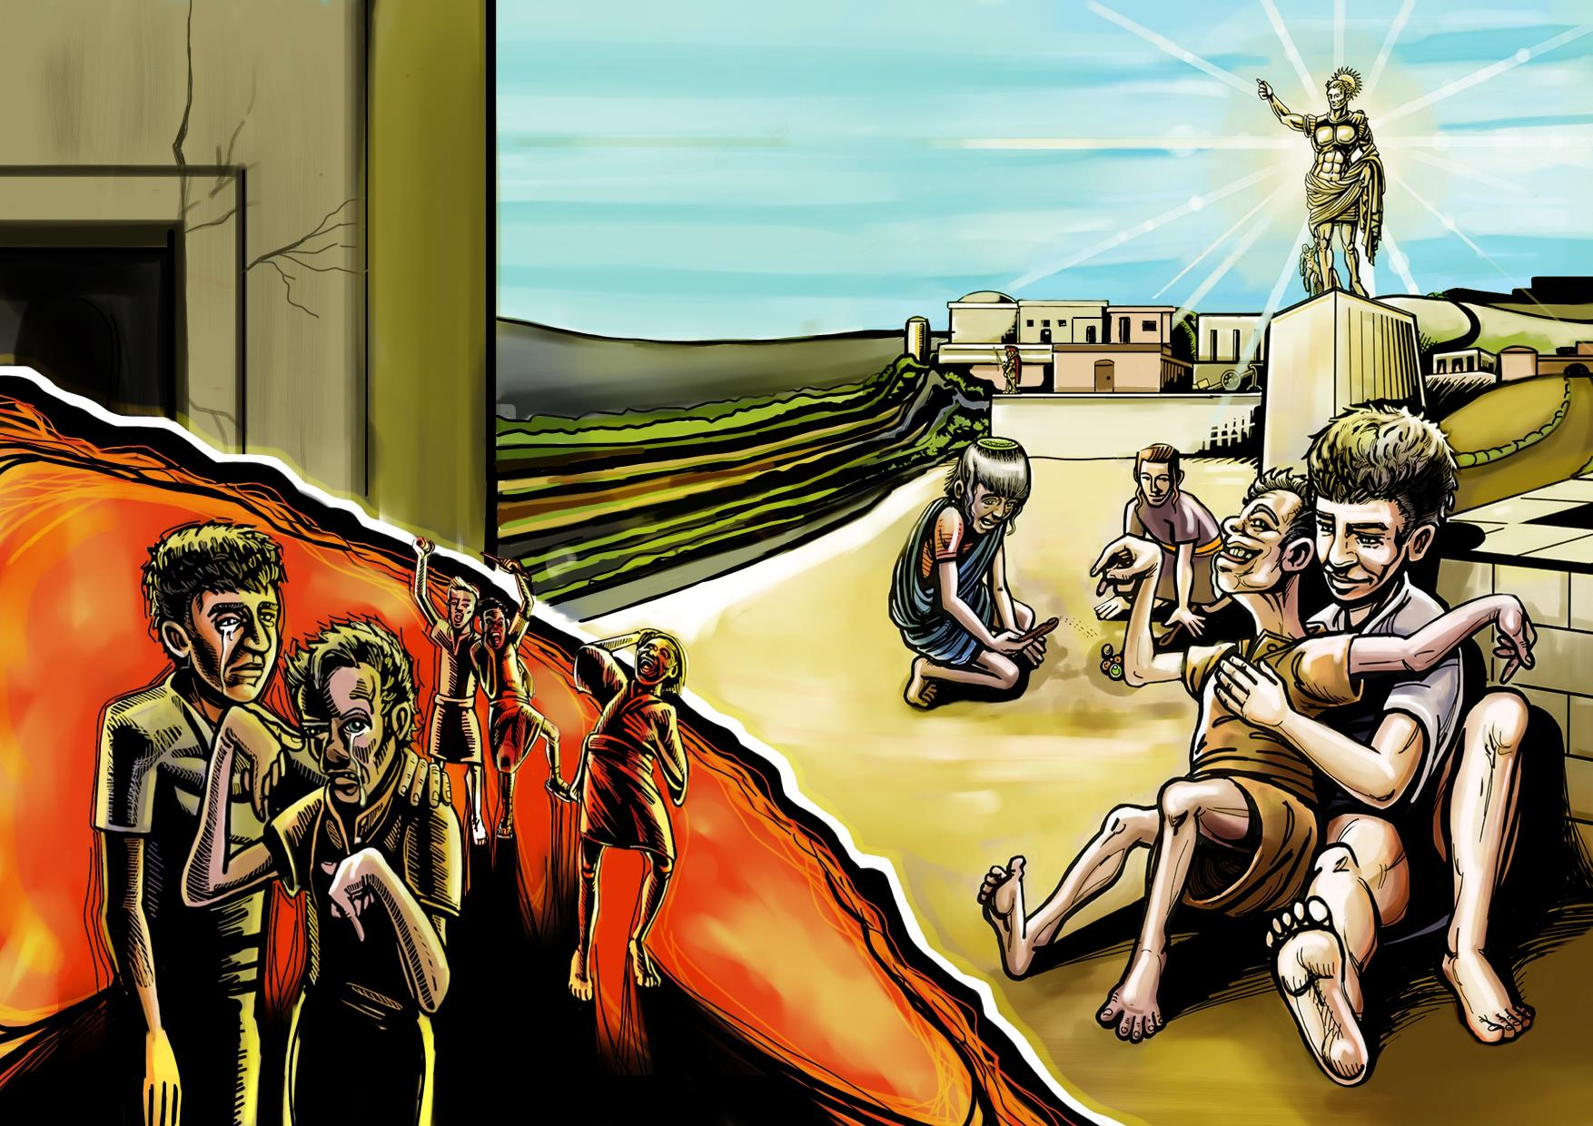

Slide 7
The story so far… After being refugees in Egypt, the family of Jesus returned to Nazareth (Matthew 2:19) his hometown and family’s community. But they continued to live under the oppressive regime of the Roman Empire. The Romans controlled by violence and oppression. You can see the statue of Caesar in the background. We don’t know much about Jesus growing up until later on but if we use our imagination, we can imagine that he was developing characteristics which we know he would have later as an adult. Those characteristics are described in Galatians as the “fruits of the spirit” (see below). Here you can imagine boy Jesus caring for a child with a disability. These are the kind of people he would have healed as an adult. Other children would have liked hanging out with him too because he was kind. In contrast are the bullies who thought Jesus was wasting his time on losers and is therefore a loser himself. Bullies followed Jesus all his life.
Questions for adults An unborn child, a disabled child, a toddler who can’t speak; Are they any less important loved by God than a strong man or beautiful woman? How can we communicate to children at risk that they are of equal importance to God? | Scripture to read Galatians 5:23-24 But the fruit of the Spirit is love, joy, peace, forbearance, kindness, goodness, faithfulness, gentleness and self-control. Against such things there is no law. | Questions for child How do you see yourself in the world? Do you see yourself as a child at risk? Have you been bullied? How are you at risk? How have you dealt with these risks yourself? with the help of your family and community? and with God’s help? How can you help others on the margins?

Slide 8
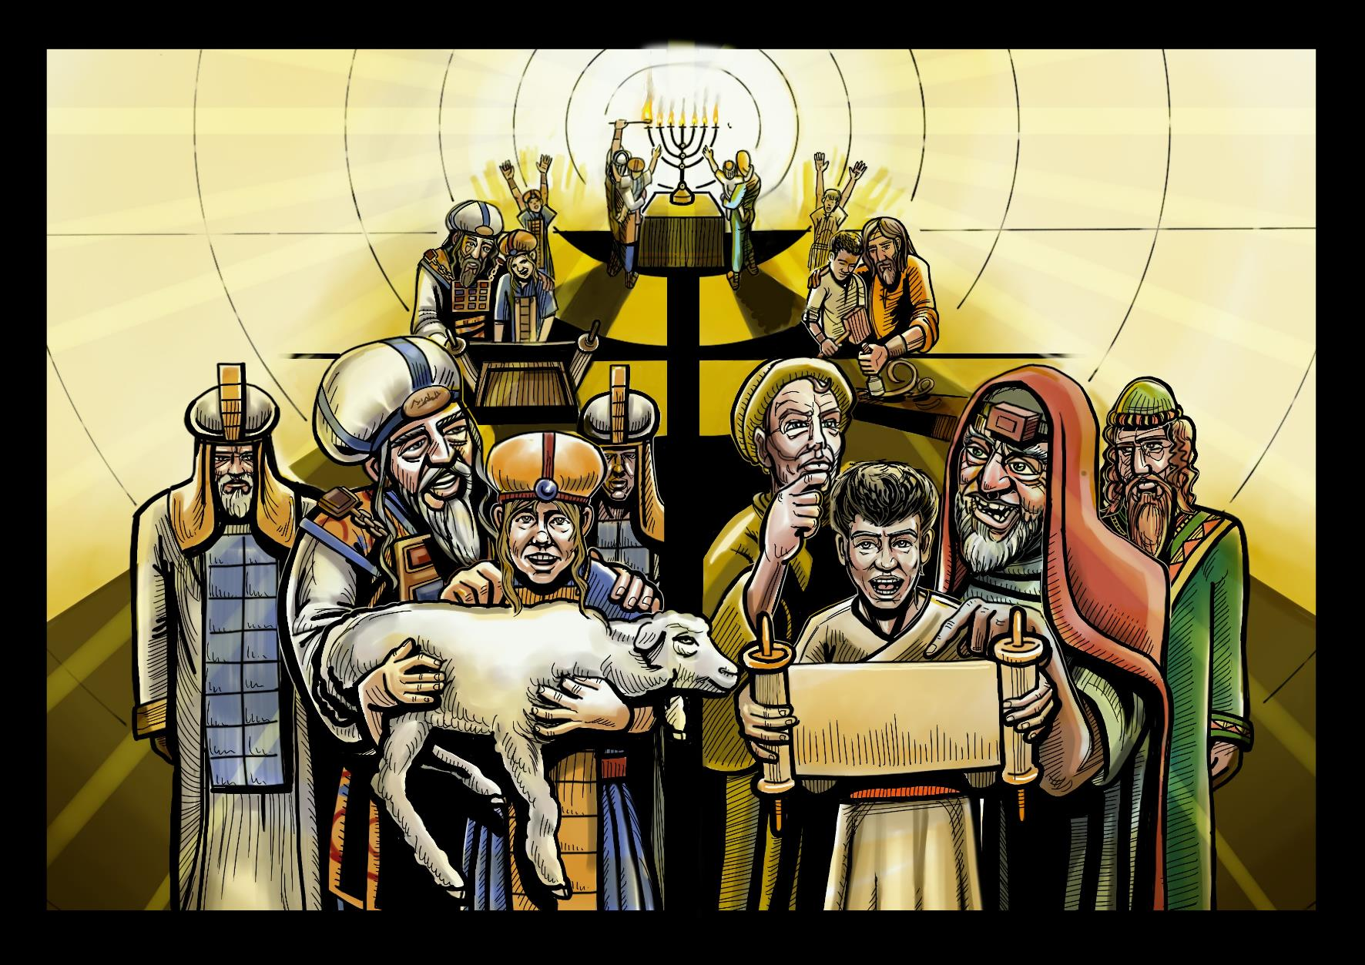

Slide 9
The story so far… We see in scripture that Samuel in the Old Testament and Jesus in the New Testament both grew up from being babies to adults. In the picture you can see Samuel on the left and Jesus on the right at the back lighting candles Then we see young Samuel helping in the temple and young Jesus helping his dad Joseph in the carpenter’s workshop. We also see Samuel assisting with the sacrifices and Jesus going to the Temple in Jerusalem; that he was learning about his relationship to God and what that meant for his life.These passages recognize the importance of growth in all areas of development and that nurture of the whole child is necessary for children’s well-being. The intellectual, physical, spiritual, and socio-emotional aspects of the human experience are interdependent and essential to wholeness and reflect the integrated way that children engage with life.
Questions for adults As a parent and/or an adult in child-care ministry, what does it feel like to know that Jesus was a child and had to grow up and experience difficulties that all children have to face? How do you think it felt like to be Joseph and Mary, when they thought they had lost Jesus and when they found him and he responded in the way he did? | Now the boy Samuel continued to grow both in stature and in favor with the Lord and with the people” (1 Sam 2:26, NRSV) We will learn more about Samuel later on. “Jesus grew in wisdom and in stature and in favor with God and all the people” (Luke 2:52, NLT). Luke 2:39-52 The story of Jesus family going to Jerusalem and Jesus becomes separated from his parents | Questions for children What does it feel like to know that Jesus was a child and had to grow up and experience difficulties that all children have to face? How do you think it felt like for Samuel to grow up in a temple away from his family? How do you think it felt like for Jesus to be in the temple surrounded by the teachers and priests?

Slide 10
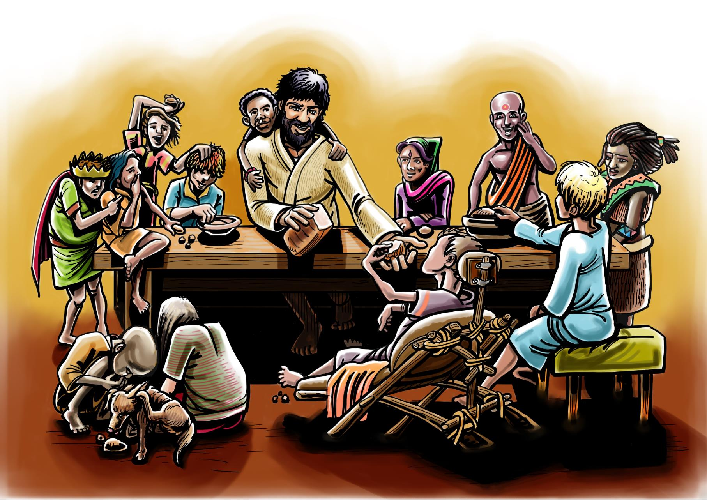

Slide 11
The story so far… God loves and uses those on the margins of life, where many children find themselves. Jesus talks about sharing the table with everyone without exception, a demonstration of a loving openness to all people without any social restrictions. Here we use our imagination again to imagine the ‘first’ supper where the adult Jesus opens up his table to invite all the local children from the streets who want to come for a meal whether they are girl or boy, hungry and malnourished or well-fed, disabled or abled, black or white, and whichever ethnicity or country they come from.
Questions for adults How does Jesus invitation to his table affect the way you see how God sees you? How does this affect how you see God? How can you welcome all types of children? | Scriptures to read Mark 2:15-17: ¹⁵ Later, Levi invited Jesus and his disciples to his home as dinner guests, along with many tax collectors and other disreputable sinners. (There were many people of this kind among Jesus’ followers.) ¹⁶ But when the teachers of religious law who were Pharisees saw him eating with tax collectors and other sinners, they asked his disciples, “Why does he eat with such scum?”¹⁷ When Jesus heard this, he told them, “Healthy people don’t need a doctor—sick people do. I have come to call not those who think they are righteous, but those who know they are sinners.” Also read: Luke 7:36; 11:37; 14:1; 15:2; 19:5 | Questions for children How does this affect the way God sees you? How does this affect how you see God? How does this affect how you see other children? How can you make them feel welcome too?

Slide 12
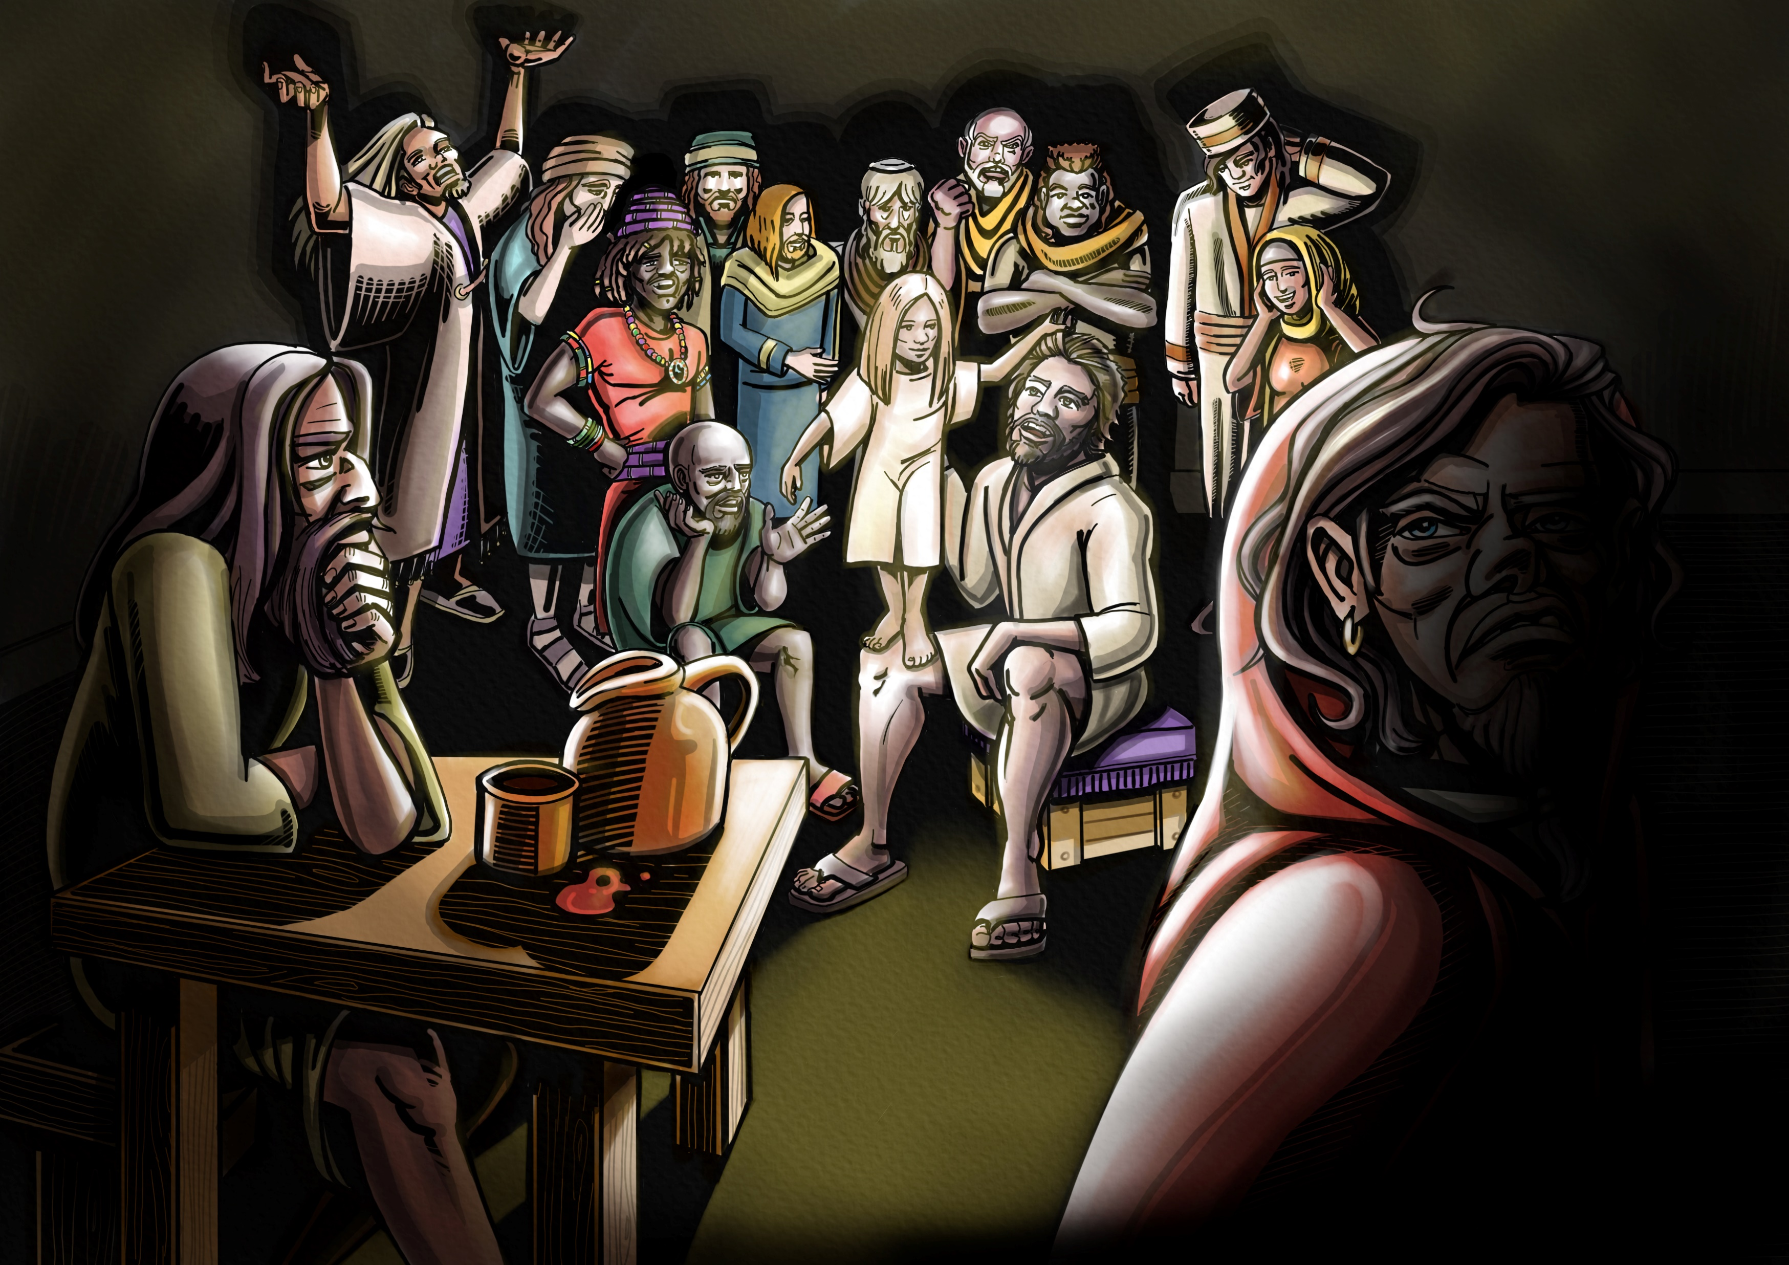

Slide 13
The story so far… Jesus sat down and called for the 12 disciples to come to him. Then he said, ‘Anyone who wants to be first must be the very last. They must be the servant of everyone.’ Jesus took a little child and had the child stand among them. Then he took the child in his arms. He said to them, ‘Anyone who welcomes one of these little children in my name welcomes me. And anyone who welcomes me also welcomes the one who sent me.’ (Mark 9:35–37, NIRV). In this picture you can see the different attitudes of the disciples to children and to what Jesus was saying.
Questions for adults Why do you think Jesus put the child in the midst? As an adult which disciple are you most like in the picture and why? | Scripture to read Matt 18:2-6 (NIV) ^{2 “}He called a little child to him, and placed the child among them. ³ And he said: “Truly I tell you, unless you change and become like little children, you will never enter the kingdom of heaven. ⁴ Therefore, whoever takes the lowly position of this child is the greatest in the kingdom of heaven. ⁵ And whoever welcomes one such child in my name welcomes me. ⁶ “If anyone causes one of these little ones—those who believe in me—to stumble, it would be better for them to have a large millstone hung around their neck and to be drowned in the depths of the sea”. | Questions for children Do you feel welcomed into the church and by your community? How can you make other children who feel excluded feel welcomed?

Slide 14
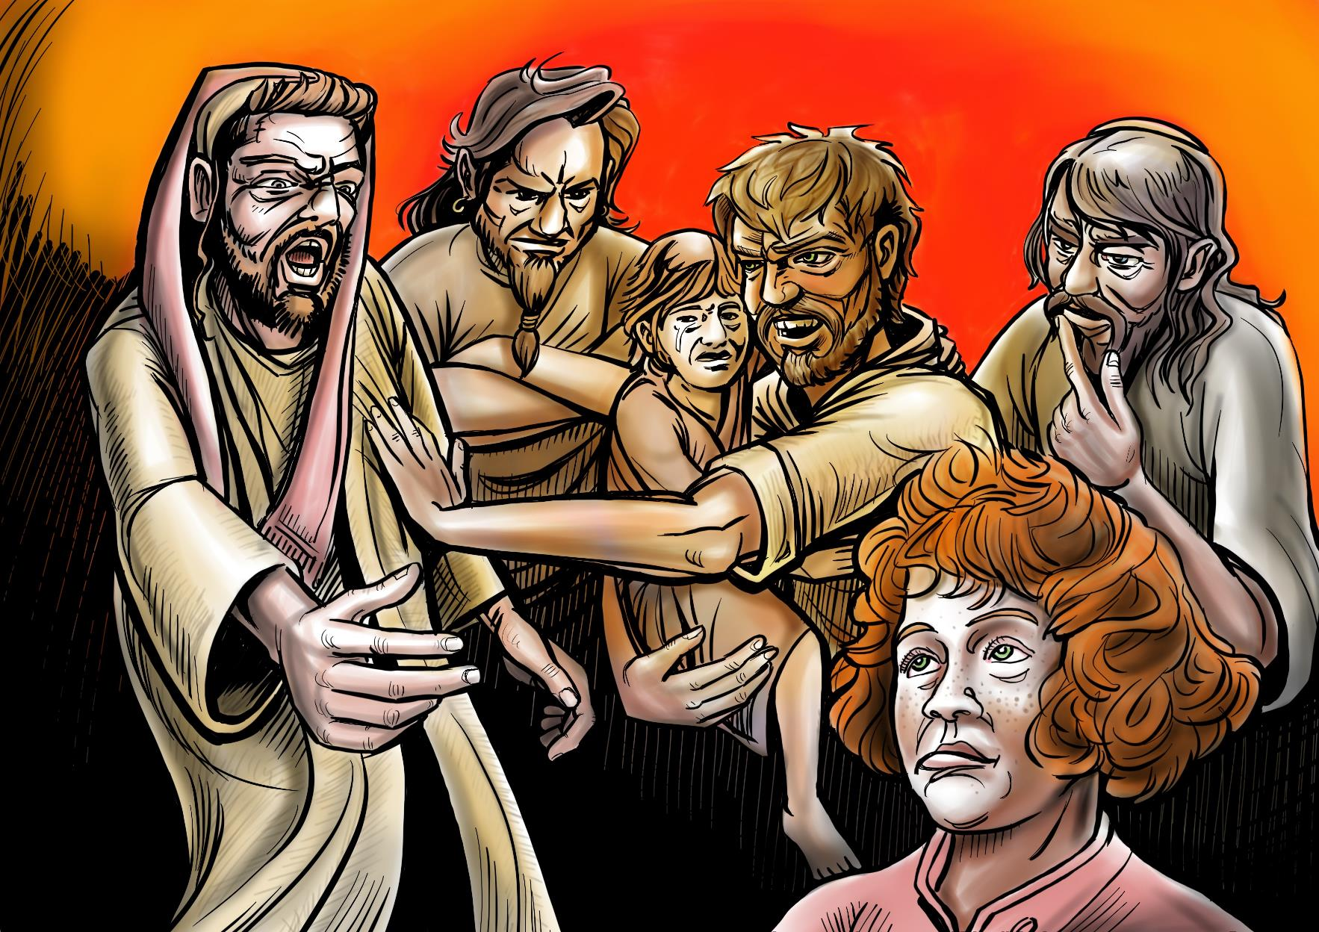

Slide 15
The story so far… Jesus had a particular concern for children. He knew that adults tend to think they are important but that children are not so important. Jesus didn’t agree with this. One time he noticed that the disciples were pushing children away who wanted to be with Him. Jesus told the disciples off for doing that and told them to let the children come to him. In the picture you can see Jesus was angry. Who do you think the character at the bottom right is? A confused mother who wanted her child to be blessed by Jesus? Or a marginalised red haired child watching the way Jesus intervenes? On another occasion Jesus said it would be better for someone to have a millstone (a very heavy stone) to be tied around the neck of the person who seeks to harm and lead children astray and to be thrown in the sea.
Questions for adults If Jesus could see the way your church or organisation cared for children how would he respond and what would he do? | Scripture to read Matt 18:6, 19:13–14; Mark 9:42, 10:13–14; Luke 18:15–16 | Questions for children If Jesus could see the way your church or organisation cared for children how would he respond and what would he do?

Slide 16
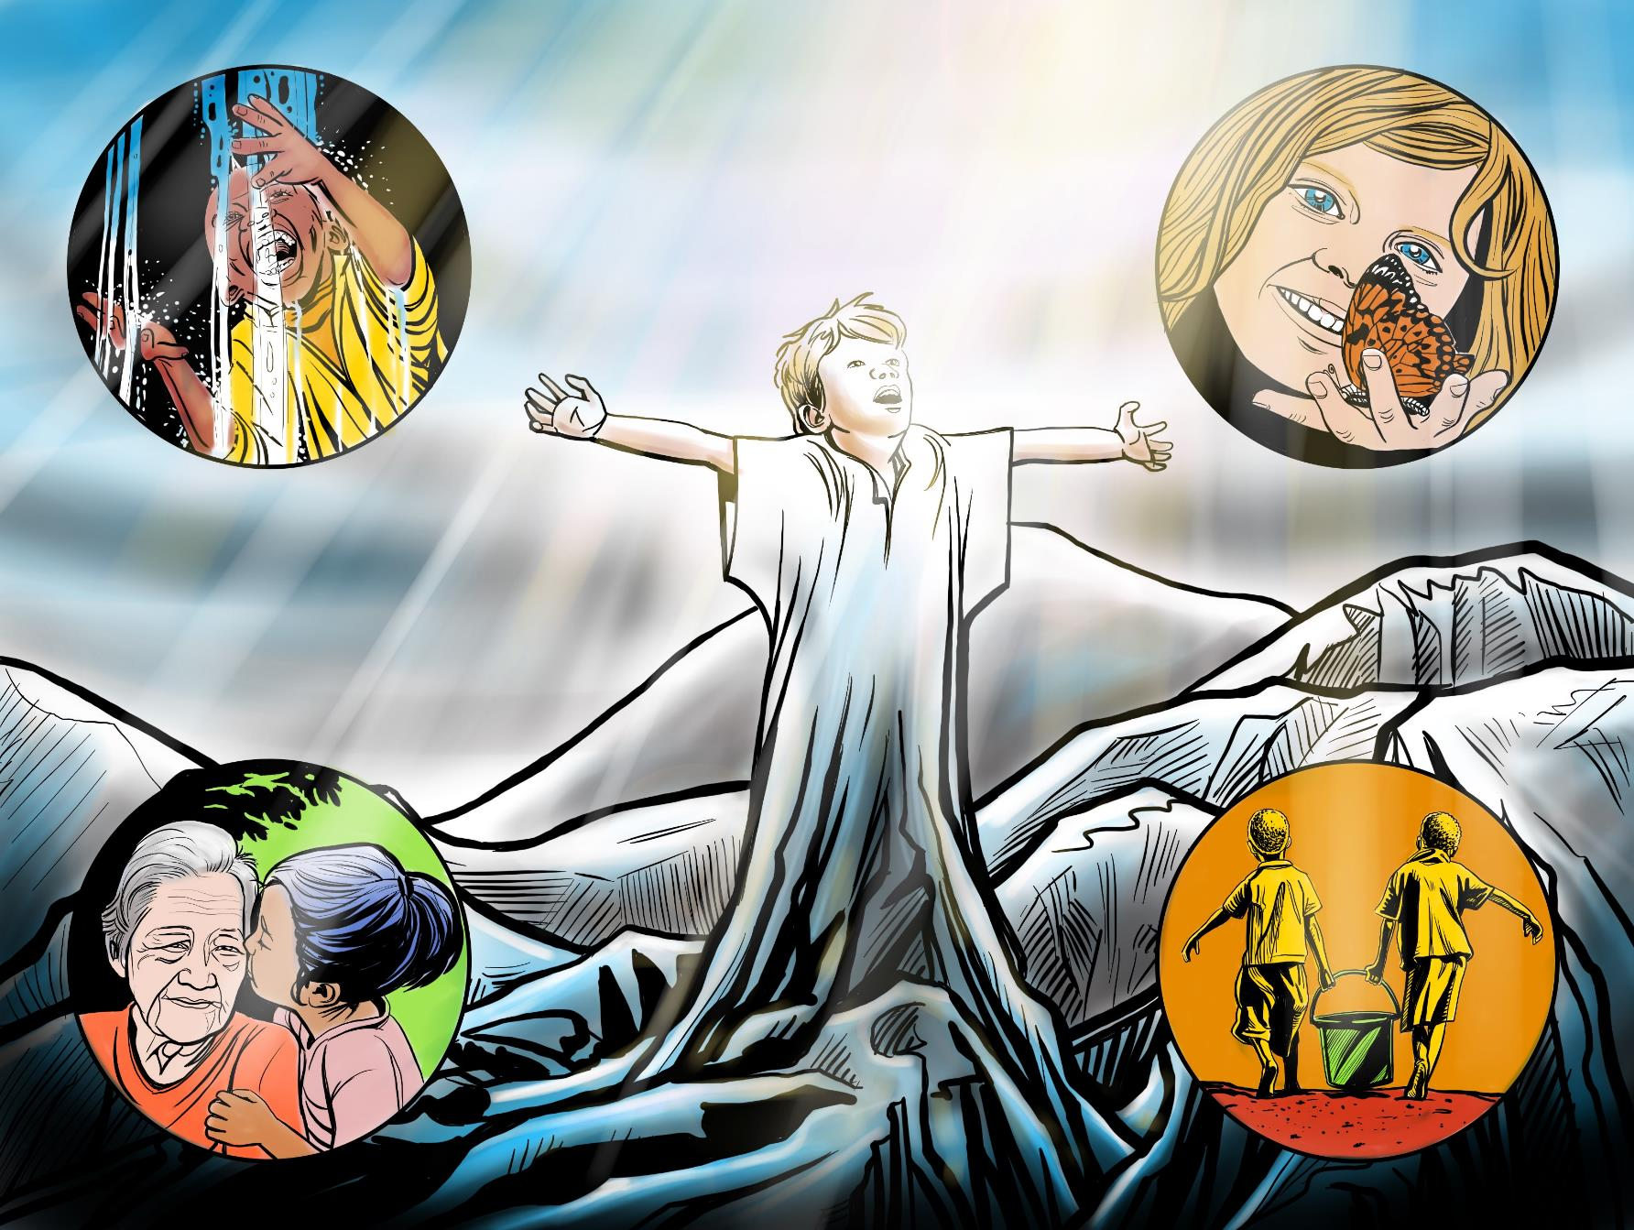

Slide 17
The story so far… God loves to see children worshipping him. Whether it is singing or dancing or doing art or enjoying His amazing creation. A flower, a sunset, an animal, a mountain, a tree, the seaside. When Jesus travelled to Jerusalem the crowds were very excited. They thought he had come to rescue them, but they didn’t understand what he would need to do to achieve this. Adults and children waved palm branches and laid them down on the road in front of the donkey which he rode. Later the religious leaders complained about how his followers were so excited and worshipping Jesus but Jesus said how important worship was. That even the stones would burst out in praise. In the four pictures in the corners you can see that worship can be delighting in things like flowing water or a butterfly but it can also involve service to others like honouring our grandparent or parents and doing household chores like collecting water .
Questions for adults Sometimes we are sad and sometimes we are happy. When you are happy, how do you like to worship and show how much you love God? | Scripture to read Matthew 21: 1-11 Luke 19:35-40 | Questions for children Sometimes we are sad and sometimes we are happy. When you are happy, how do you like to worship and show how much you love God?

Slide 18
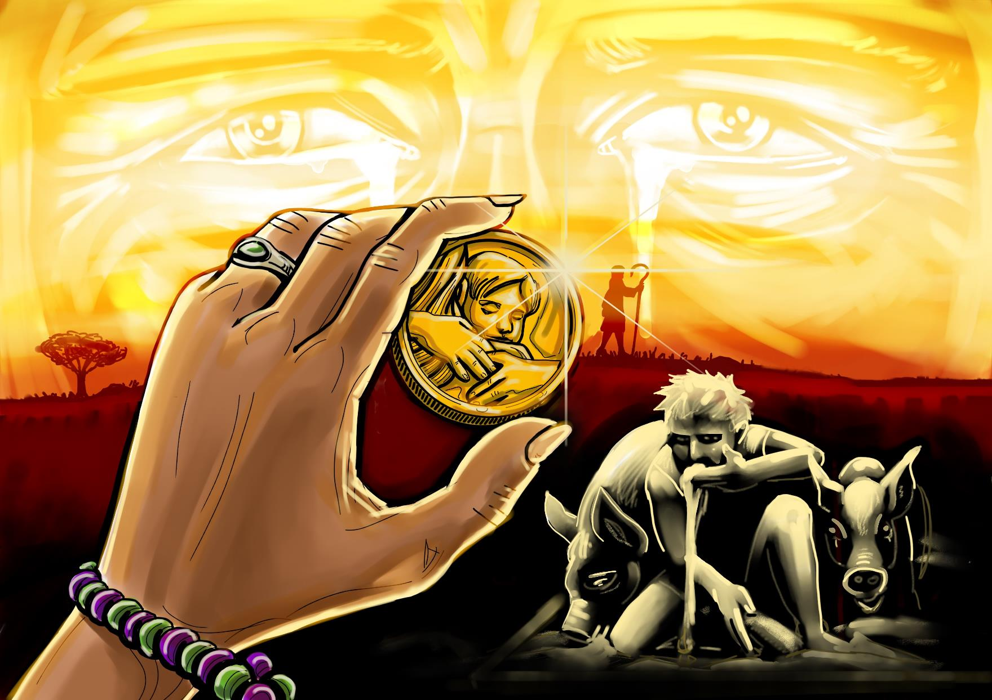

Slide 19
The story so far… Jesus told many stories for people to understand more about God and how much he loves us and how we should love others including those who are hard to love. He told three stories about things being lost and found. The first was about a shepherd who lost a sheep and went to some trouble to find it. The second was about a woman who lost a coin which was likely part of a necklace and very valuable to her. She cleaned the house top to bottom until she found it. The third story was about a lost boy who left his father and went away from him and did bad things. When he eventually realized about the bad decisions he had made, he returned back to his father. His father loved him so much he was waiting for him and ran to hug him. These stories teach us that we belong to God and He deeply loves us. He will do everything to draw us back to him. He also wants us to help him restore others
Questions for adults Of the children in your care who are the lost ones? What makes them lost? How can you help them to enter back into the community? | Scripture to read Lost Sheep: Luke 15: 1-7 Lost Coin: Luke 15: 8-10 Lost Boy: Luke 15: 11-31 | Questions for children Do you ever feel lost? In what way? If you feel apart from God, pray that you can find a way home. Who could you help to find their way home?

Slide 20
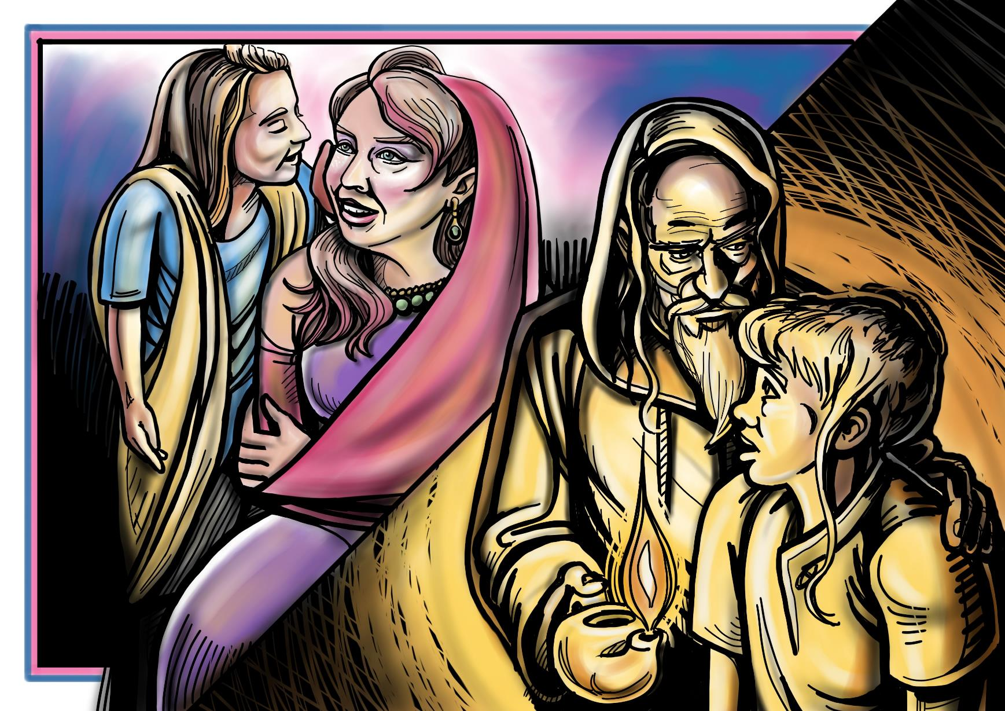

Slide 21
The story so far… You know that children can be called by God and hear God’s voice? The servant girl to Naaman’s wife (2 Kings 5) is a particularly good example, since she was a prisoner of war whose family was probably killed when her new master pillaged her city. Yet, despite this, when Naaman contracts leprosy she was willing to share about Elisha, which sets him on a path not just to a miraculous healing but also to spiritual transformation. As a result, Naaman abandons his Aramean gods in favor of YHWH (God). The young Samuel (1 Sam 1–3), though less at-risk than Naaman’s servant-girl, is still in a difficult situation. He was dedicated to the temple once he had been weaned, leaving him outside of the protection of his family. Perhaps more importantly, this leaves him in the care of the aging priest Eli, whose parenting credentials are highly suspect. Yet, despite these conditions, God calls to Samuel while he is still a child and gives him prophetic messages that he faithfully delivers to Eli.
Questions for adults Do you notice that in both of these stories it was the adults who had to believe that God could speak through a child? Do you believe that God can speak through a child? When was the last time you heard God’s voice to you through a child? | Scripture to read 2 Kings 5 The story of the servant girl’ relationship with Naaman’s wife and how Naaman was healed because he listened to her and got advice from Elisha 1 Sam 1-3 The story of Samuel and how God speaks to him; but also how Eli has to recognise that God is doing that and tell him to listen to God. | Questions for children How do you think God speaks to children? Does God speak to you? How can you hear Gods voice?

Slide 22
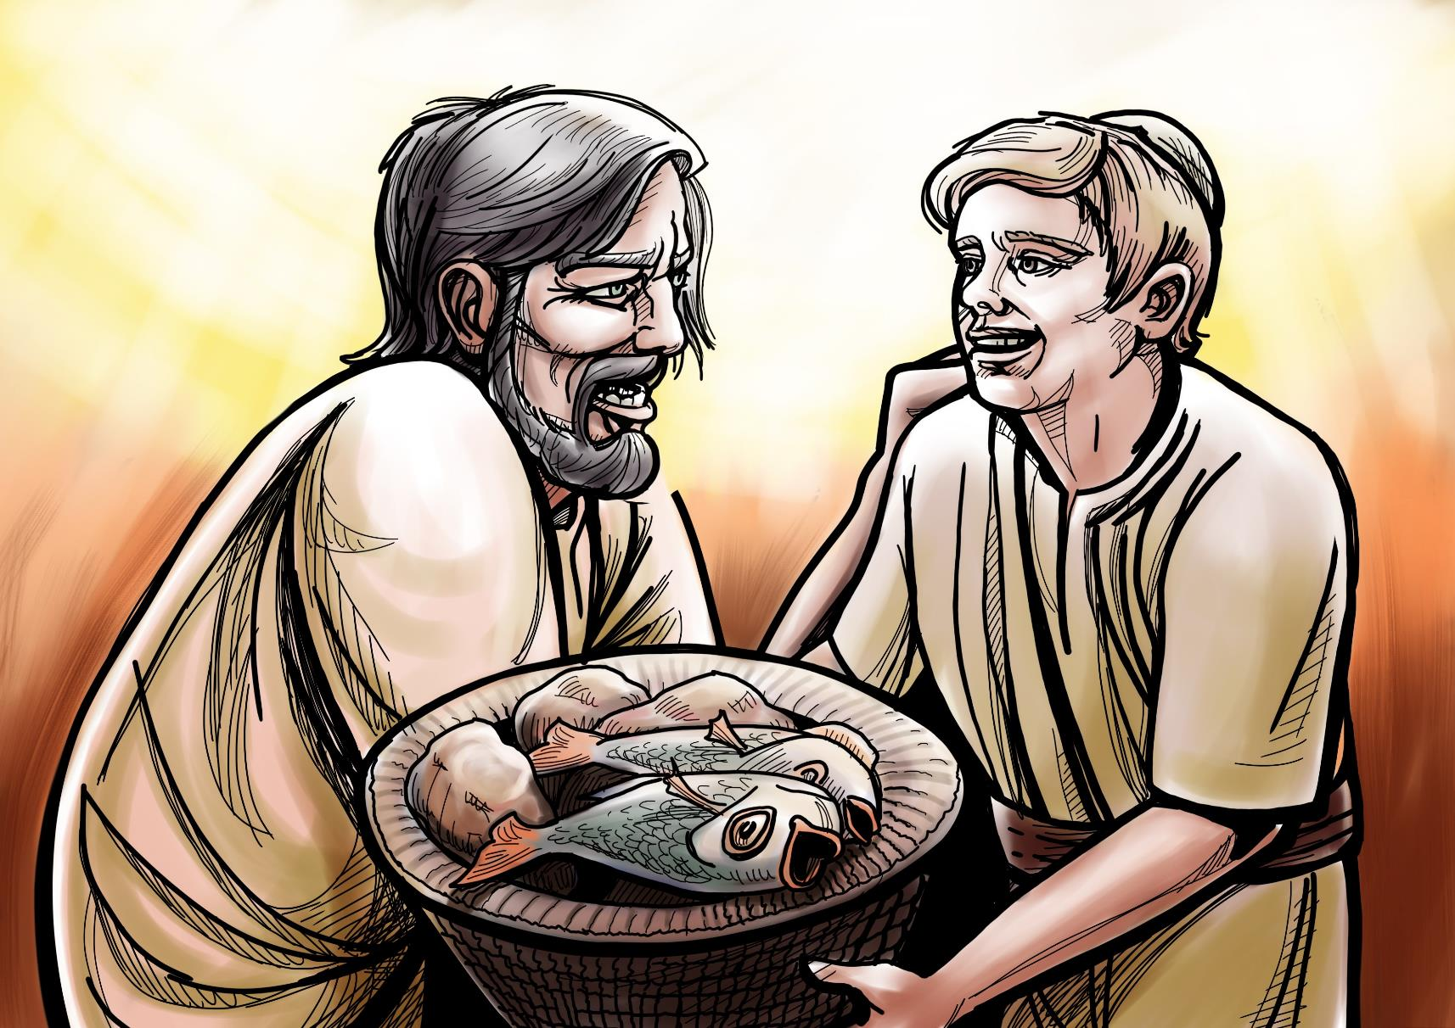

Slide 23
The story so far… Jesus cared about people’s needs. When he told stories, people came to listen. One day there were 5000 people on the hillside listening to him. He asked one of the disciples Philip where they could buy bread for the people to eat. Philip said it would cost half a year’s wages just to buy enough food for people to each have one bite! Andrew said that there was a boy with two small fish and five small loaves of bread. Jesus told them to tell the people to sit down. Then he distributed the food the boy had given them and a miracle happened and there was even left-overs after everyone had eaten.
Questions for adults The boy in this story was able to serve Jesus and the people with what he had; his lunch. What do you do in your church that enables children to Jesus by serving others in the community? | Scripture to read John 6: 5-14 8 Another of his disciples, Andrew, Simon Peter’s brother, spoke up, 9 “Here is a boy with five small barley loaves and two small fish, but how far will they go among so many?” | Questions for children The boy in this story was able to serve Jesus and the people with what he had; his lunch. What can you do to serve Jesus by serving others in your community?

Slide 24
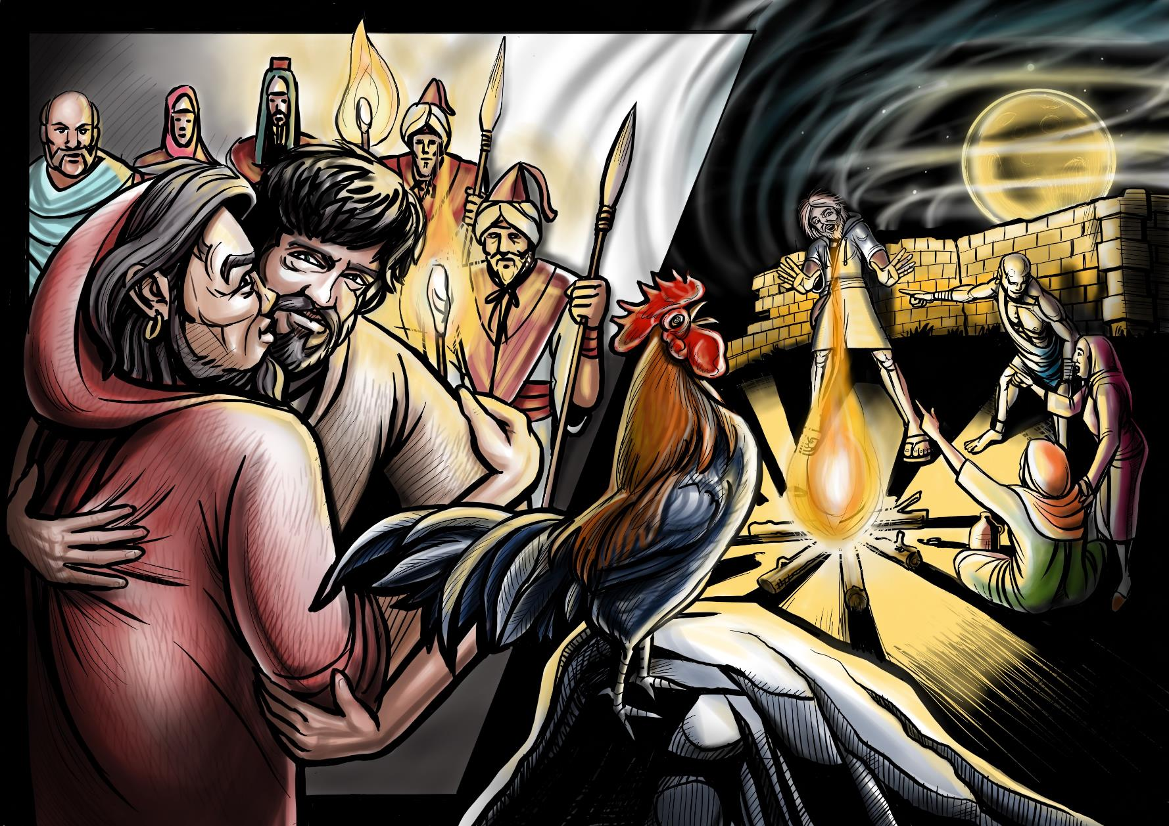

Slide 25
The story so far… This picture portrays how Jesus was betrayed to the Roman soldiers by Judas with a kiss so they could recognise which person it was. Then later Peter who was one of Jesus closest friends said he didn’t know Jesus three times. Jesus told him that he would do that and that the cock would crow and it did. Jesus had special friends who loved him and who he loved but when he needed them most, then they let him down and even ran away. How must Jesus have felt when that occurred?
Questions for adults How can you support children who feel abandoned or let down by their families and friends? What can you remind them about God’s love? | Scripture to read Matthew 26: 31-56 The story of Jesus in the Garden of Gethsemane | Questions for children Do you sometimes feel let down by the people who should be caring for you? What does it feel like to know Jesus felt that way too? How can you support others who feel bullied or let down by others?

Slide 26
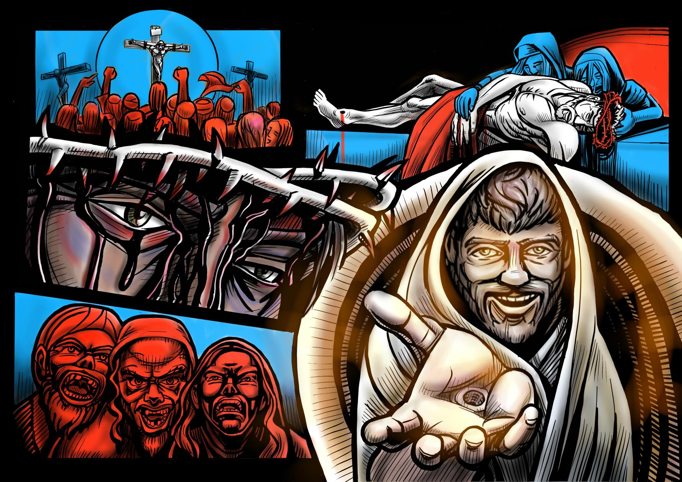

Slide 27
The story so far… We have read how Jesus as a child and then an adult was at risk. He experienced really difficult things through his life. He was unwanted, was bullied, was abandoned. Then everyone turned against him and he suffered a terrible death on a cross. But the story didn’t end there. He was resurrected from death and we can still pray to him as someone who knows what it was like to be at risk. He still has the scars of the hard things he experienced. He forgave those who let him down. He is our comforter and counsellor and we are his children, adopted into his family. Like a butterfly emerging from the chrsallis we can also change from caterpillars to butterflies and be born again. But we are born again not just for our own sake but also so that we can serve others
Questions for adults As you reflect on the resurrection of Jesus how does it inspire and encourage you as a Children at risk Ambassador? | Scripture to read Matthew 28 | Questions for children As you reflect on the resurrection of Jesus how does it inspire and encourage you as a Child at risk?

Slide 28
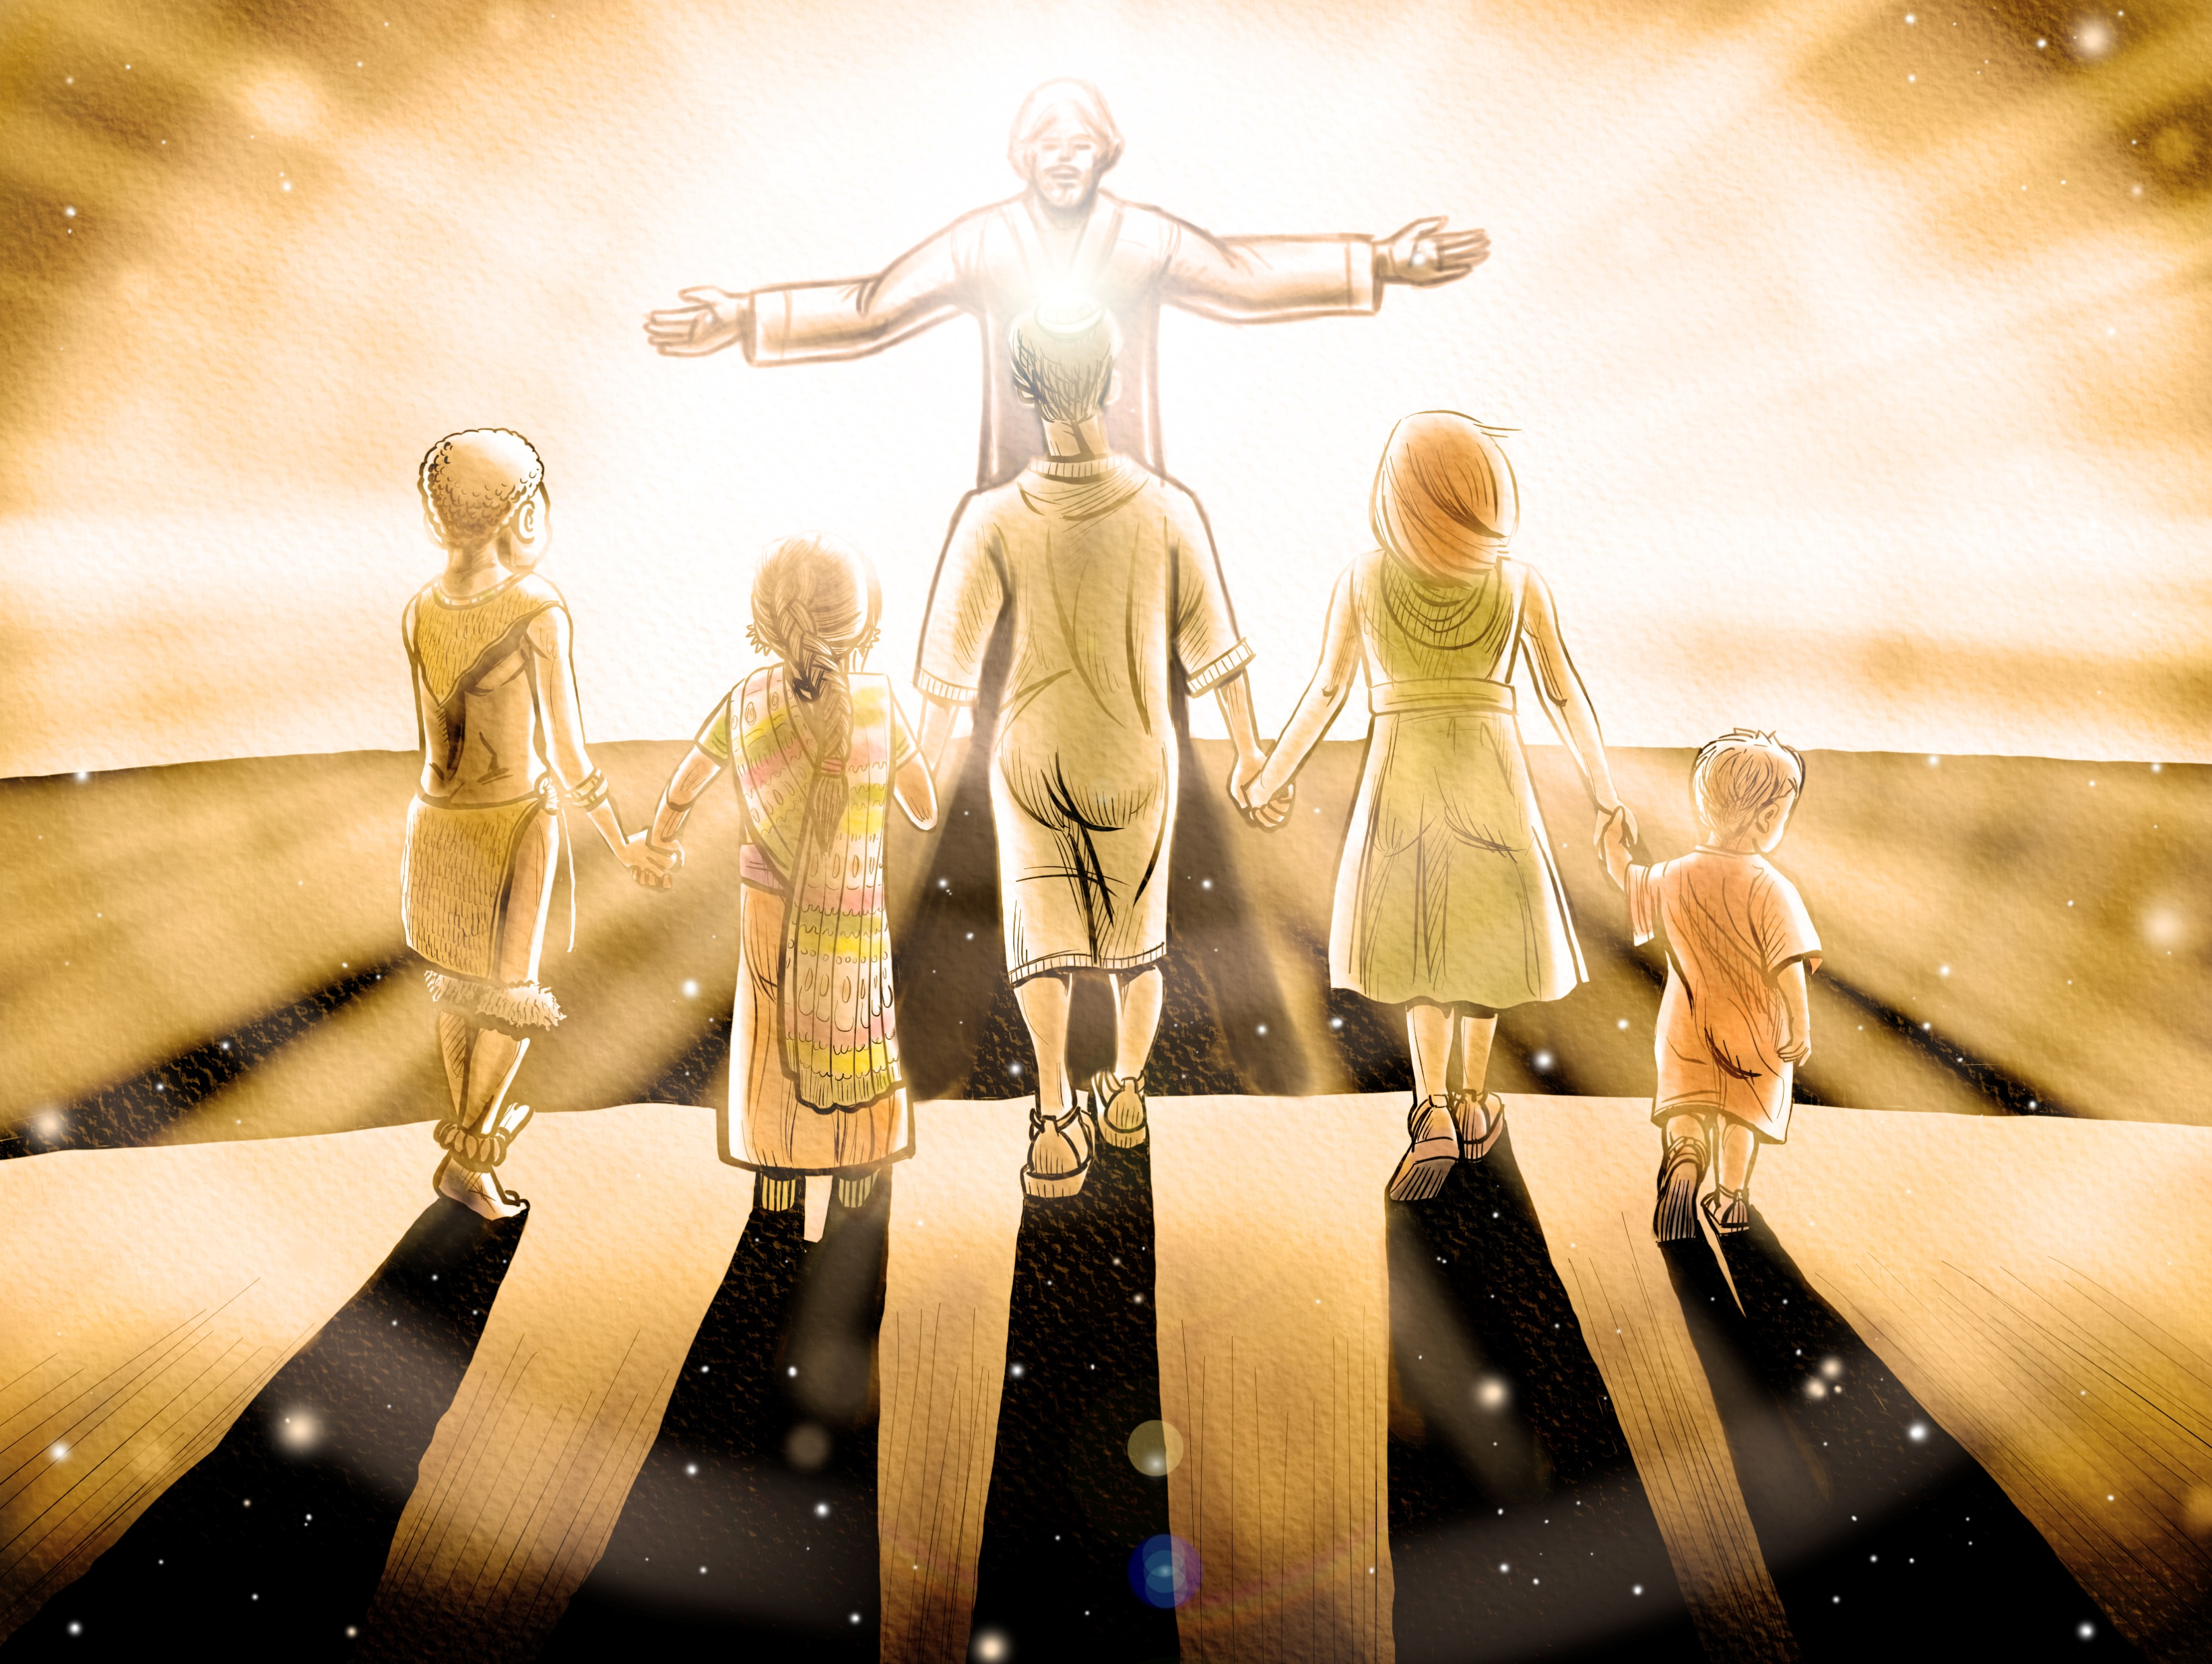

Slide 29
The story so far… When Jesus looks at us he sees us as beautiful children whom he loves. Before we were in darkness. But He sees beyond our flaws or ways in which we are at risk. He values even the smallest thing we offer him when we worship him or serve God by serving others. He sees us and he loves us and he also sees who we can become and how we can participate in mission. Precious jewels. Children of Light. In this picture you can see children walking towards God and the central figure represents the boy Jesus holding their hands.
Questions for adults After you have read this scripture think about how you can walk in the light and pass on that light to children in your care? How can you encourage children to be part of God’s mission to the world? How can you encourage children to partner with Jesus in Jesus’ mission in your life, among your friends, in your family, in your community? | Scripture to read Ephesian 5:8-10 8 for you were formerly darkness, but now you are Light in the Lord; walk as children of Light 9 (for the fruit of the Light consists in all goodness and righteousness and truth), 10 trying to learn what is pleasing to the Lord. John 12: 36 As you have the light, believe in the light. Then the light will be within you, and shining through your lives. You’ll be children of light.” | Questions for children When you read this scripture think about how you can walk in the light and be children of the Light? How can you serve God by serving others in his mission to the world? How can you partner with Jesus in Jesus’ mission in your life, among your friends, in your family, in your community?

